Slide 1







SMALL HOMELANDS
How to tell the story of your place on earth in an interesting way?
M2W1-M01

Slide 2
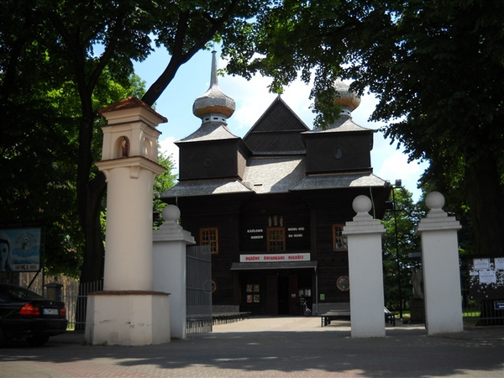
Aim of the workshops:
The audience will learn the definition of a "small homeland" and the storytelling method.

Slide 3



CAN EVERYONE TELL STORIES?

Slide 4
SMALL HOMELAND – A PLACE you’re emotionally connected with
where one was born
where one grew up
where one lives

Slide 5

TELL ABOUT YOUR SMALL HOMELAND ACCORDING TO THE SCHEME:
  What’s that place? (name, location)
  Why is it important?
  What makes it special?

Slide 6
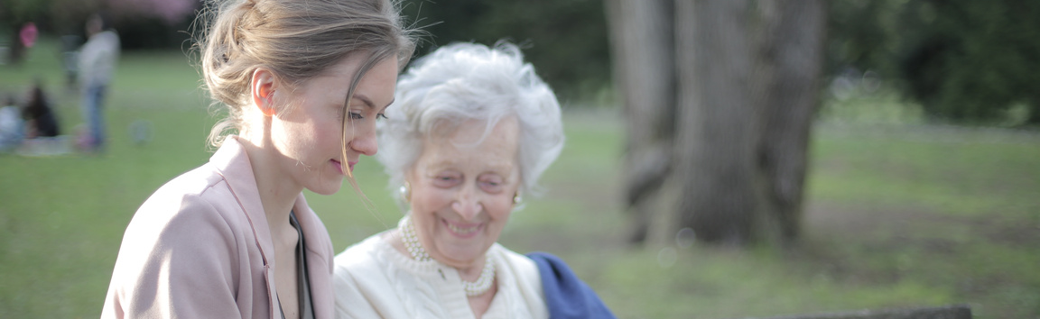
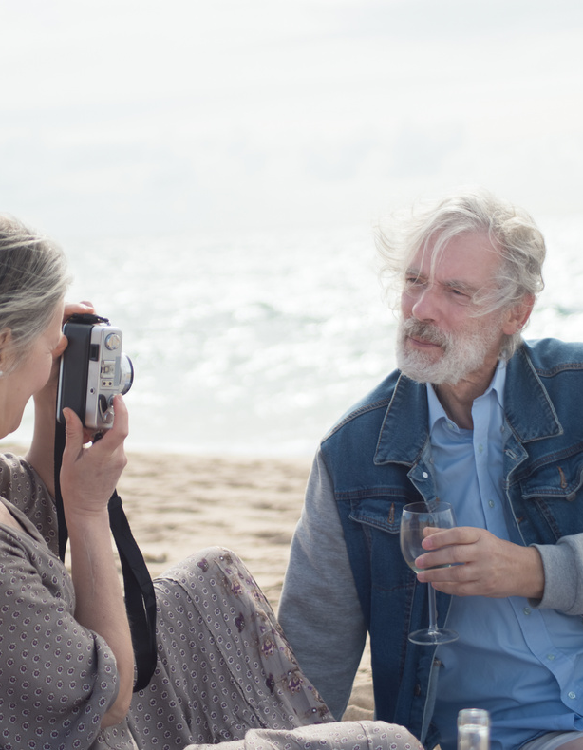

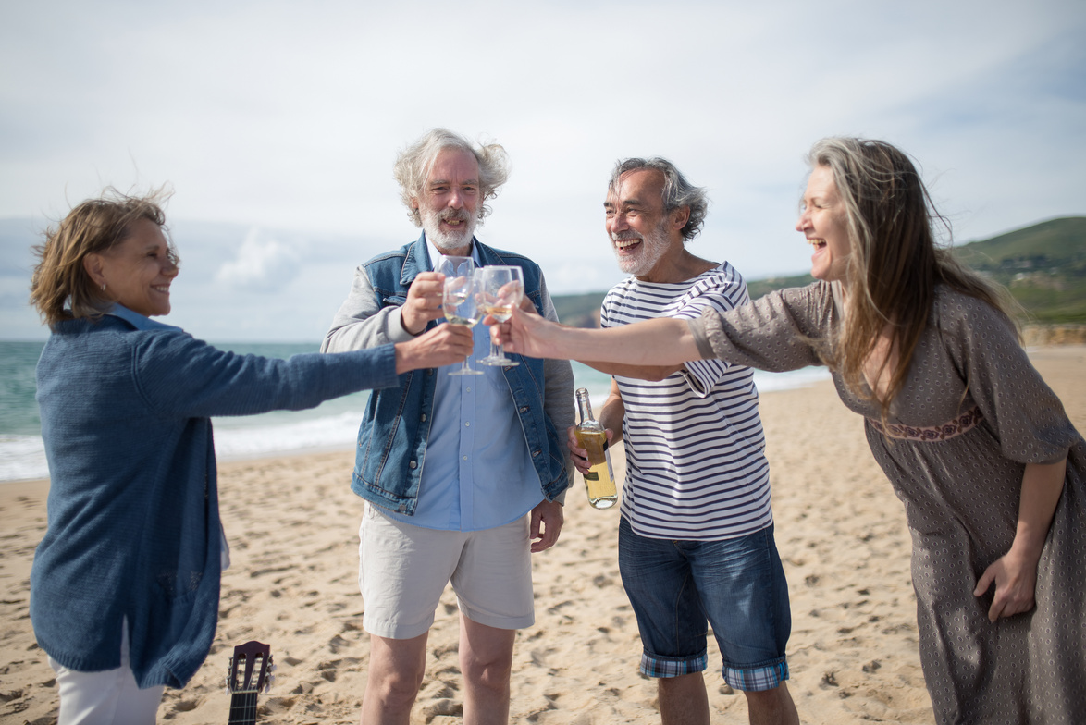

STORYTELLING – TELLING A STORY

Slide 7


Storytelling is a process that requires the involvement of the narrator and the listener at the same time

Slide 8


RULES OF CREATING A GOOD STORY:
  BUILDING CONNECTION
  EMOTIONS
  AUTHENTICITY

Slide 9

STORY PLAN No. 1
INTRODUCTION
DEVELOPMENT
CONCLUSION
Attempt of solving the problem by the protagonist
Solving the problem and conclusion
Presenting the protagonist and their problem

Slide 10

STORY PLAN No. 2
BEGINNING
PROBLEM
FAILED ATTEMPT OF SOLVING THE PROBLEM
SOLVING THE PROBLEM
CONCLUSION

Slide 11
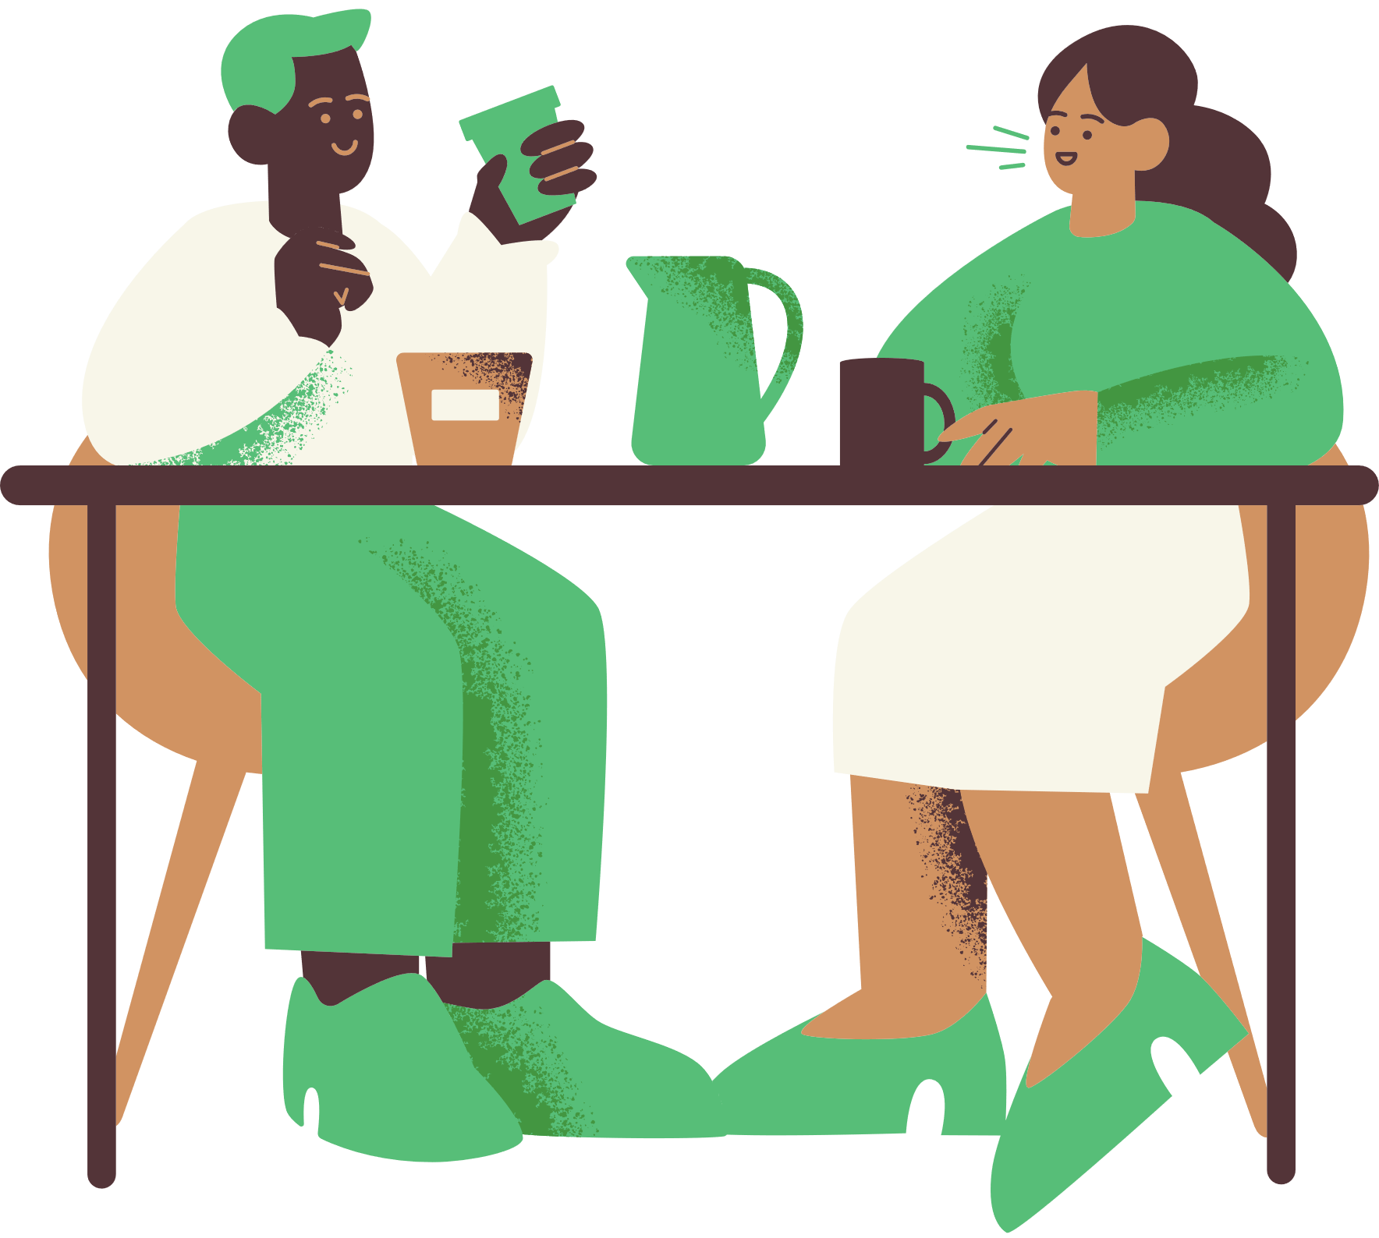
Listen to the story about my small homeland

Slide 12




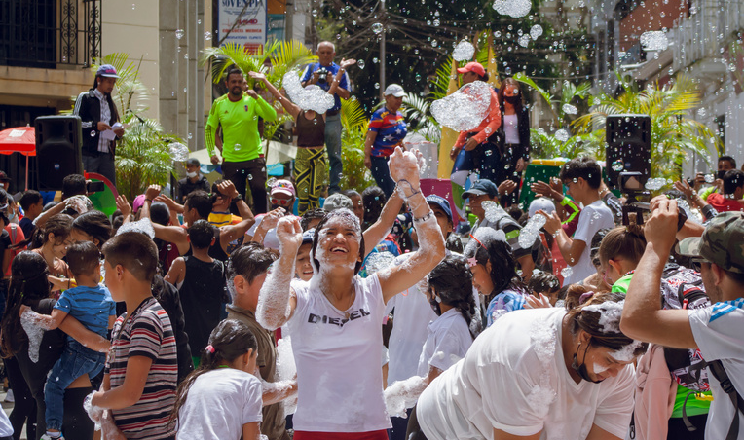
ASSOCIATIONS
MY SMALL HOMELAND
EMOTIONS
PEOPLE
EVENTS

Slide 13
WORKSHEET 1/5
CREATING ONE'S OWN STORY ABOUT ONE’S SMALL HOMELAND USING THE STORYTELLING METHOD
Your notes
Beginning
Introduce your little homeland, the protagonist and the context, describe why he or she is important in your story. Remember that at this point you already need to know how the story will end and what you want to say to your audience with it.

Slide 14
WORKSHEET 2/5
CREATING ONE'S OWN STORY ABOUT ONE’S SMALL HOMELAND USING THE STORYTELLING METHOD
Problem
Outline the problem faced by the hero of your little homeland you depicted and describe why it is so significant to him/her (you can be this hero too).
Your notes

Slide 15
WORKSHEET 3/5
CREATING ONE'S OWN STORY ABOUT ONE’S SMALL HOMELAND USING THE STORYTELLING METHOD
Failed attempt of solving the problem
Your notes
Describe the protagonist's first and unsuccessful attempt by the protagonist to deal with a problem from his or her individual perspective. Describe what the protagonist felt at that moment and how this failure affected him/her..

Slide 16
WORKSHEET 4/5
CREATING ONE'S OWN STORY ABOUT ONE’S SMALL HOMELAND USING THE STORYTELLING METHOD
Solving the problem
Your notes
Describe the situation that led to the resolution of the problem paying particular attention to the elements likely to elicit emotion.

Slide 17
WORKSHEET 5/5
CREATING ONE'S OWN STORY ABOUT ONE’S SMALL HOMELAND USING THE STORYTELLING METHOD
Zakończenie
Your notes
End the story with some kind of conclusion that will be meaningful to your audience.

Slide 18




CREATING OUR OWN STORY

Slide 19

Preparation for presentation of prepared stories:
  Listen carefully
  Ask questions
  Assess on the ballot card

Slide 20
BALLOT CARD
CREATING ONE'S OWN STORY ABOUT ONE’S SMALL HOMELAND USING THE STORYTELLING METHOD
Name and surname of the storyteller
THE SCORE GOES FROM 1 TO 10, WHERE 1 MEANS I DIDN'T LIKE IT AND 10 MEANS I LIKED IT A LOT
Justification

Slide 21
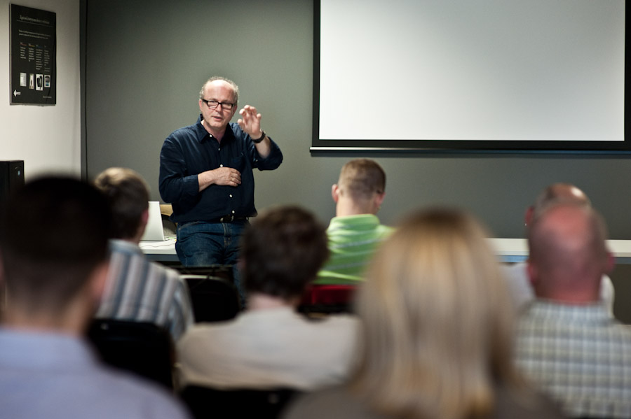
Telling stories about small homelands

Slide 22


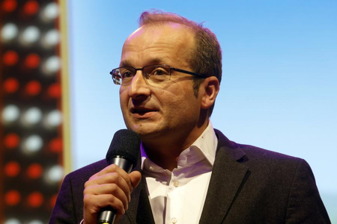



Choosing three best storytellers
Lidia
Nina
Robert
Score.......
Score......
Score......

Slide 23
Reiterating the principles of storytelling about a small homeland by means of storytelling
Failed attempt of solving the problem
Beginning
Problem
Solving the problem
Conclusion

Slide 24

Thank you for attention

