Slide 1







STORY OF A PLACE
HOW TO DISCOVER INTERESTING PLACES IN YOUR AREA THAT TELL A STORY AND HOW TO TELL THE YOUNGER GENERATIONS ABOUT THEM?
M2W3-M01

Slide 2
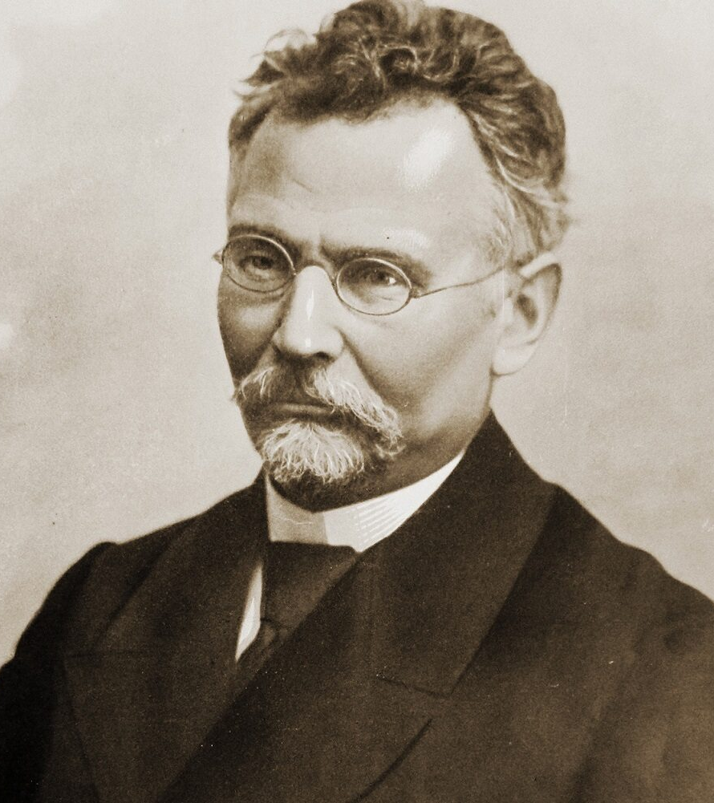
AIM OF THE WORKSHOP:
The students will discover an interesting place associated with a historical figure and learn how to talk about it in an interesting way by adapting the language to the young listener.

Slide 3
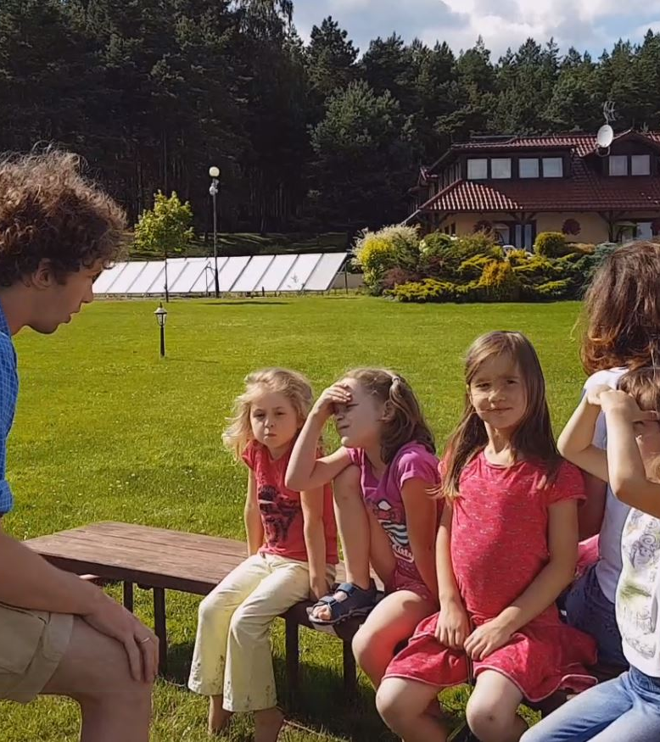

STORYTELLING
Telling a story

Slide 4

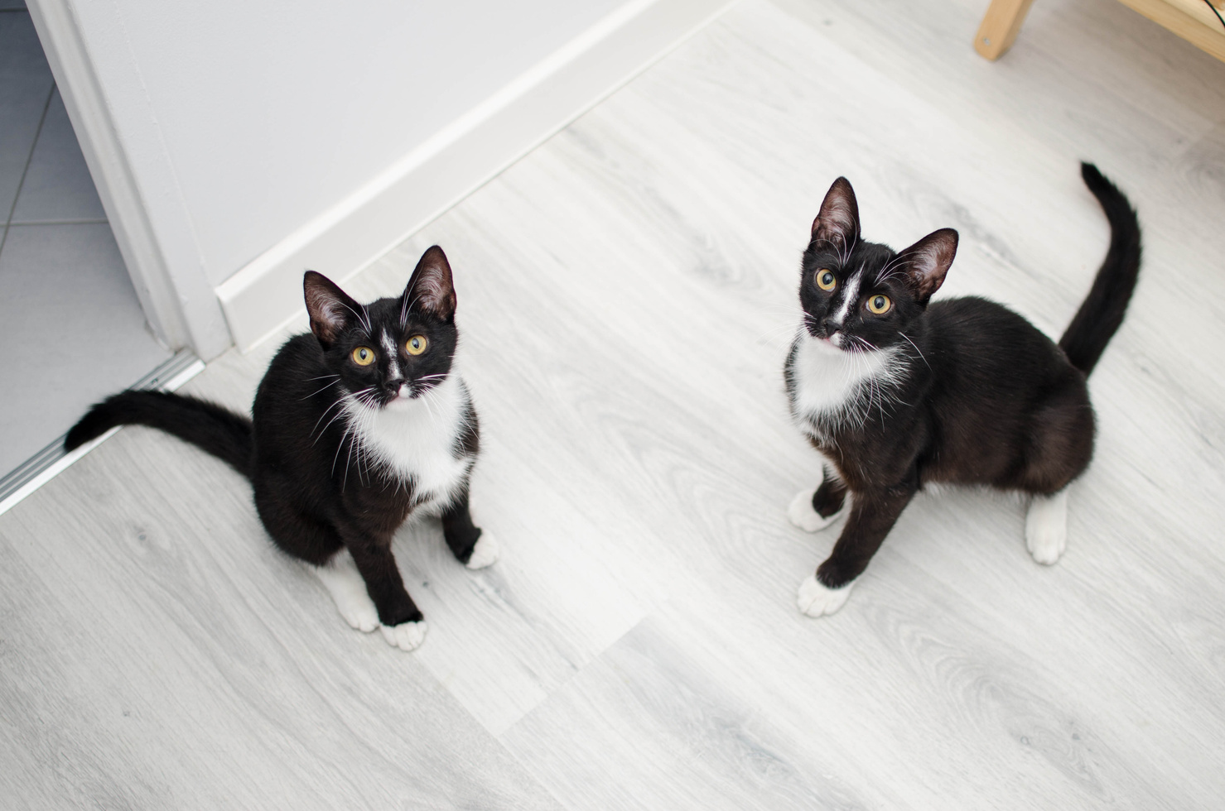
Storytelling is a process that requires the involvement of the narrator and the listener at the same time

Slide 5




Principles of creating a good story
  BUILDING CONNECTION
  EMOTIONS
  AUTHENTICITY

Slide 6

Storytelling is a process that requires the involvement of the narrator and the listener at the same time
narrator
listener

Slide 7
STORY PLAN No. 1
1
  2
  3
INTRODUCION
DEVELOPMENT
CONCLUSION
NAPISZ SWÓJ PIERWSZY TEMAT LUB POMYSŁ
Presenting the protagonist and their problem
Solving the problem and conclusion
Attempt of solving the problem by the protagonist

Slide 8



1
Beginning
STORY PLAN No. 2
2
Problem
Failed attempt of solving the problem
3
4
Solving the problem
5
Conclusion

Slide 9
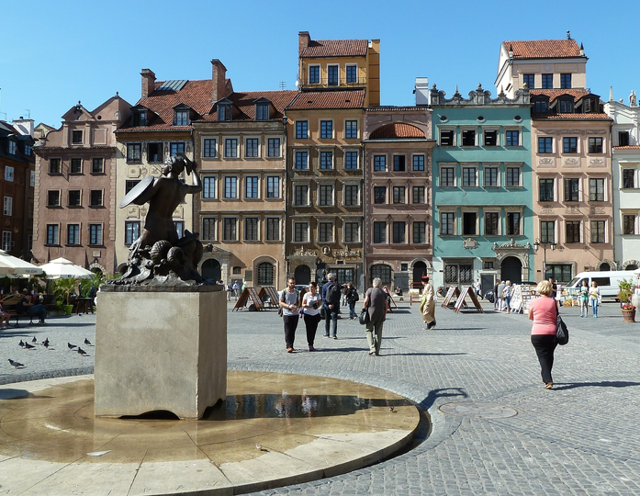
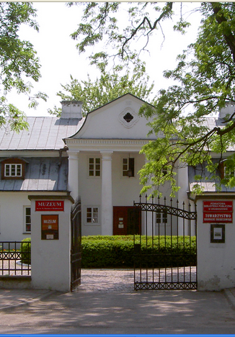
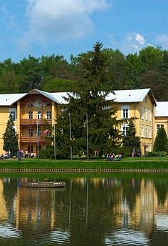
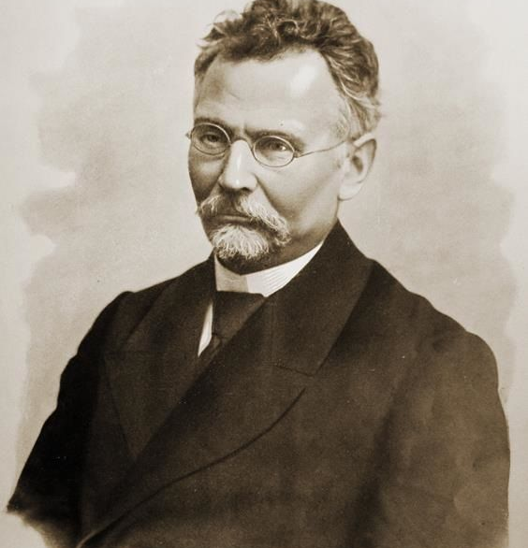
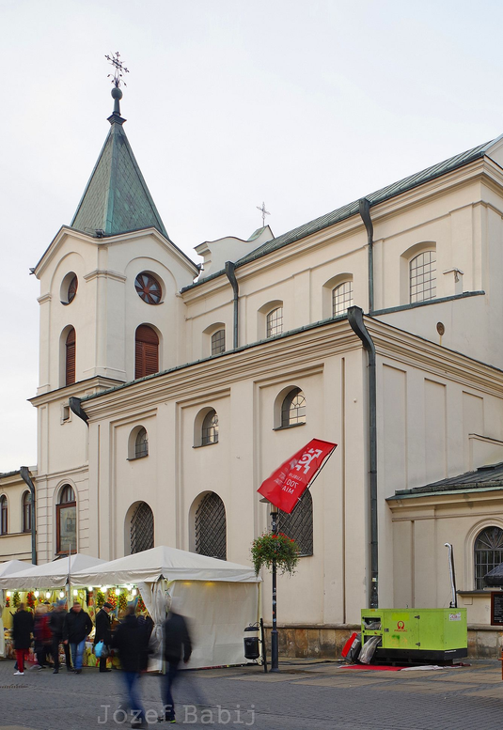
Following the footsteps of Bolesław Prus

Slide 10

HOW TO SPEAK TO YOUNG PEOPLE SO THAT THEY WANT TO LISTEN?
briefly
engagingly
clearly
emotionally
illustratively

Slide 11



GROUPWORK
GROUP 1
GROUP 2
GROUP 3

Slide 12
Groupwork
GROUP 1
GROUP 2
GROUP 3
Task no. 1
Task no. 2
Task no. 3

Slide 13
WORKSHEET 1/5
CREATING ONE'S OWN STORY ABOUT ONE'S HOME COUNTRY USING THE STORYTELLING METHOD
Beginning
Introduce your little homeland, the protagonist and the context, describe why he or she is important in your story. Remember that at this point you already need to know how the story will end and what you want to say to your audience with it.
Your notes

Slide 14
WORKSHEET 2/5
CREATING ONE'S OWN STORY ABOUT ONE'S HOME COUNTRY USING THE STORYTELLING METHOD
Outline the problem faced by the hero of your little homeland you depicted and describe why it is so significant to him/her (you can be this hero too).
Problem
Your notes

Slide 15
WORKSHEET 3/5
CREATING ONE'S OWN STORY ABOUT ONE'S HOME COUNTRY USING THE STORYTELLING METHOD
Describe the protagonist's first and unsuccessful attempt to deal with a problem from his/her individual perspective. Describe what the protagonist felt at that moment and how this failure affected him.
Failed attempt of solving the problem
Your notes

Slide 16
WORKSHEET 4/5
CREATING ONE'S OWN STORY ABOUT ONE'S HOME COUNTRY USING THE STORYTELLING METHOD
Solving the problem
Describe the situation that led to the resolution of the problem paying particular attention to the elements likely to elicit emotion.
Your notes

Slide 17
WORKSHEET 5/5
CREATING ONE'S OWN STORY ABOUT ONE'S HOME COUNTRY USING THE STORYTELLING METHOD
Conclusion
End the story with some kind of conclusion that will be meaningful to your audience.
Your notes

Slide 18

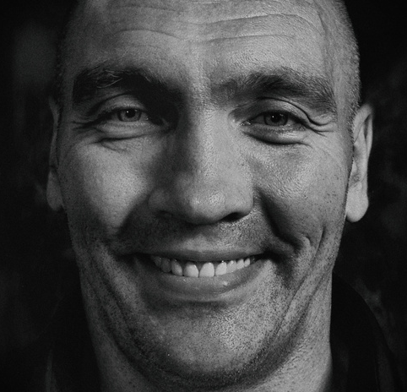

Group 1 representative
PRESENTATION OF THE STORIES PREPARED IN GROUPS
Group 2 representative
Group 3 representative

Slide 19

RESTATING THE PRINCIPLES OF STORYTELLING OF TELLING ABOUT YOUR HOME COUNTRY
Beginning
1
  Problem
  2
  3
  Failed attempt of solving the problem
  Solving the problem
  4
  Conclusion
  5

Slide 20

DISCUSSION

Slide 21

THANK YOU FOR ATTENTION

