Slide 1







INTANGIBLE CULTURAL HERITAGE - HOW TO TALK ABOUT CUSTOMS, TRADITIONS, RITUALS?
M2W4-M01

Slide 2
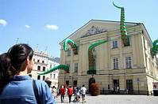
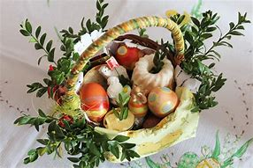
Aim of the workshop:
Mastering the ability to narrate intangible cultural heritage and to convey knowledge about customs, traditions, rituals and other aspects of culture through storytelling

Slide 3

Intangible heritage, as defined by the UNESCO Convention, includes:
  traditions and oral transmissions, including language as a vehicle for intangible cultural heritage
  visual arts
  customs, rituals and festive rites
  knowledge and practices concerning nature and the universe
  skills associated with traditional crafts

Slide 4
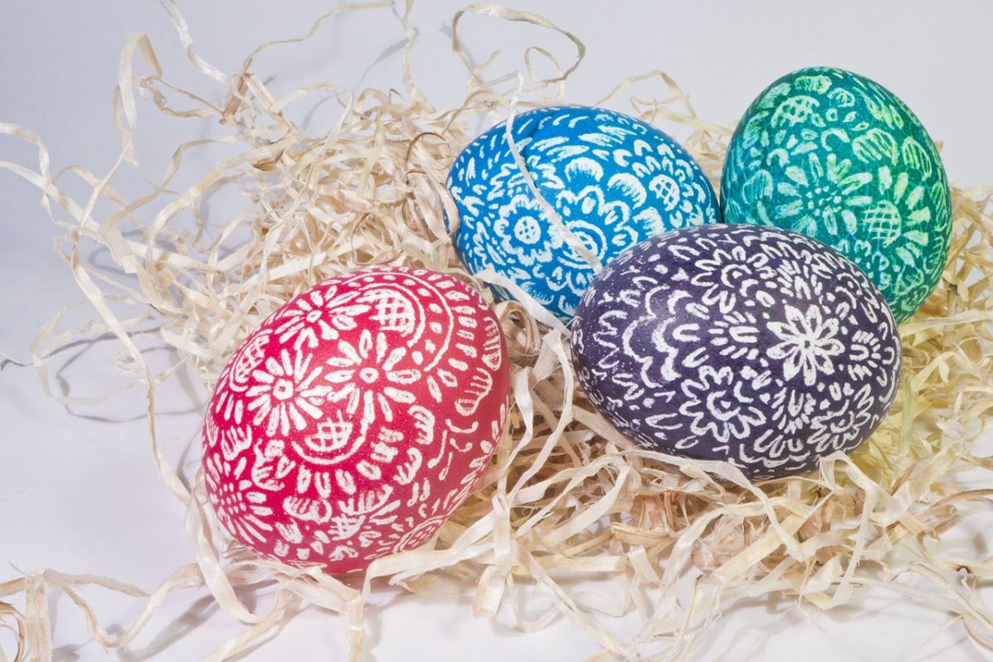
Customs
Customs are accepted behaviors in a community, based on tradition and passed on from father to son. However, unlike customs, failure to observe customs is not associated with a negative perception from the group. Customs may only occur within a particular group and thus emphasize its distinctiveness.

Slide 5
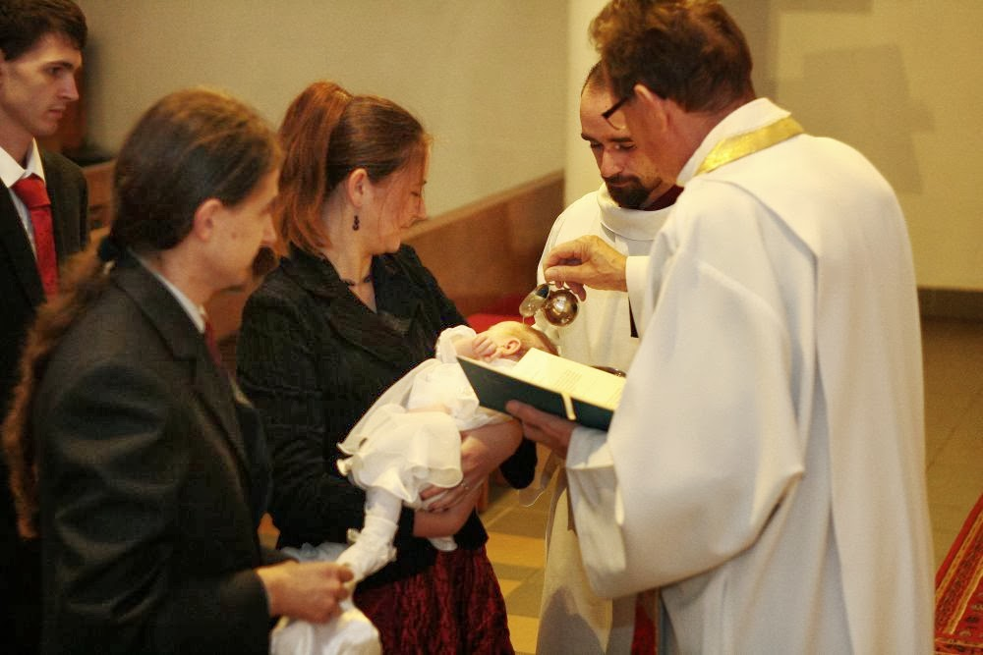
Rituals
Ritual - the most important celebration in everyone's life. Rituals are the most complicated, complex but also the most important practices. They are usually associated with moments of transition in a person's life: they accompany changes, help to accept them, explain them and familiarize people with them.

Slide 6
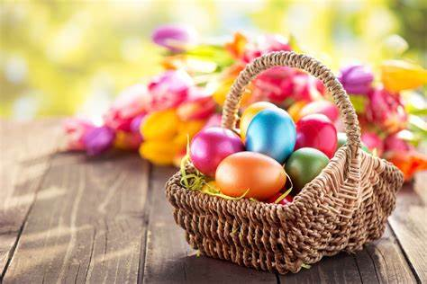
Traditions
Tradition - the totality of customs, norms, views, behaviors, etc. inherent in a social group, handed down from generation to generation; also: the continuity of these customs, norms, views or behaviors.

Slide 7
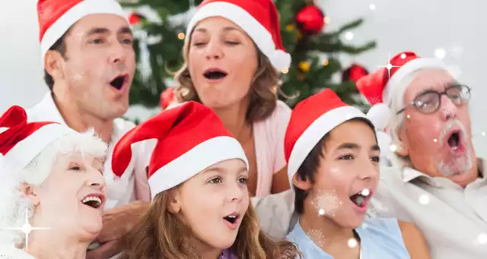
Hear a funny story

Slide 8

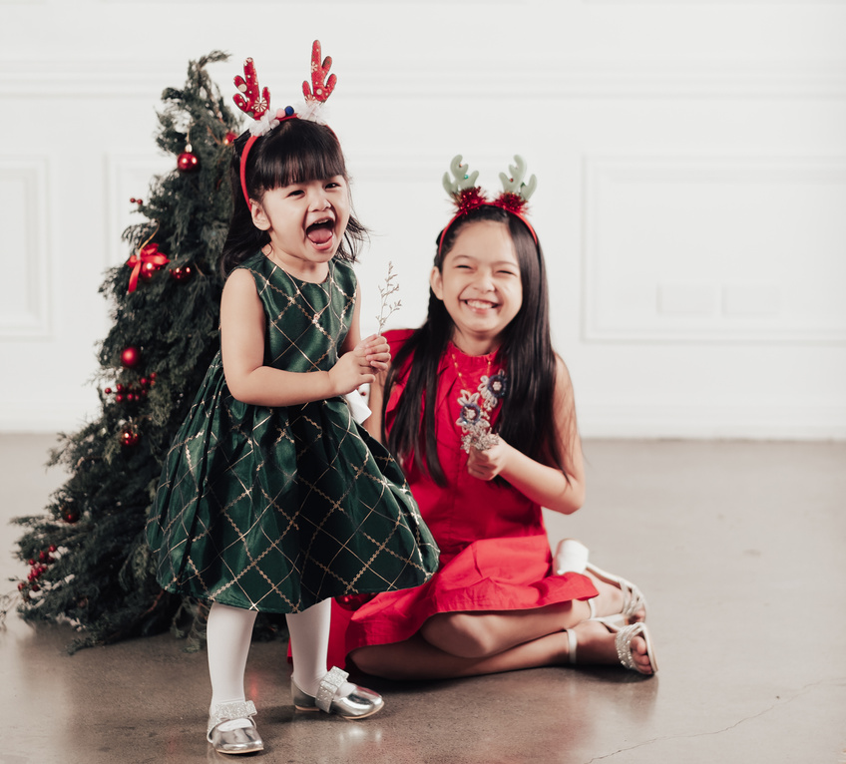
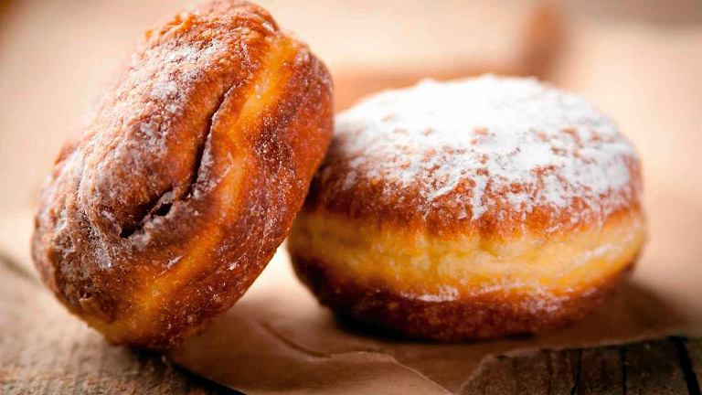
What customs, rituals, traditions are cultivated in your area?

Slide 9




STORY PLAN No. 1
INTRODUCTION
DEVELOPMENT
CLOSURE
Presenting the protagonist and their problem
Attempt of solving the problem by the protagonist
Solving the problem and conclusion

Slide 10
STORY PLAN No. 2
1
INTRODUCTION
SOLVING THE PROBLEM
4
2
PROBLEM
5
CONCLUSION
FAILED ATTEMPT OF SOLVING THE PROBLEM
3

Slide 11

Creating interesting stories

Slide 12
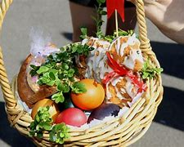
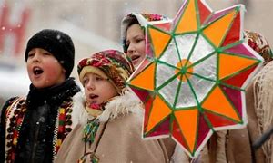
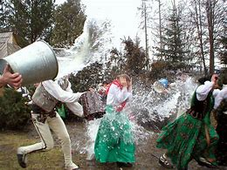
FOOD BLESSING
CHRISTMAS CAROLING
TRADITIONS
ŚMINGUS-DYNGUS
(WET MONDAY)

Slide 13
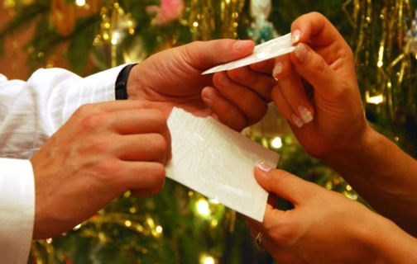

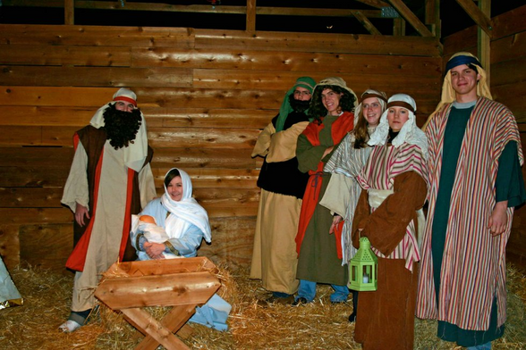
BREAKING A WAFER
EXCHANGING CHRISTMAS GIFTS
CUSTOMS
NATIVITY PLAY

Slide 14
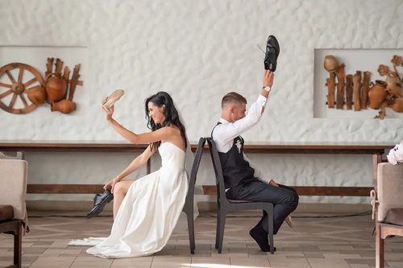
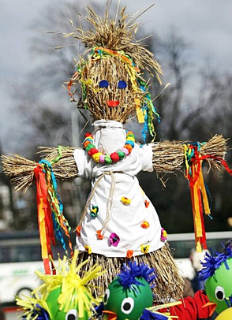
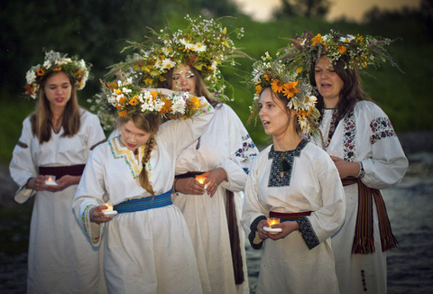
OCZEPINY
DROWNING OF MARZANNA
RITUALS
ST JOHN’S EVE

Slide 15

Create your own story based on the work sheet

Slide 16
WORKSHEET 1/5
CREATING OWN STORY ABOUT HOME COUNTRY USING THE STORYTELLING METHOD
Beginning
Introduce your little homeland, the protagonist and the context, describe why he or she is important in your story. Remember that at this point you already need to know how the story will end and what you want to say to your audience with it.
Your notes

Slide 17
WORKSHEET 2/5
CREATING OWN STORY ABOUT HOME COUNTRY USING THE STORYTELLING METHOD
Outline the problem faced by the hero of your little homeland you depicted and describe why it is so significant to him/her (you can be this hero too).
Problem
Your notes

Slide 18
WORKSHEET 3/5
CREATING OWN STORY ABOUT HOME COUNTRY USING THE STORYTELLING METHOD
Describe the protagonist's first and unsuccessful attempt to deal with a problem from his/her individual perspective. Describe what the protagonist felt at that moment and how this failure affected him.
Failded attempt of solving the problem
Your notes

Slide 19
WORKSHEET 4/5
CREATING OWN STORY ABOUT HOME COUNTRY USING THE STORYTELLING METHOD
Solving the problem
Describe the situation that led to the resolution of the problem paying particular attention to the elements likely to elicit emotion.
Your notes

Slide 20
WORKSHEET 5/5
CREATING OWN STORY ABOUT HOME COUNTRY USING THE STORYTELLING METHOD
Conclusion
End the story with some kind of conclusion that will be meaningful to your audience.
Your notes

Slide 21

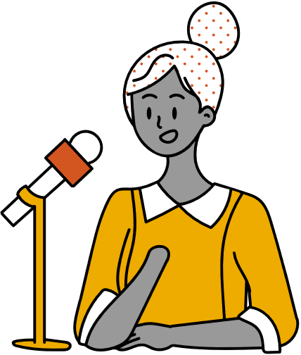
Presentation of the prepared stories

Slide 22

Conclusion

Slide 23
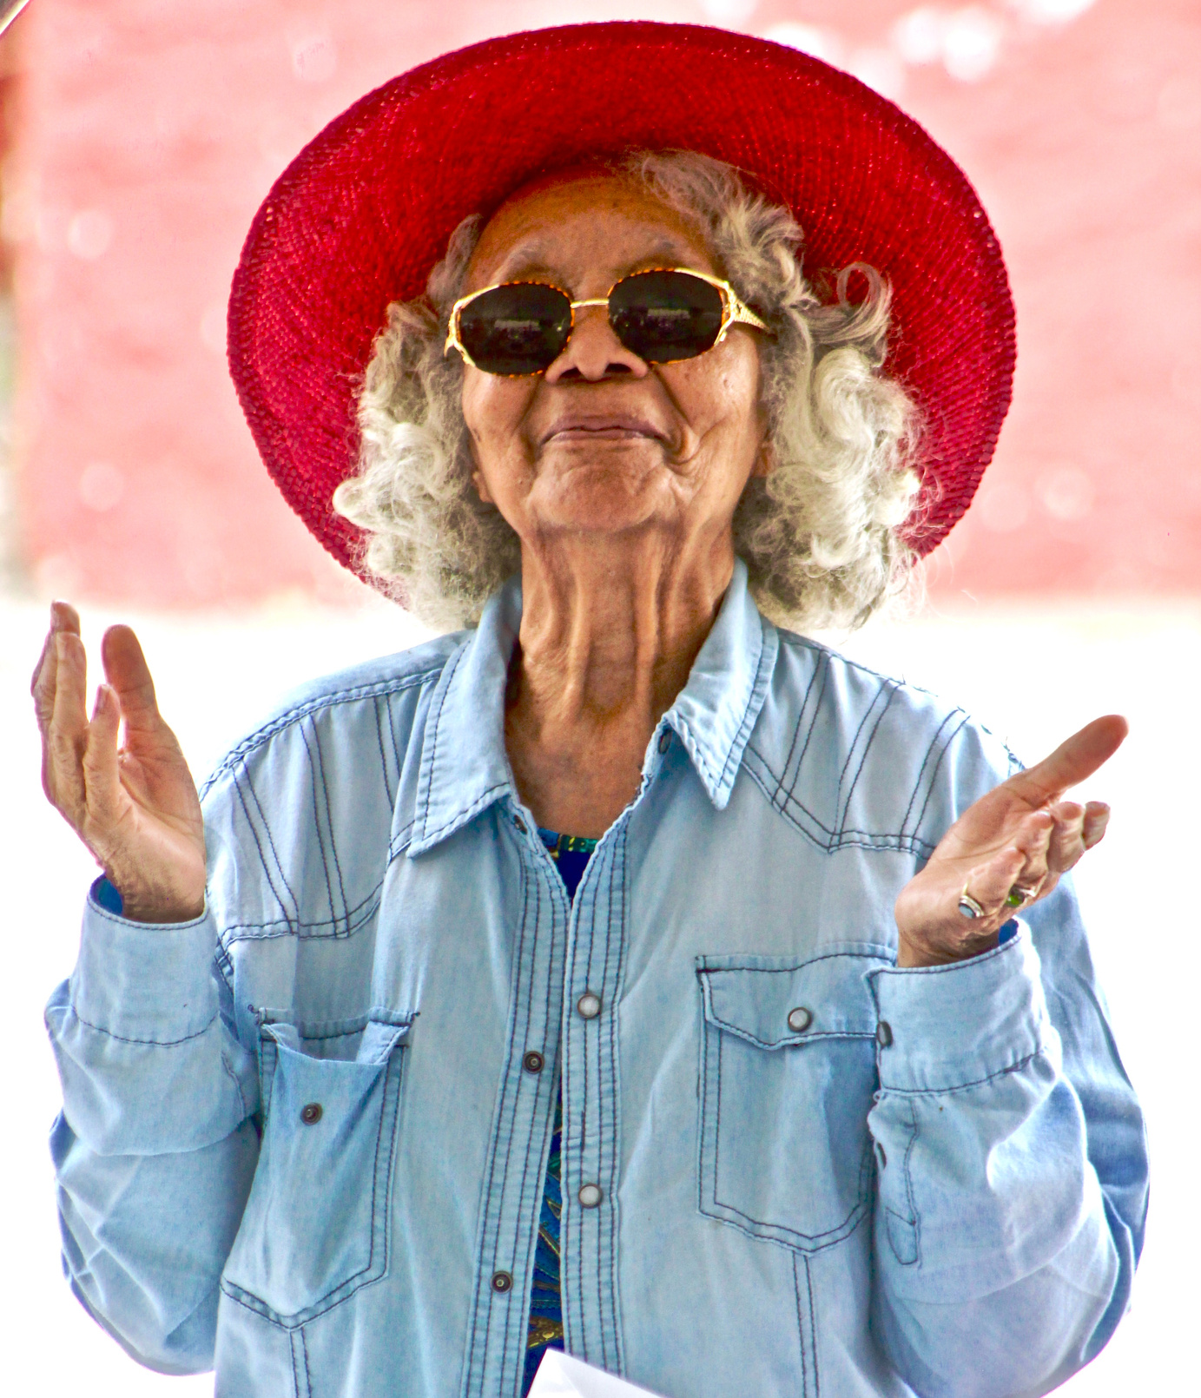
Thank you for your attention

