Slide 1







ONLINE STORYTELLING
Blogs and social networks part 1. - Technical aspects of setting up and running profiles
M3W1

Slide 2

Step 1: What is social media?
History and types

Slide 3

The term social media
first appeared in 2005
2005

Slide 4

SOCIAL MEDIA
"Internet and mobile technologies that enable contact between users through the exchange of information, opinions and knowledge."

Slide 5
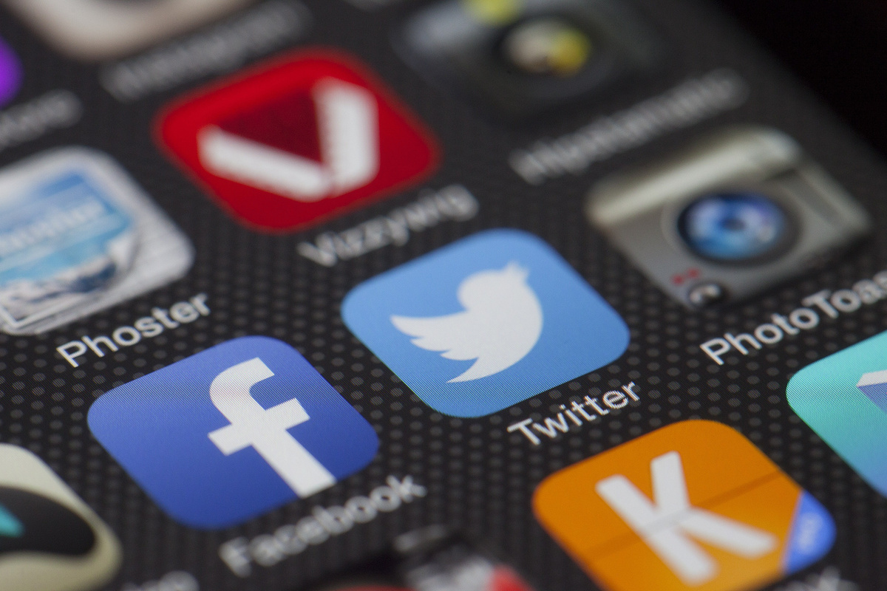
The beginning of XXI century was particularly fraught with the birth of new social networks.

Slide 6

In 2002 came LinkedIn, an international service specializing in professional and business contacts

Slide 7

In 2004 roku world-famous Facebook arrived

Slide 8

In 2005 came
YouTube, which allows all internet users to record and publish videos

Slide 9

Year 2006 means the rise of Twitter, which allows publishing short text messages known as tweets.

Slide 10

Instagram emerged in 2010, and started the new era of picture communication

Slide 11
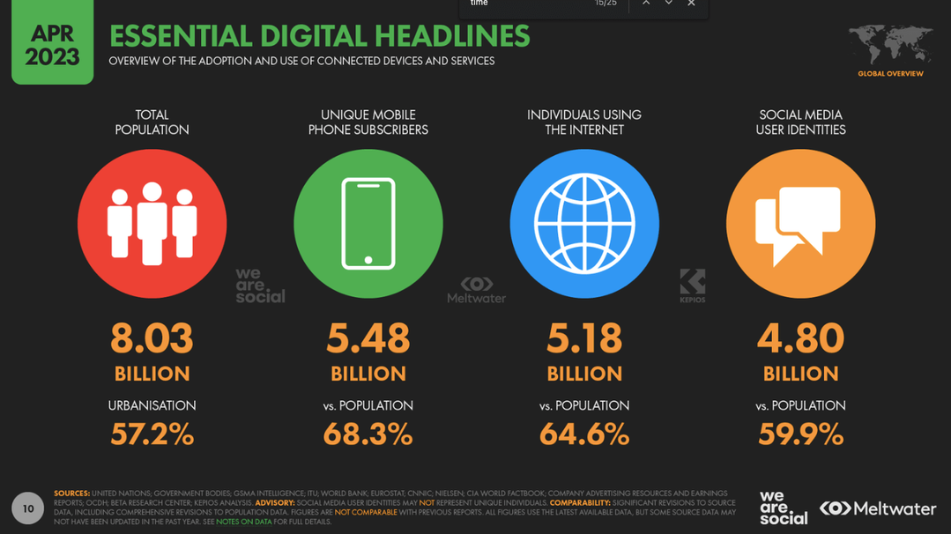
Global population vs. number of social media users
źródło: https://www.smartinsights.com/social-media-marketing/social-media-strategy/new-global-social-media-research/

Slide 12
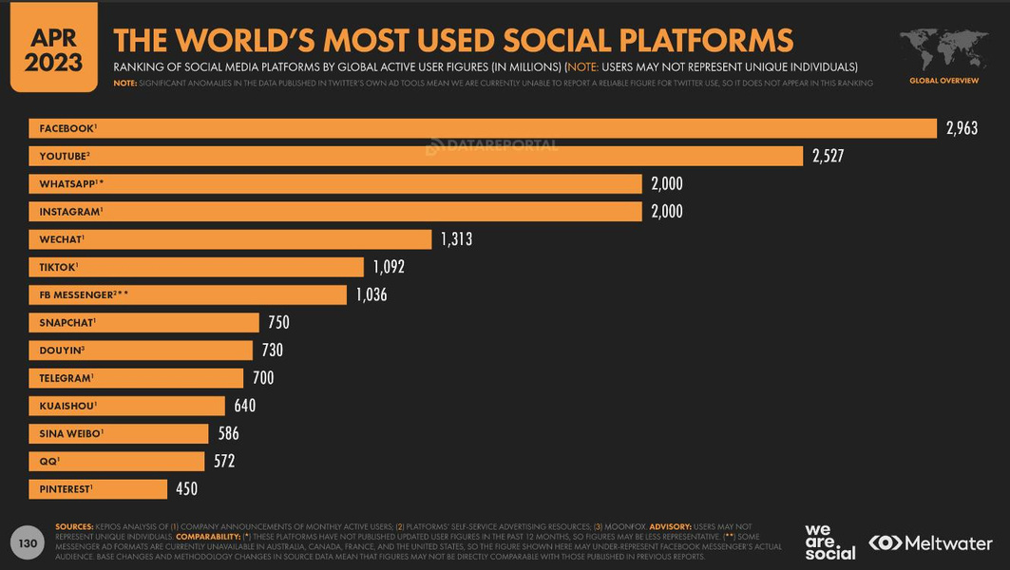
Most used social media platforms in the world
źródło: https://www.smartinsights.com/social-media-marketing/social-media-strategy/new-global-social-media-research/

Slide 13

Step 2: Facebook - setting up and maintaining a profile

Slide 14
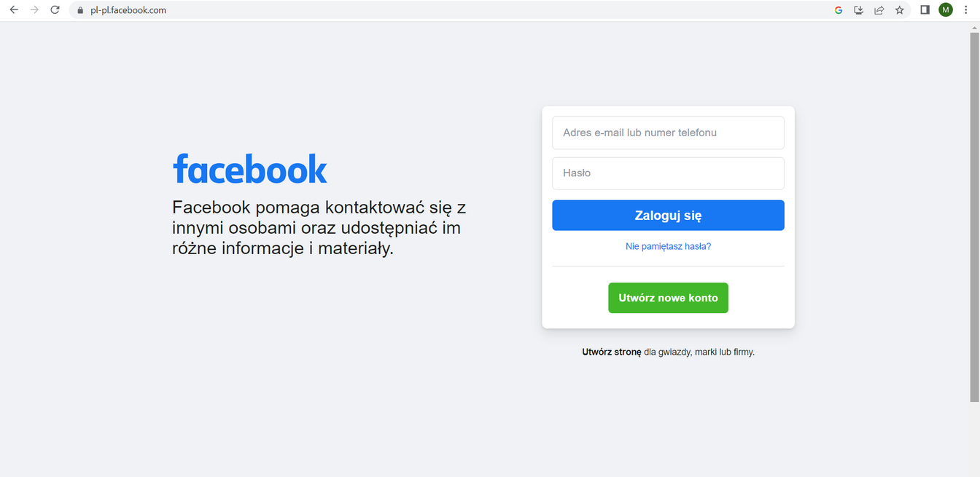

Step 1. Go to facebook.com and click "Create a new account."

Slide 15
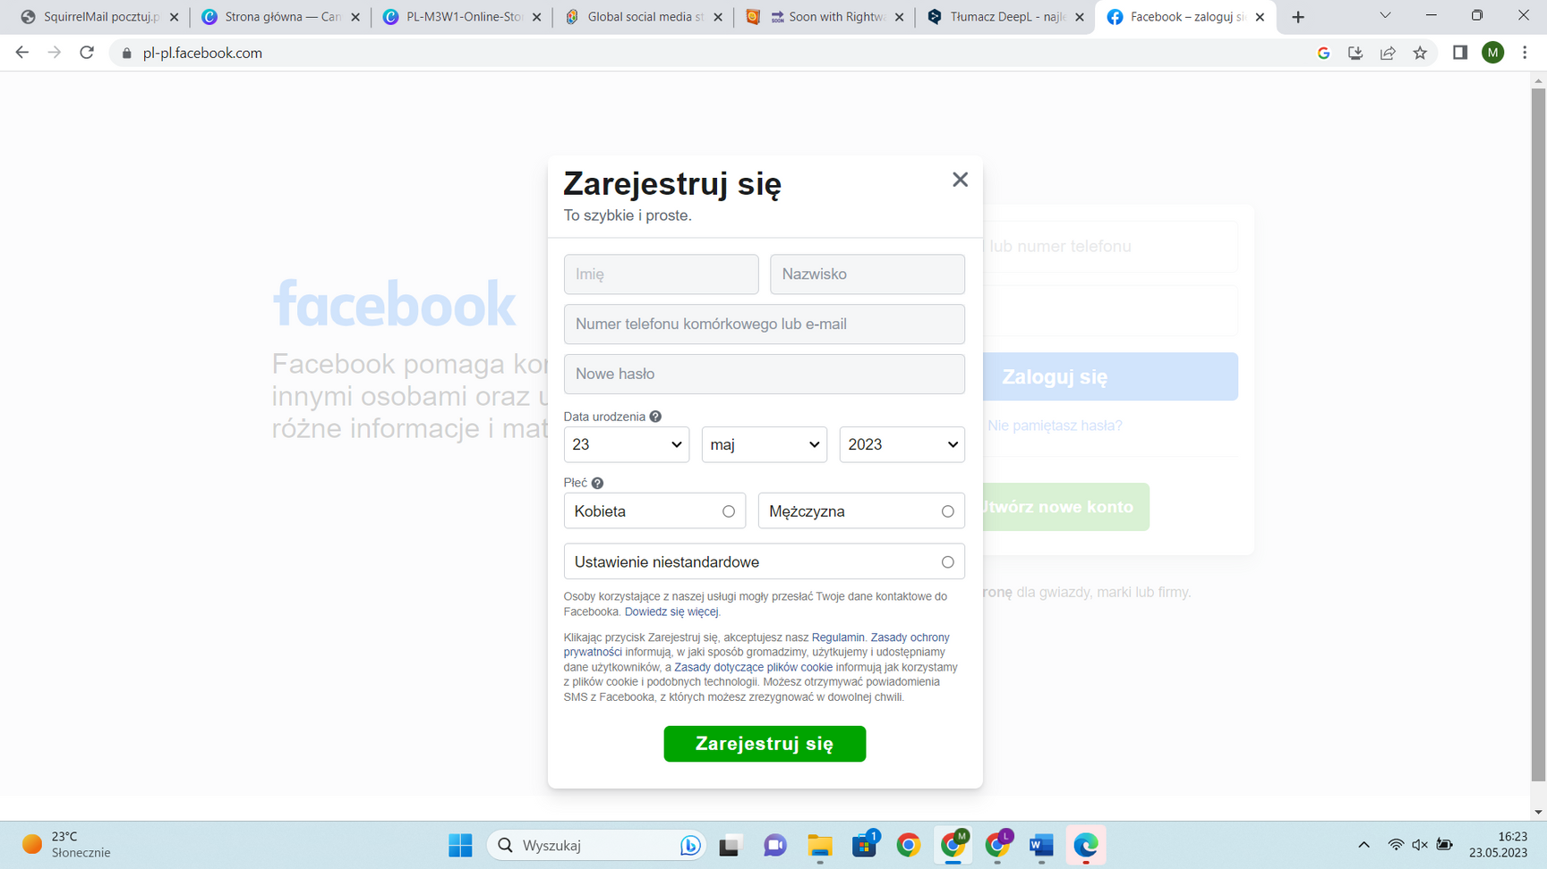
STEP 2. Enter your first and last name, email address or cell phone number, password, date of birth and gender.Click the Register option.
STEP 3. Confirm your email address or cell phone number to complete account creation.

Slide 16
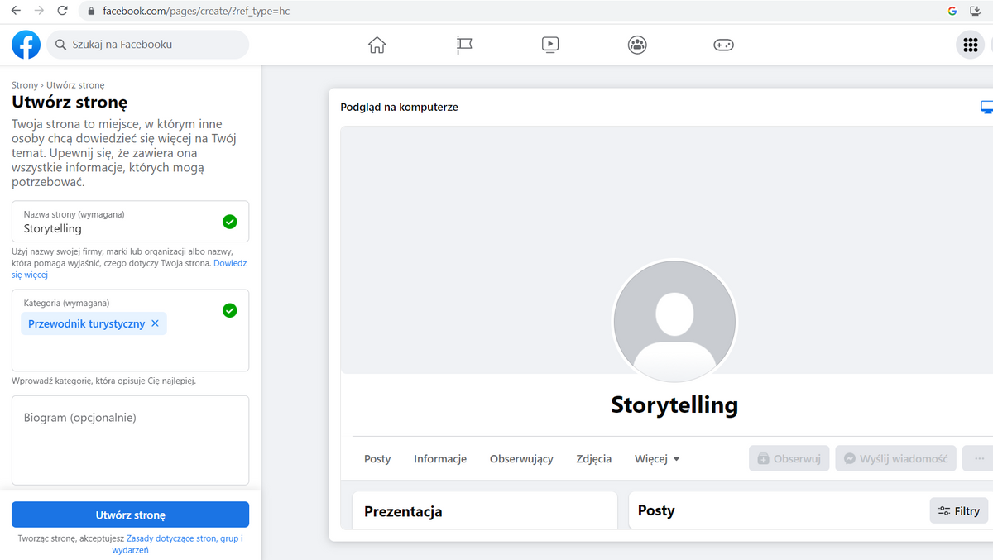

Slide 17
Creating a Facebook page:
  Go to facebook.com/pages/create.
  Enter the name of the page and the category.
  Fill in the bio (opctional).
  Click on Create page.
  You can then add the profile and background pictures.

Slide 18
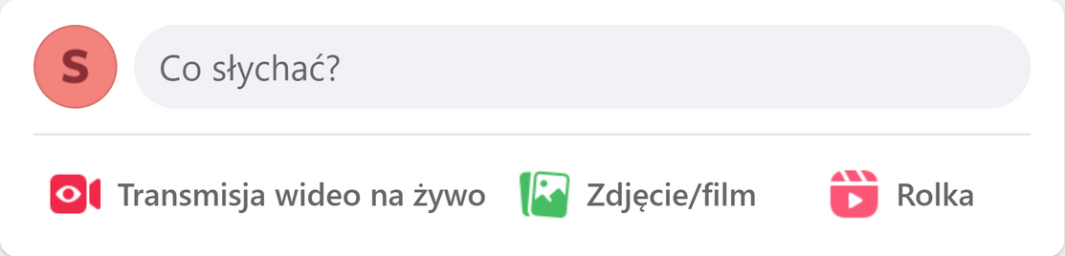
Facebook enables:
  sharing photos and videos
  sharing reels
  running live video transmissions
  sharing stories

Slide 19

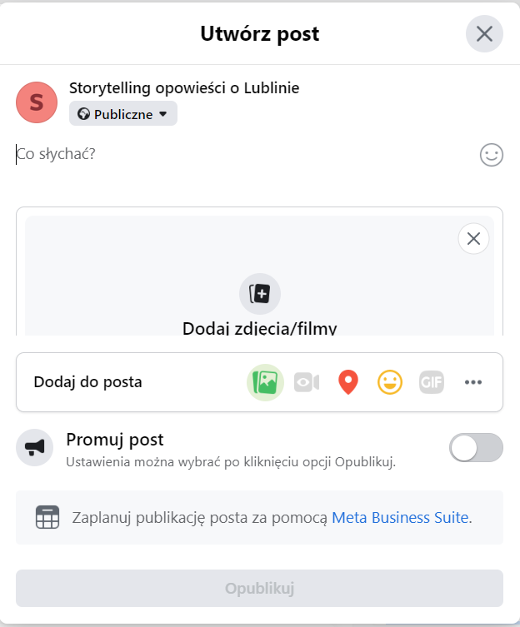

Slide 20
Text
Photo or video
Location
Mood

Slide 21

Glossary

Slide 22

ADMINISTRATOR
The person who manages a particular profile on social media. Can grant and revoke permissions to other people managing the account.

Slide 23

BAN
Facebook account blocking, most often caused by violation of the rules of the portal.

Slide 24



EMOJIS
Small graphics that you can insert into a Facebook conversation and thus give it an emotional dimension. They can depict emotions or things. Used to draw attention to words in text.

Slide 25
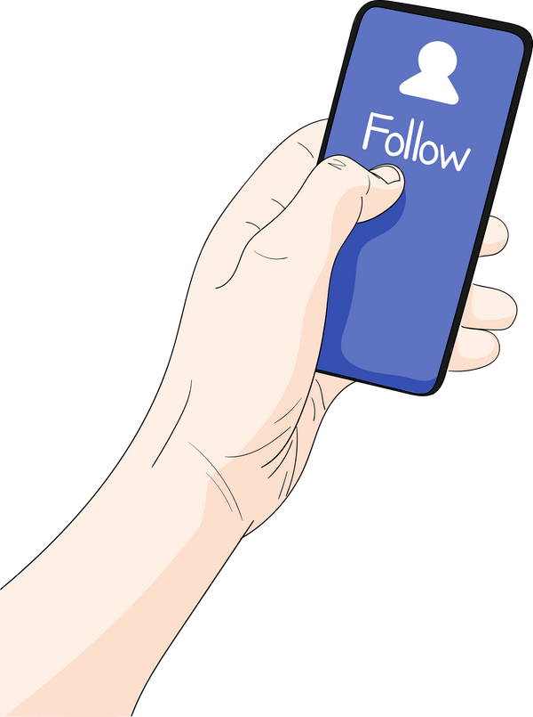
FOLLOWER
A person watching our profile.

Slide 26

#HASHTAGS
Keywords. Included in posts make it easier to find topical issues in Facebook's resources.
#Lublin
#monument
#Palermo
#nature
#RogaskaSlatina

Slide 27

INFLUENCER
A person who, because of their popularity, can influence the opinions and decisions of others through the social media profile they maintains.

Slide 28






Likes
The most popular tool for expressing one's opinion.

Slide 29
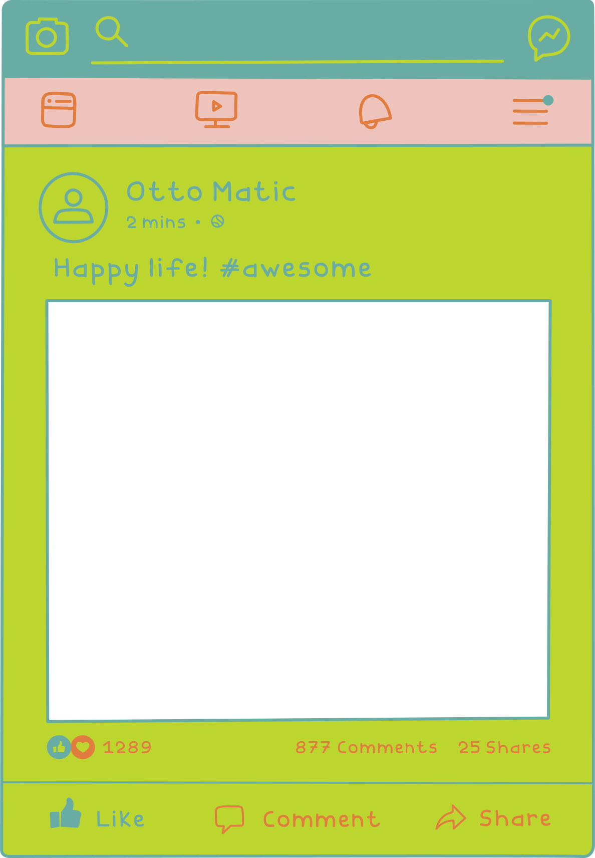
post
PUBLISHING CONTENT ON FACEBOOK. THE MOST POPULAR TYPE OF POST IS A GRAPHIC ALONG WITH A DESCRIPTION.

Slide 30

RTM - REAL TIME MARKETING
publication of a post (advertising creation) relating to current events that users like to discuss.

Slide 31
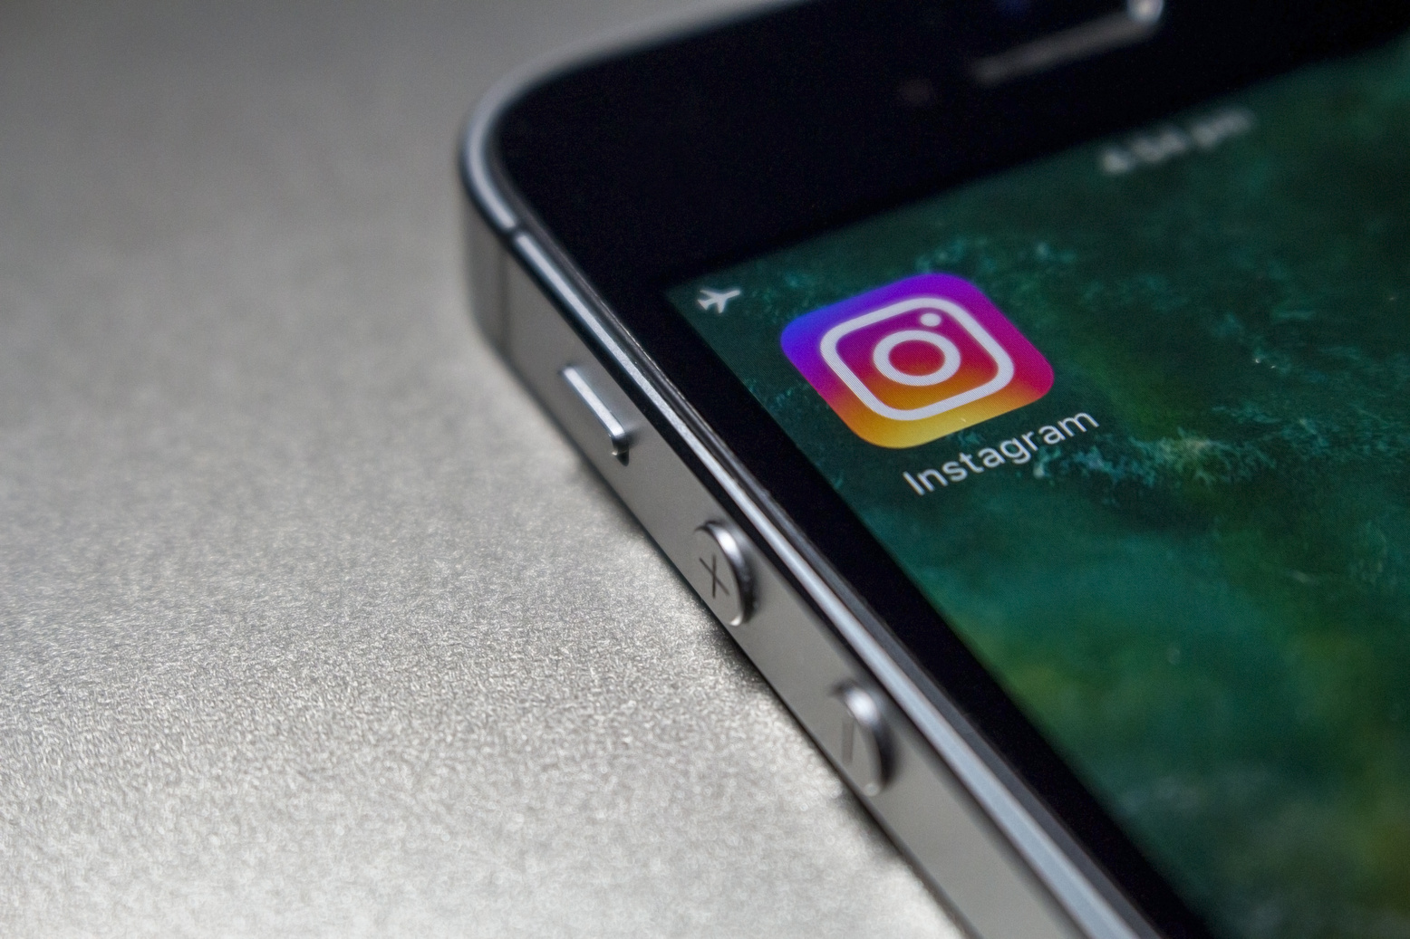
STAGE 3: Instagram – setting up and maintaining a profile

Slide 32
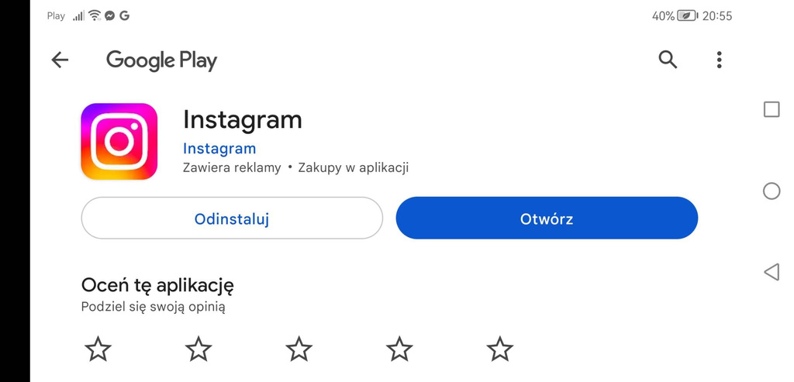
Download the Instagram app from the Google Play (Android) or App Store (iPhone)

Slide 33
After installing touch the
icon to open the app

Slide 34
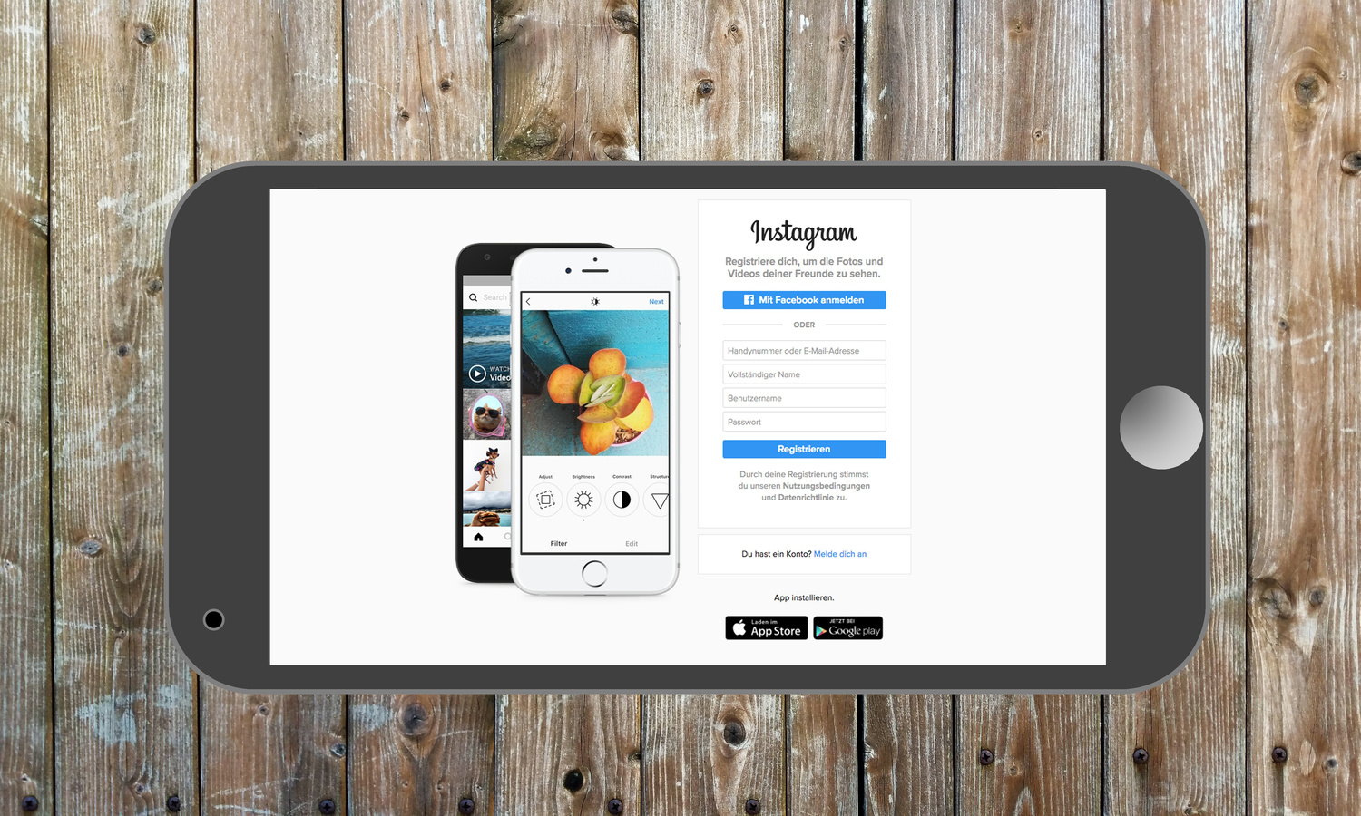
Touch the Create a new account and insert your e-mail address or phone number

Slide 35
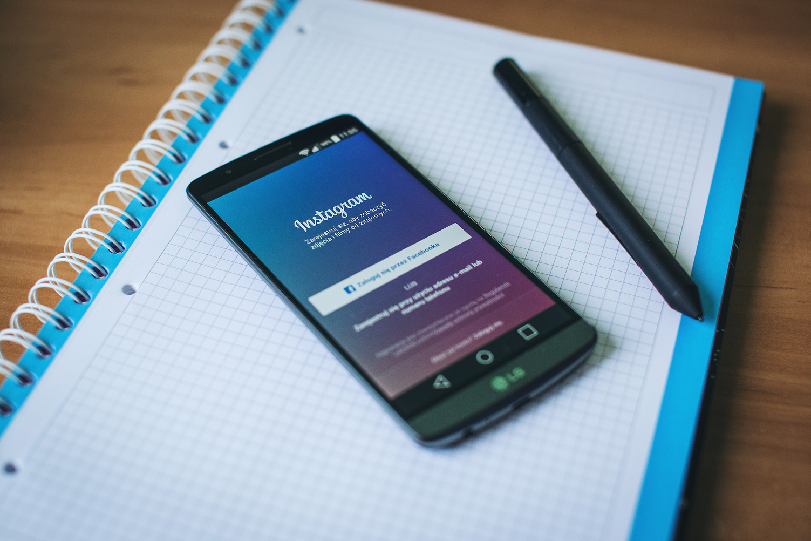
Enter the confirmation code received in an email or to your cell phone number

Slide 36
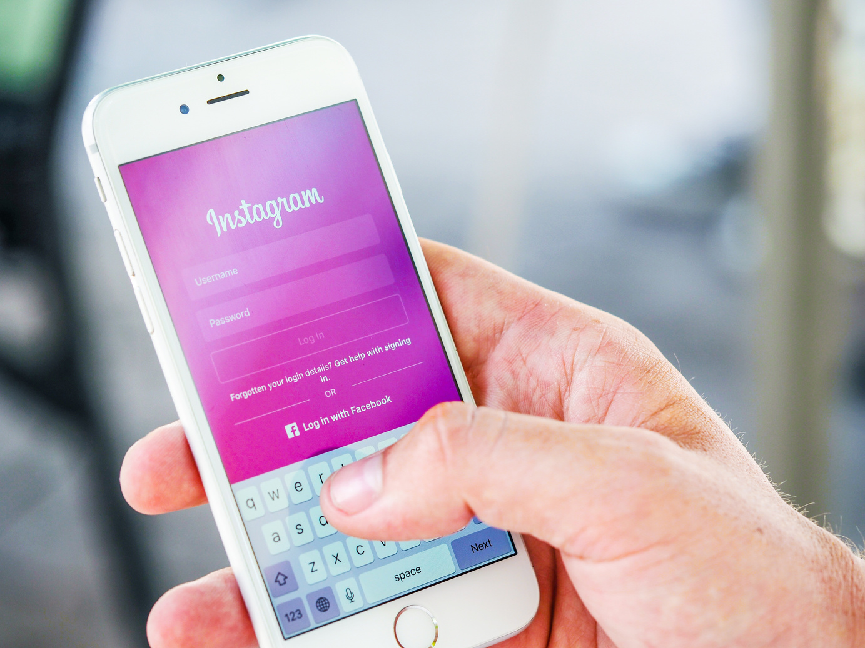
Create a password

Slide 37

In the next steps add:
birth date
first and last name

Slide 38
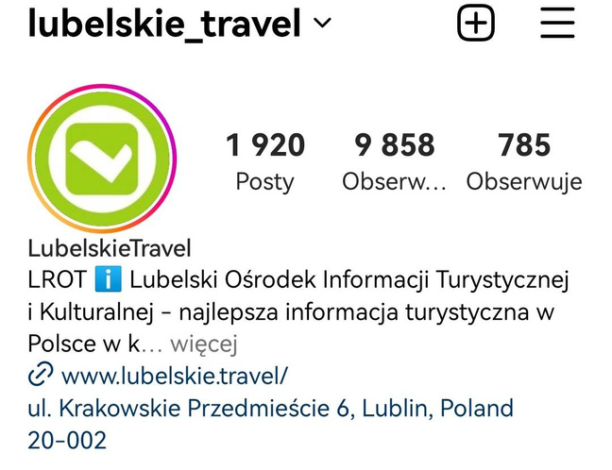
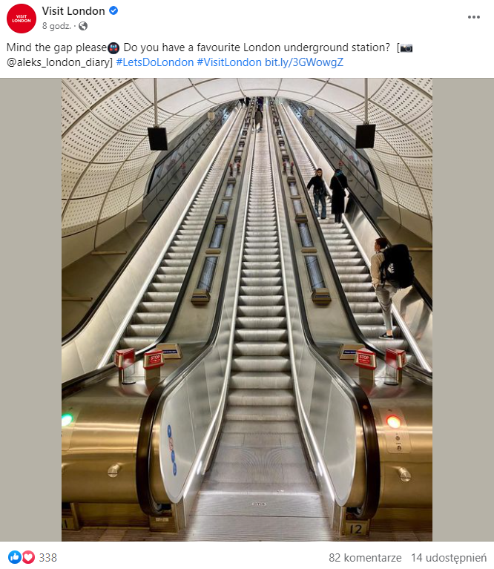
Create your username

Slide 39

Read and accept Terms and conditions

Slide 40

Add profile picture

Slide 41


You can also create an account on Instagram using Facebook, synchronizing data from both profiles
Facebook integration enables publishing a post simultaneously on both profiles.

Slide 42

In a post one can also tag friends or other profiles. Tagged profile will be notified about our post.

Slide 43
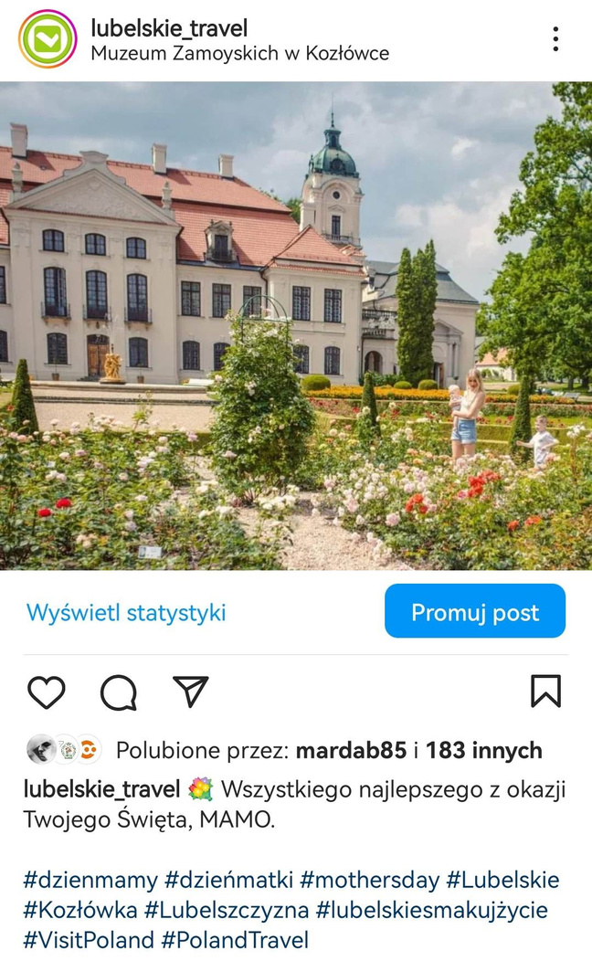

Location
do not omit
Photo
the most essential part of the Instagram post
Text
cohesive is the best
Hashtags
ideally between 11 and 15

Slide 44
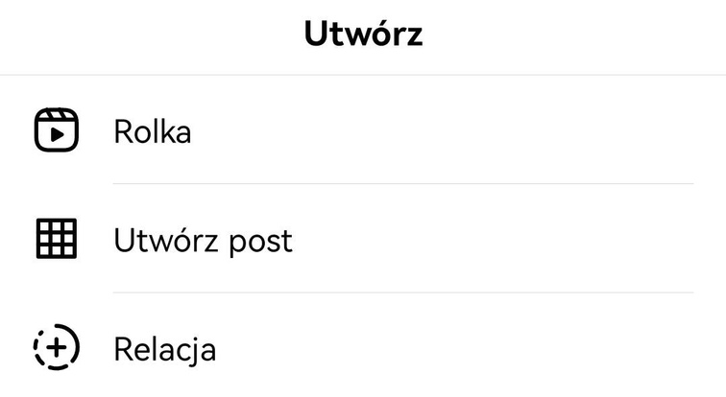
Instagram usters mostly create posts, stories and reels

Slide 45
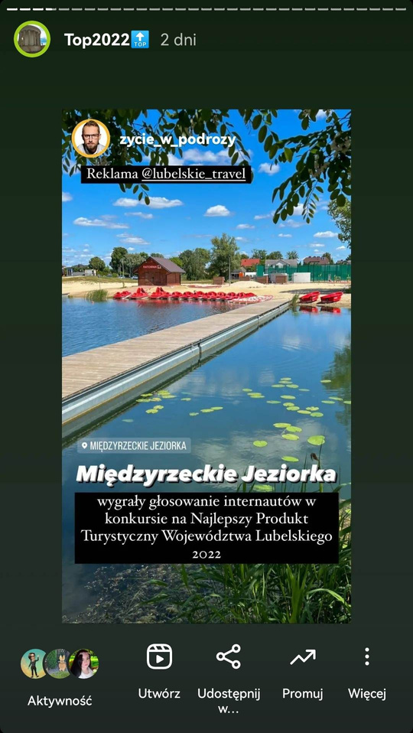
Instagram story allows adding photo, short movie, text information, or sharing a post.
Maximum length of a single story is 15 seconds. Published story is visible for 24 hours.

Slide 46
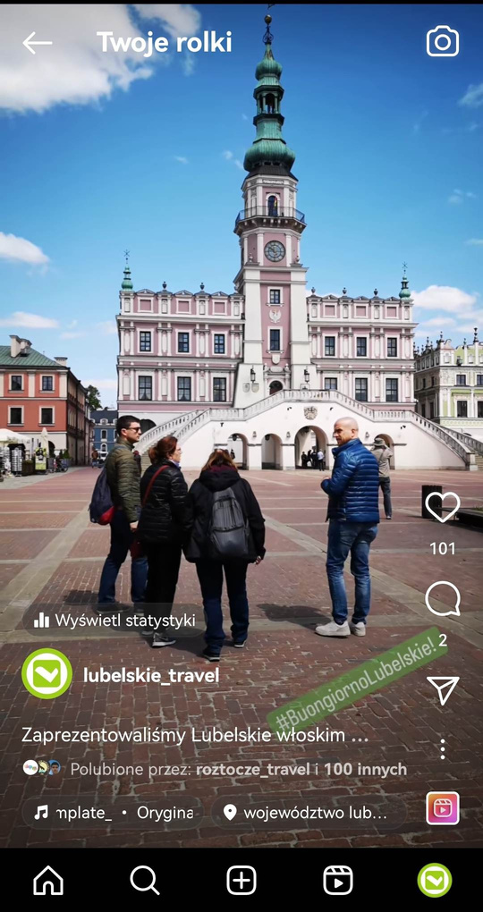
Reel function on Instagram enables recording a short video material (from 3 to 60 seconds) in vertical format. The video can be enhanced with soundtrack, special effects, text, gifs and stickers.

Slide 47

Stage 4: QUIZ

Slide 48
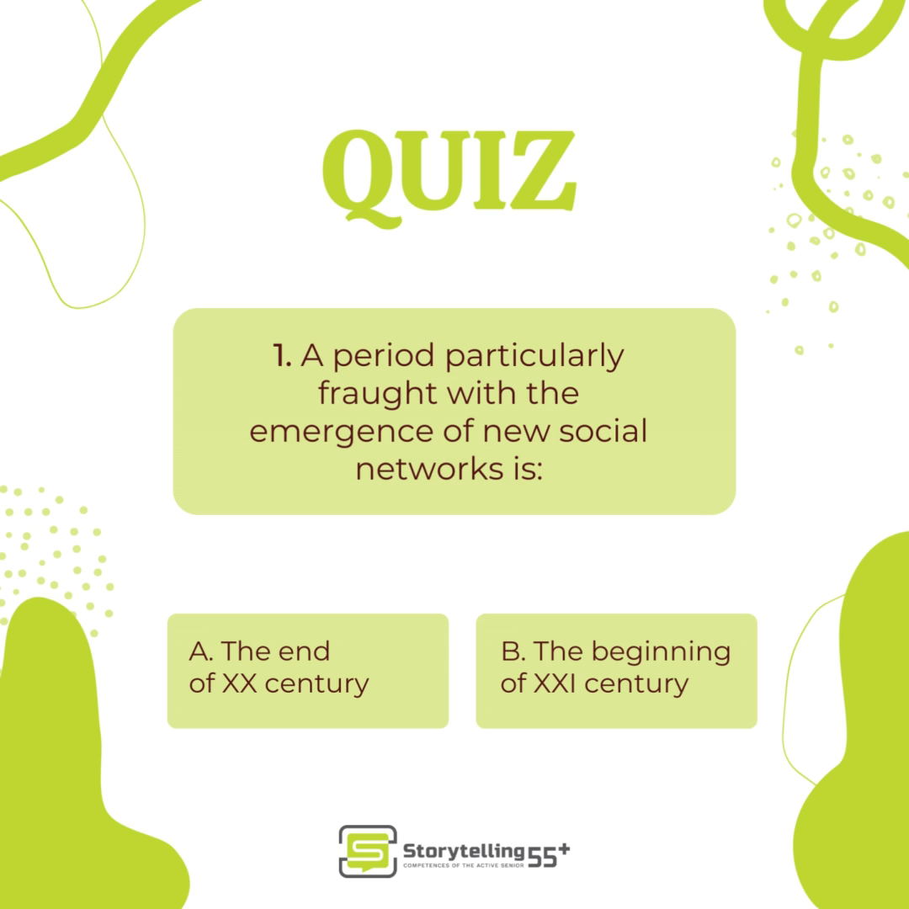

Slide 49
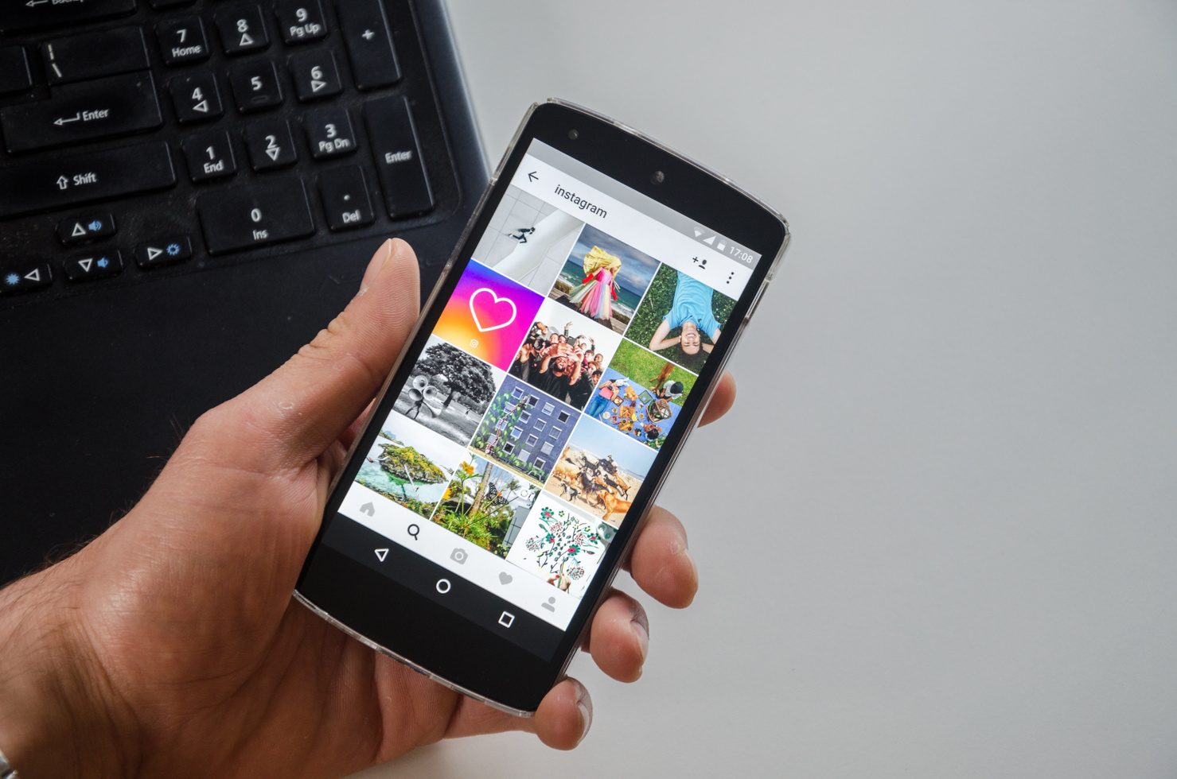
Stage 5: Conclusion

Slide 50


Social media are online and mobile technologies that enable users to connect with each other by sharing information, opinions and knowledge.

Slide 51


Social media are used by over 4,8 bilion people, so almost 60% population!

Slide 52


The most popular among social media platforms is Facebook

Slide 53


Another popular platform is Instagram, that can be integrated with Facebook account

Slide 54


Both on facebook and on Instagram one can not only publish posty but also stories, that effectively draw consumers’ attention

Slide 55


Do not be afraid of social media -
try to experiment and implement
your own original ideas!

Slide 56
THANK YOU FOR ATTENTION

Slide 57



