Slide 1







ONLINE STORYTELLING
Blogs and social networks part 2
Preparing interesting content
to promote cultural heritage
M3W2

Slide 2




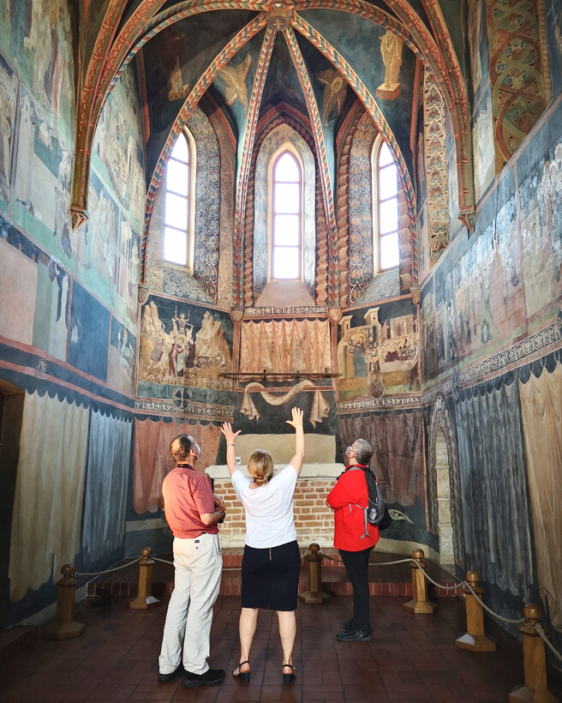


WELCOME TO THE WORLD OF SOCIAL MEDIA

Slide 3

Stage 1: Types of social media vs effective messaging

Slide 4

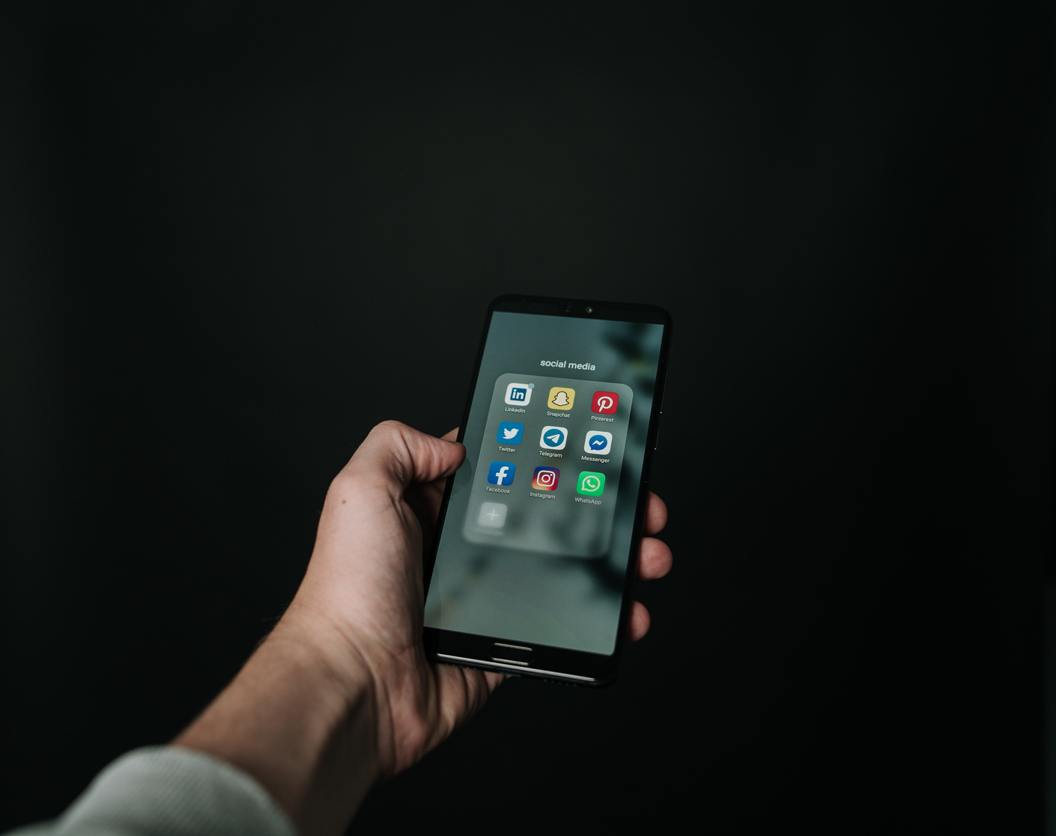
Over 100 types of social media around the world!

Slide 5


4,62 bilion social media users
Over 58% world’s population uses social media

Slide 6

Person spends on average 2,5 hours per day using social media
Average time of a focus on a single posts is barely 8 seconds

Slide 7

46% people uses recommendation of blogers and vlogers

Slide 8





Social media explained with coffee:
I like coffee.
Watch me drink my coffee
Here’s a photo of me drinking coffee
Drinking #coffee

Slide 9

60% of Internet users use Facebook
90% of users uses Facebook on mobile devices
Storytelling on Facebook is popular and effective while promoting products and services

Slide 10
Higher post engagement rates than other social media platforms
Photos on Instagram achieve 23% higher engagement than on Facebook
The most active people on Instagram are between 18 to 34 years old

Slide 11
60% prefer to watch Youtube than television
About 20% of users stop watching Youtube material after 10 seconds - a good introduction is key
YouTube is the third most visited website in the world (1. Google, 2. Facebook)

Slide 12
Twitter is aimed for fast communication
The content answers the question
„What’s happening now? "
The maximum amoung of characters within a single message is 280
It informs about current events e.g. economical, political, cultural

Slide 13
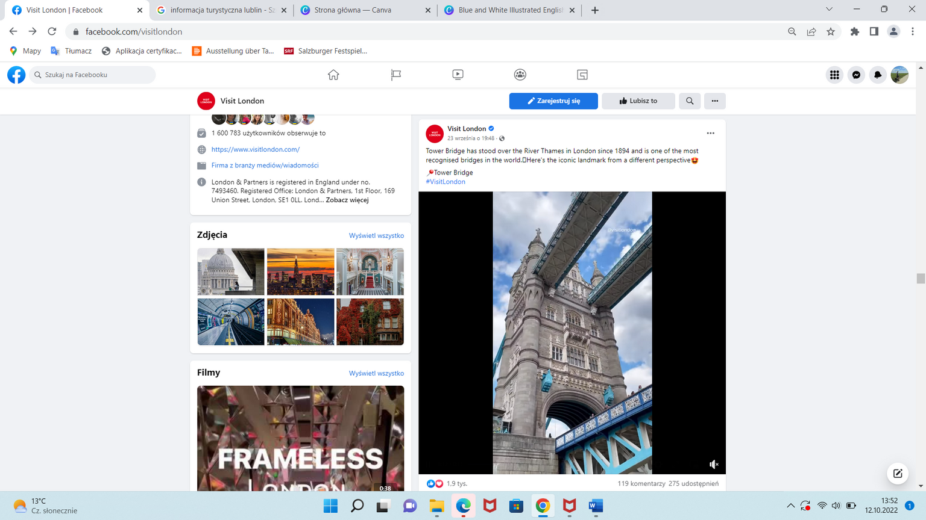
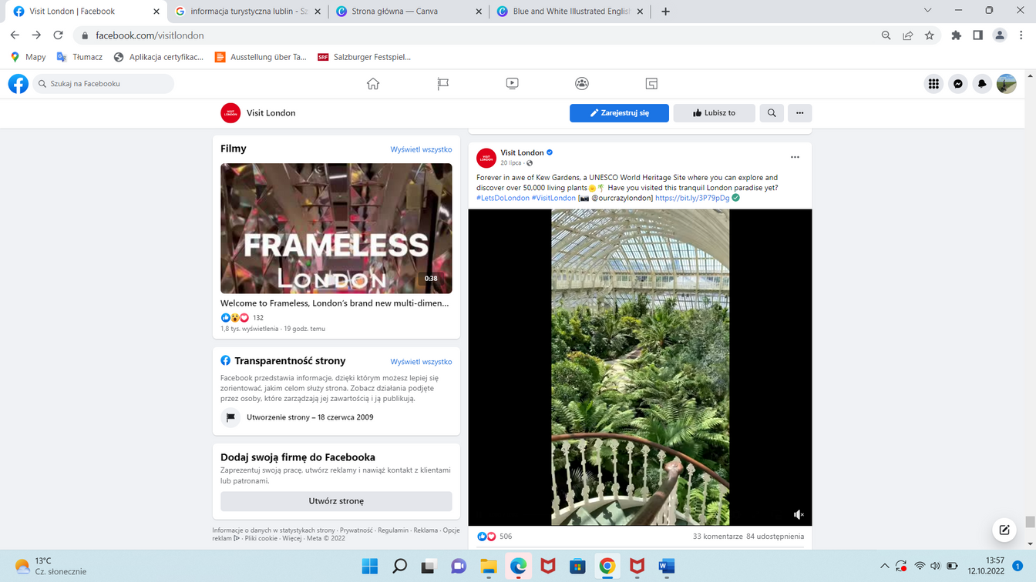
Facebook.com/VisitLondon

Slide 14
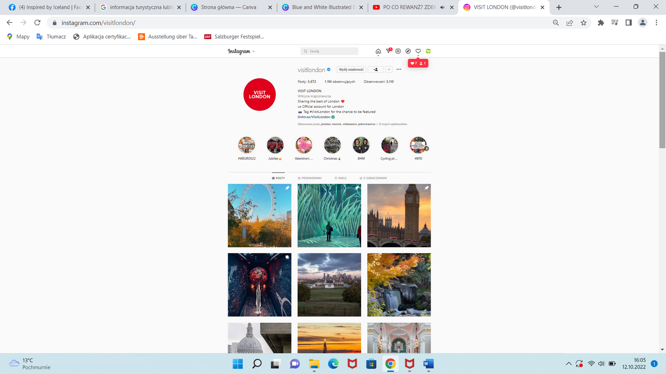
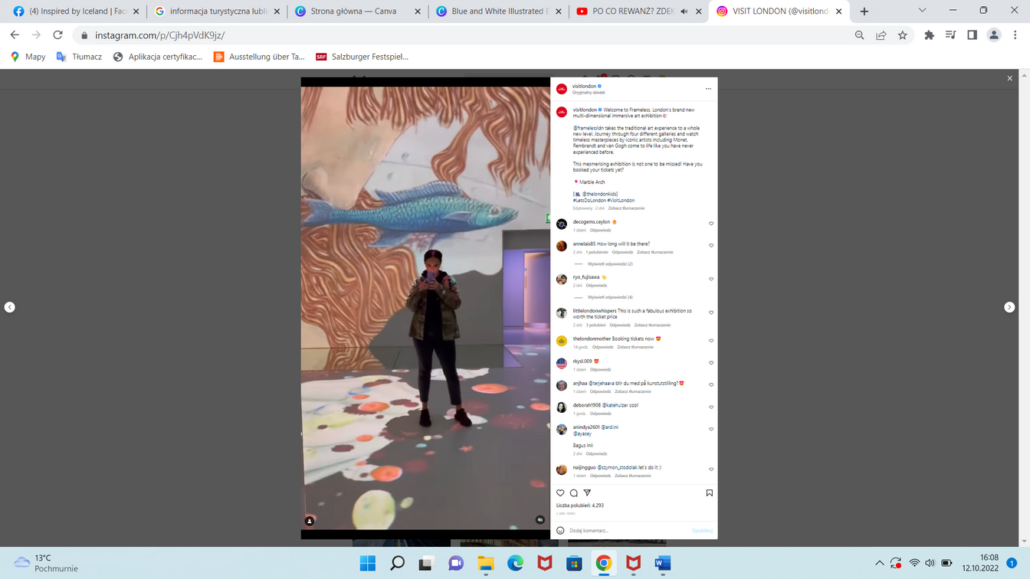
Instagram.com/VisitLondon

Slide 15
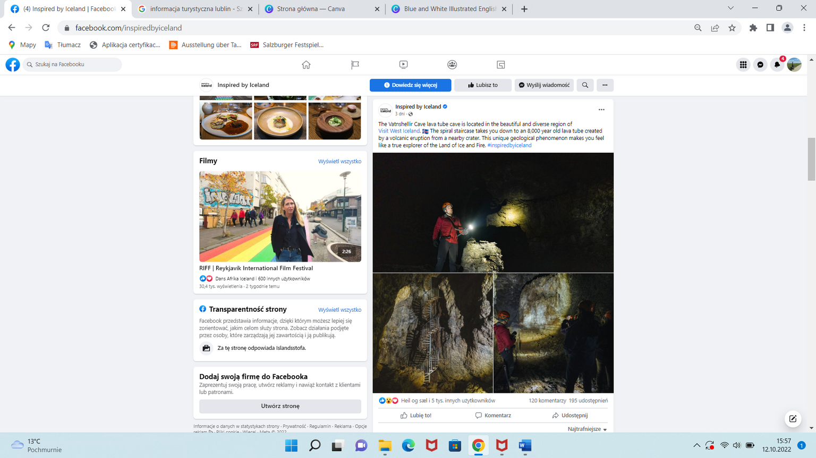
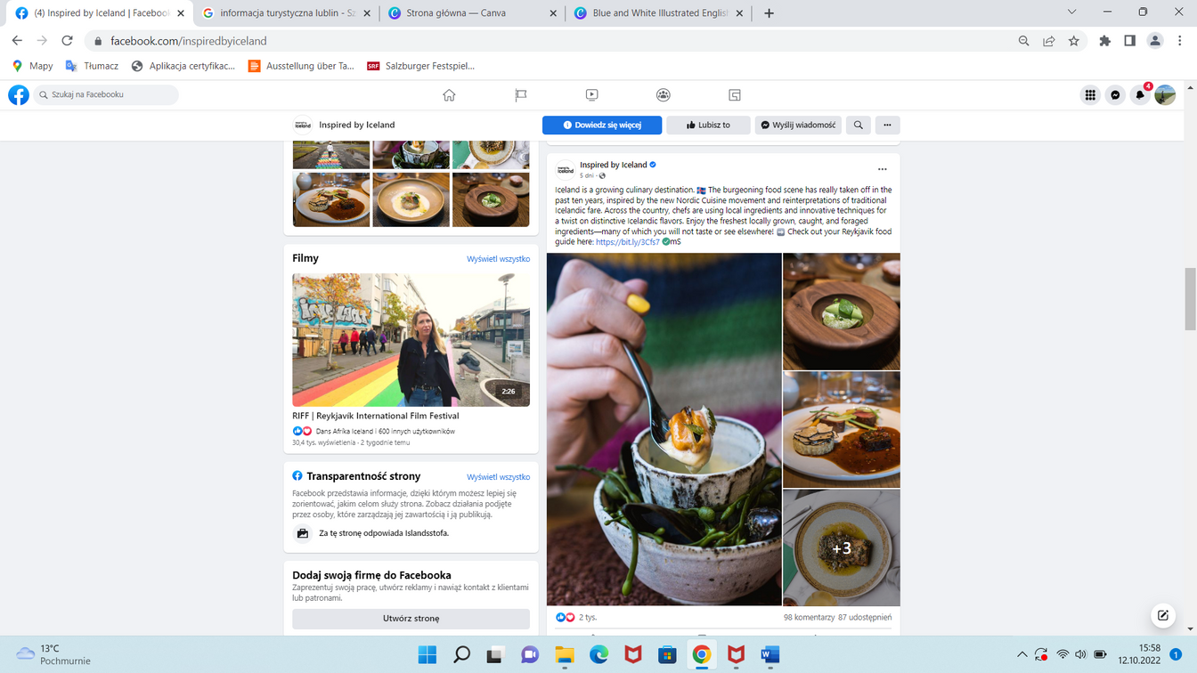
Facebook.com/InspiredByIceland

Slide 16
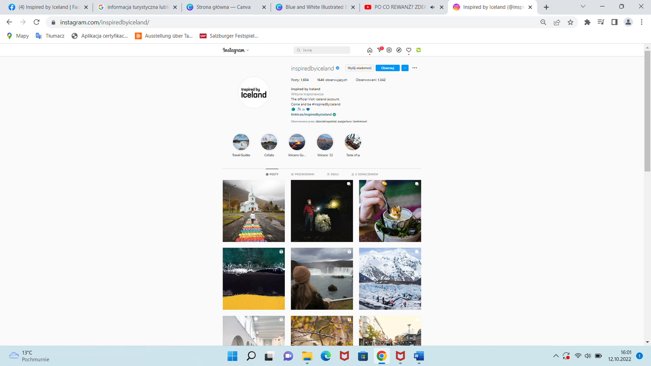
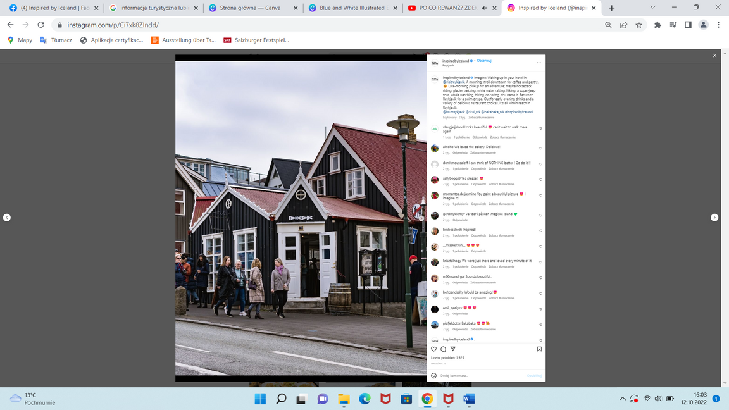
Instagram.com/InspiredByIceland

Slide 17

Stage 2: Rules for building effective content on Facebook

Slide 18

Short, catchy content
It is worth to create short, catchy content to avoid boring the viewer

Slide 19

Call for action
Give your audience a reason to respond to your post - ask for feedback

Slide 20

Use emojis
Emoji express emotions, and thanks to their colours they have positive effect on the visibility of the posts

Slide 21

Publish interesting photos and videos
This element most often determines whether the recipient will stop while browsing the posts

Slide 22

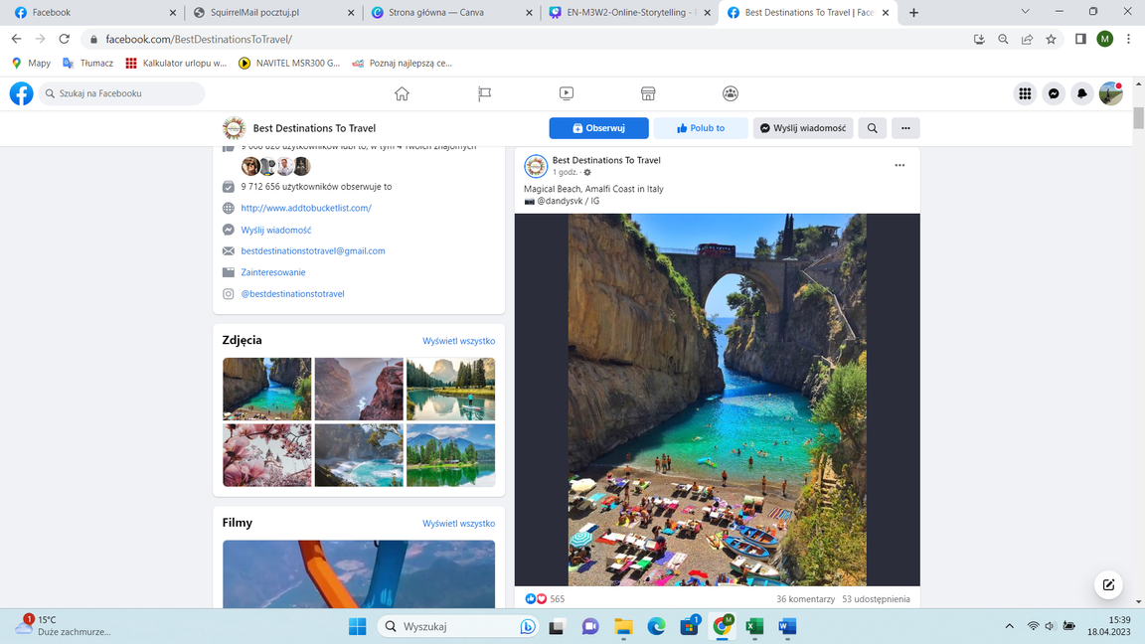
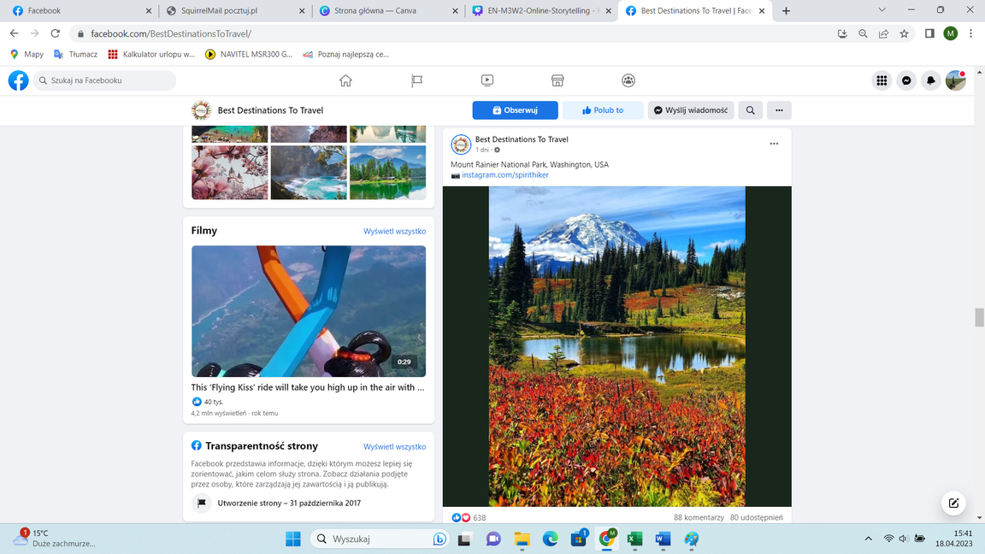
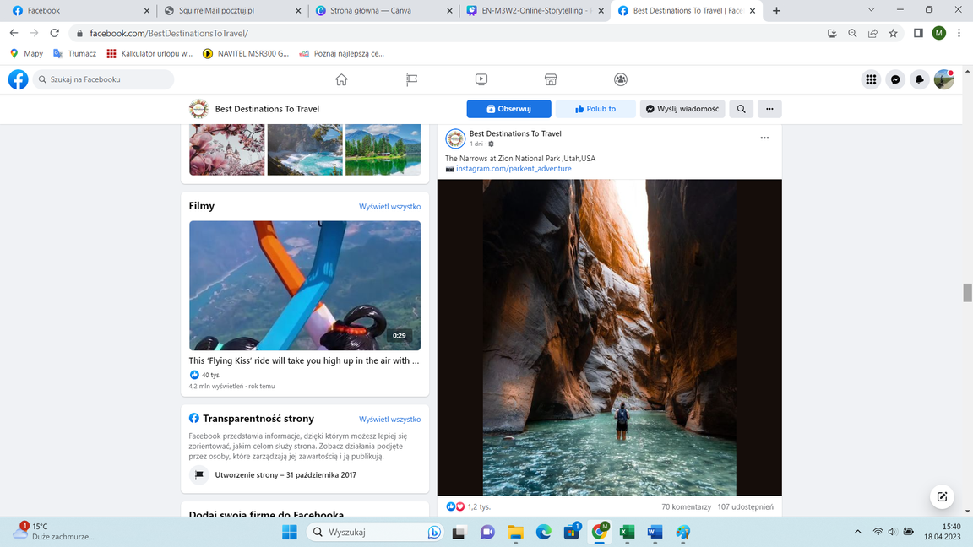

Slide 23
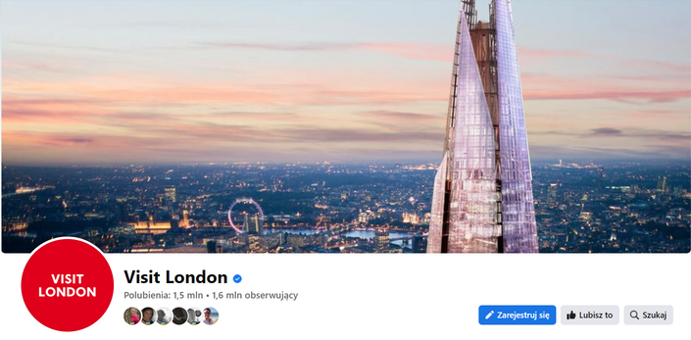
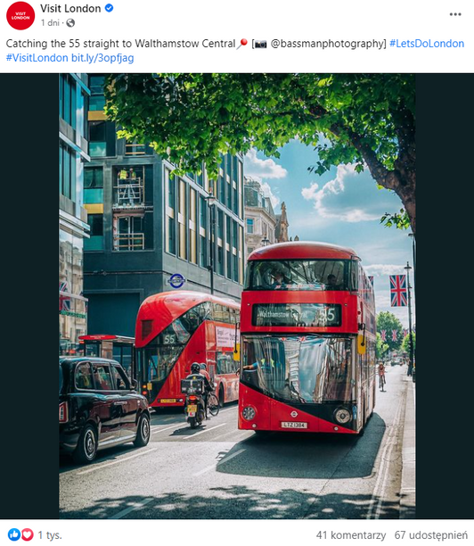
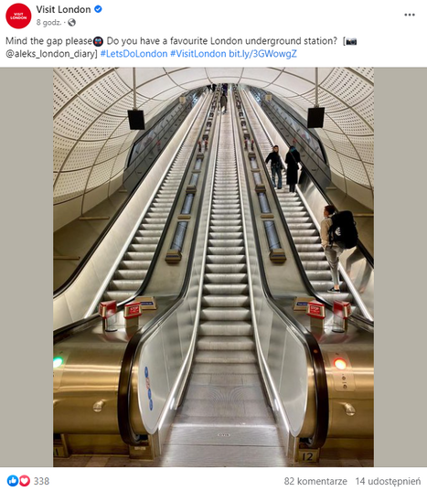

Slide 24
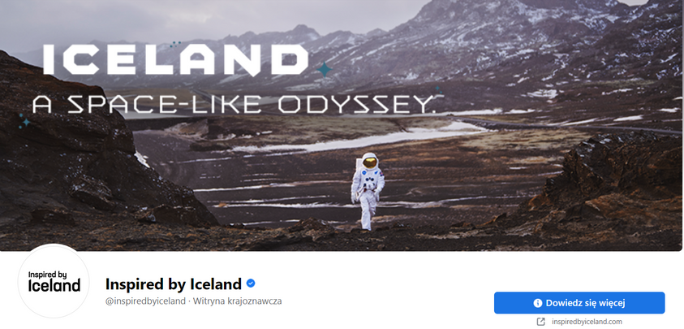
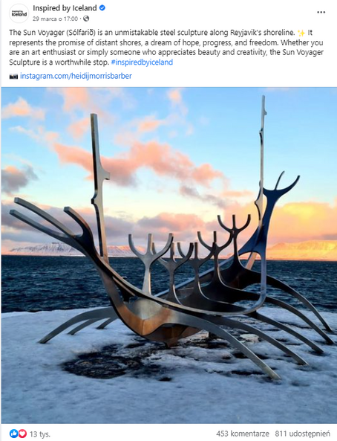
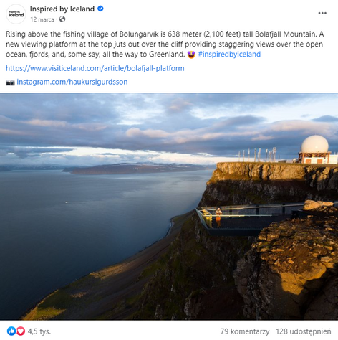

Slide 25

Stage 3: How to write interesting texts? A guide

Slide 26

IDEA!
#1

Slide 27
WHO IS YOUR RECEPIENT?
Identify who you are writing to and why should someone read your text
#2

Slide 28
Make sure the title is good
Use of keywords in titles matters for search engine optimization
#3

Slide 29
Address the reader directly
#4

Slide 30
Be concise
Try to divide
compound sentences
into singular ones
#5

Slide 31
Look for imagination-stimulating comparisons, metaphors and stories
#6

Slide 32
Avoid the passive side, denials, generalities, platitudes and specialist vocabulary known only to you
(Unless you are writing a text
dedicated to specific industry)
#7

Slide 33
Use bullet points
#8

Slide 34
Check the text
Take a walk, get some sleep and check the text again
#9

Slide 35
Edit and update previously published texts
This will positively affect the positioning of texts and lengthen their life
#10

Slide 36

Stage 4: How to write interesting texts?
EXERCISE

Slide 37

EXERCISE:
Write a text about the place shown on the card you received, using the knowledge gained during the workshop
Work in pairs. Exchange texts with your partner and share your observations

Slide 38

LET’S TALK

Slide 39

Stage 5: Summary and conclusion

Slide 40
Think about who your audience is and what goal you want to achieve
Tailor your content and message appropriately to the type of social media

Slide 41
A photo or graphic is an important part of communication and a key to effectively draw attention to the content

Slide 42
Draw inspiration from the best practices available online,
stay up-to-date

Slide 43
Remember that social media posts like short and concise forms

Slide 44
Check the text carefully before publication

Slide 45

THANK YOU
FOR ATTENTION

Slide 46


