Slide 1
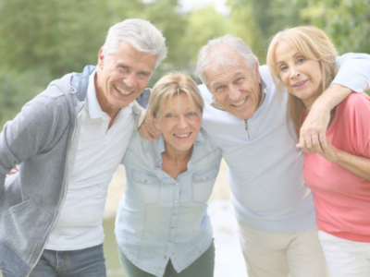





DIGITAL COLLECTIONS OF CULTURAL HERITAGE
Learn how to promote culture and art of our territory through innovative digital channels
M3W3-M01

Slide 2
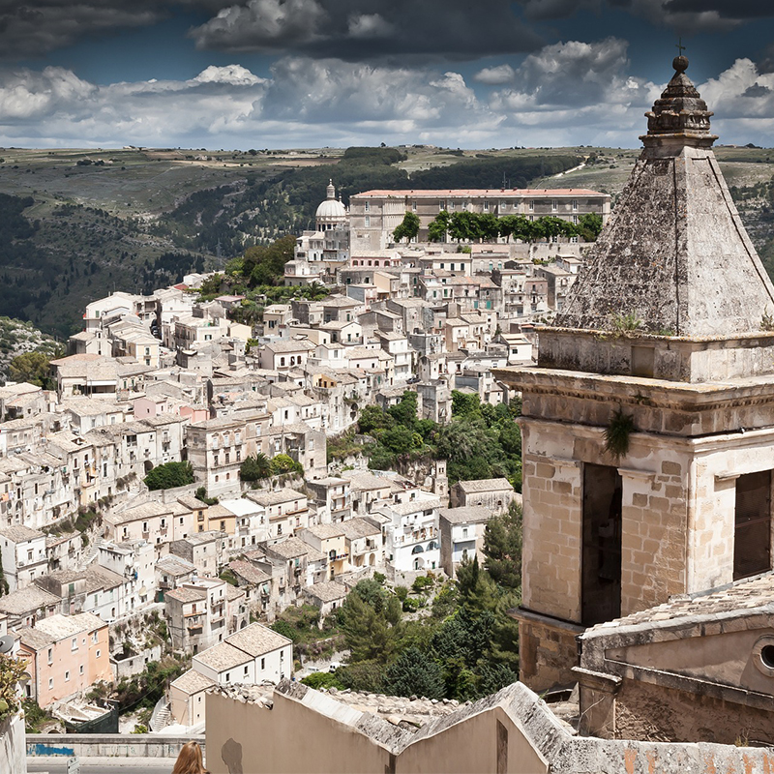
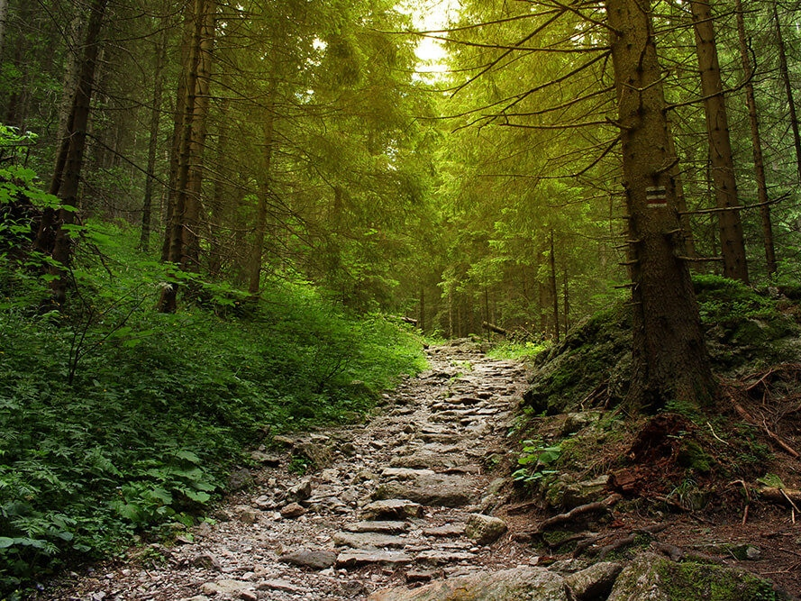
Cities, countryside villages, natural beauty: all the world is full and rich of natural wonders that often are not well known.
How could we present to the world al the fantastic cultural heritage or natural beauties that surround us?
How, in practice, we could promote the potential of cities and areas green, peaceful and rich of art and traditions?

Slide 3
01
Virtual museum
It is a completely digital communication channel that shares only some characteristics of what we usually refer as "traditional" museum.
It aims to improve and increase the museum experience through forms of personalization, interaction and enrichment of the museum's contents.
It can be presented as a digital reference of a physical museum, or also it can be made as independent museum

Slide 4
Virtual museums
The virtual museum’s main aspects are:
Being accessible to the public, widely thanks to the digital
Allow to everyone to access to knowledge related to cultural heritage contents (pictures, video etc.)
Organize material in a coherent and systematic way, keeping the cultural contents accessible for a long time

Slide 5
Virtual museum
In EU, the process of adapting to the new digital tools was gradual but remarkable: virtual museum of cities and countries, becoming an opportunity during the pandemic period. The impossibility of accessing physical museum brought to new digital solution that changed the ideal of traditional museum, inserting video tours, audio guides and other digital elements that could give a wide sharing of the cultural heritage.
In specific, today digital communication has undergone a change of direction, from an exclusively promotional and informative purpose to an attractive storytelling, aimed at getting to know what the museum offers and its modern interpretation.

Slide 6
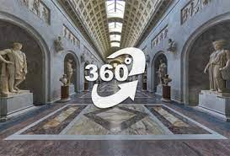
The virtual tours of the civic museums offer a full-screen visit of the rooms and allow a virtual experience for all that goes beyond the limits of space. Using the mouse and keyboard, clicking on the hotspots inserted in the rooms and browsing the interactive maps, the visit is deepened with context elements: photos, videos and texts and the path is freely chosen by the visitor.

Slide 7
02
Blog
The blog is an online diary that allows you to create content in chronological order. The structure resumes that of a diary, each page has a date and an address of recognition (permalink). The main difference compared to a website is its continuous evolution.

Slide 8
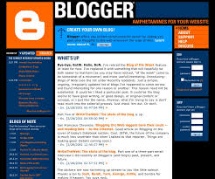
Blog
The flora and fauna of a place, for example, could be explored in ad hoc articles, with a detailed account of the park, structured in many small chapters.
If we link to each of these chapters a valuable content, an element of strong interest for the user whose use is bound to the insertion of some data, we will be able in one fell swoop to collect contacts of people interested in the territory and divide them into based on your interests.

Slide 9
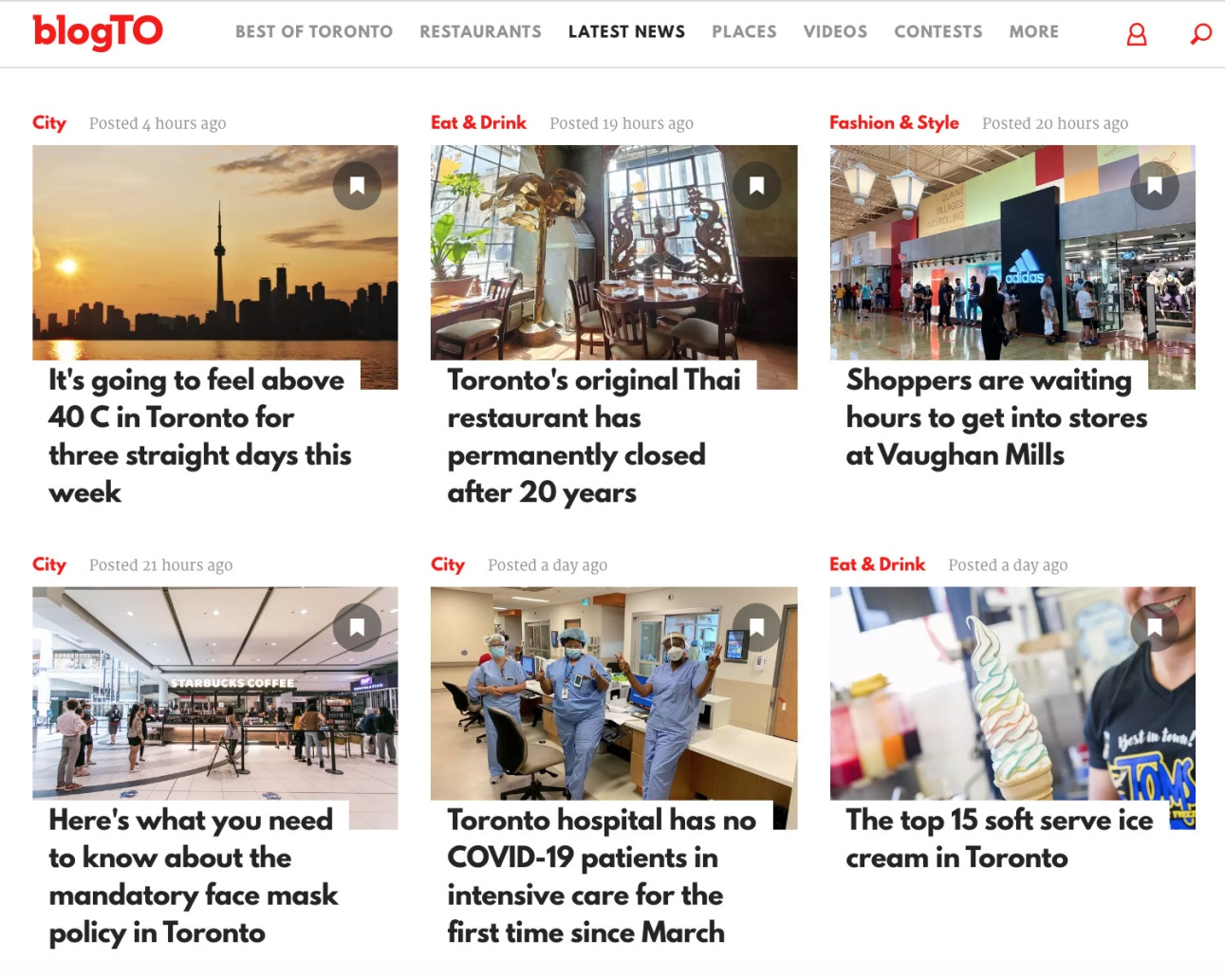
Blog
If the user interested in these contents enters an e-mail address to access it, we will be able to contact him again to offer him other contents tailored to him.

Slide 10
03
Digital Libraries
The digital library is an intangible library, in which only digital documents are stored and made available, whether they are digital natives or converted from paper originals, managed and cataloged electronically. Each operation can be carried out via the network from home, from the studio, from the classroom or from the office.

Slide 11
Digital Libraries
The actual conversion takes place by superimposing a dense grid of pixels on the analog image: the denser the grid, the greater the number of pixels and therefore the illusion of seeing an image that is completely faithful to the original.
A digital book consists of a collection of texts and / or images obtained through acquisition through analog to digital conversion tools. By "digitization" we mean the conversion of an image into pixels (English contraction of picture elements).

Slide 12
Digital Libraries
The major advantage is that it allows you to take even large maps and acquire the image without the need to manipulate books that are too old and therefore fragile and easy to deteriorate; it is a very useful technique for digitizing old manuscripts or books.
Three parameters are usually used to evaluate the digital image created:
Resolution, which refers to the number of pixels used to represent an image
The bit depth per pixel, which refers to the number of colors that can be represented depending on the number of possible combinations of bits within a pixel
Color, there are many ways to represent images in color and the most common is RGB (additive color system) which combines variations of red, green and blue to form white.

Slide 13
Digital Libraries: how are they created?
01
02
03
04
Log in to your Google account
Add books to your library
Personalize the library with reviews, ratings and labels
Share your library with whoever you want
Your library is now online, you can share it with your friends by giving them the direct link, simply copy the URL of your library.

Slide 14
“The meeting of art”
Exercise for single person.
Each participant must describe (draw) a representative work of their municipality and exhibit it to the other participants. In the end, the group will have to choose the work that has been most accurately described and that particularly impressed the other participants (not their own work).

Slide 15
“Guess the monument”
Exercise for the group, also possible to do alone.
Deliver a document with an important monument and the group must search the internet for basic information and know how to communicate it to the other groups who will have to guess the monument in question.

