Slide 1
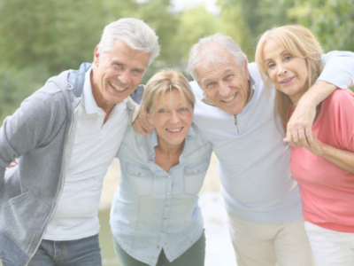





INTERNET AND ITS DANGERS
Conscious use of the network
M3W4-M01

Slide 2
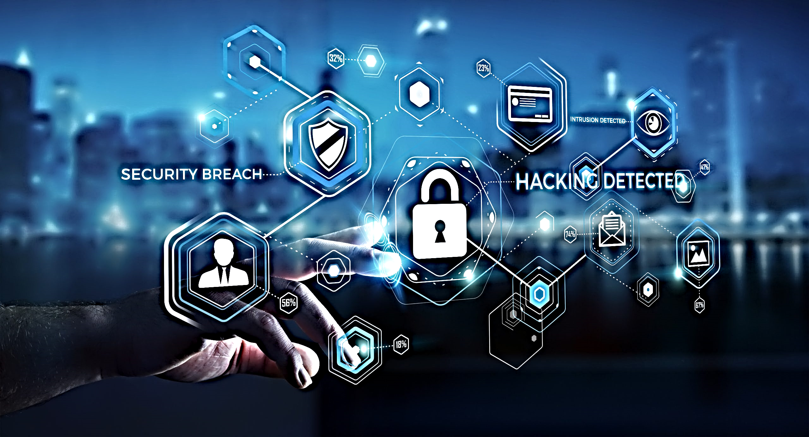
Internet and its dangers
CONSCIOUS USE OF THE NETWORK

Slide 3

ARGUMENTS:
What is the Internet and why can it be dangerous?
The daily risks we expose ourselves to (social media, e-mail, blogs, etc.).
Common and most dangerous attacks
Privacy and copyright

Slide 4
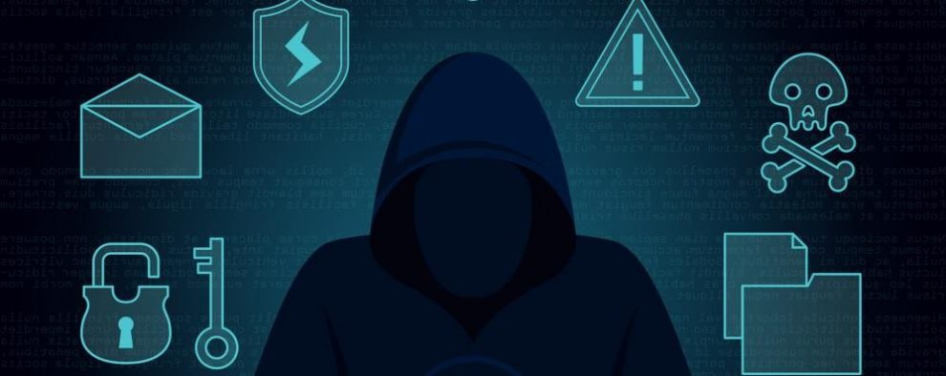
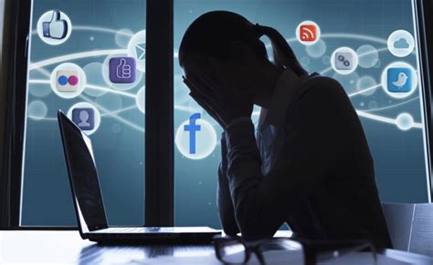
THE INTERNET AND ITS RISKS
The Internet is the global connection of the world
Web browsers, mail, chat and social networks allow us to search, communicate and express ourselves with anyone who uses the net.
All the information we put on the web will stay there forever.
You should always THINK before posting personal information on the network.

Slide 5
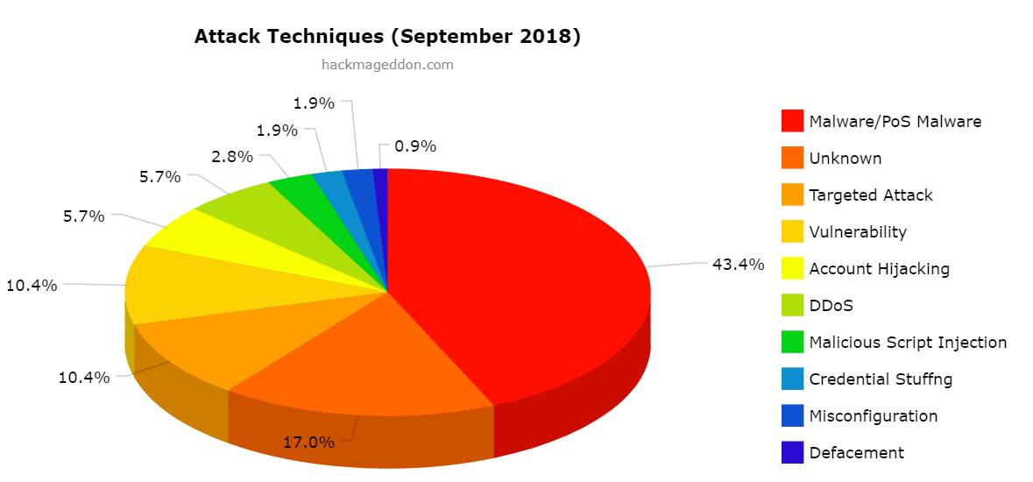
RISKS AND ATTACKS ON THE WEB
Sharing personal information
Cyber attacks : Phishing , Viruses , Spamming, Social engineering
Lack of awareness in the daily use of web tools (Browser, links, social networks)

Slide 6
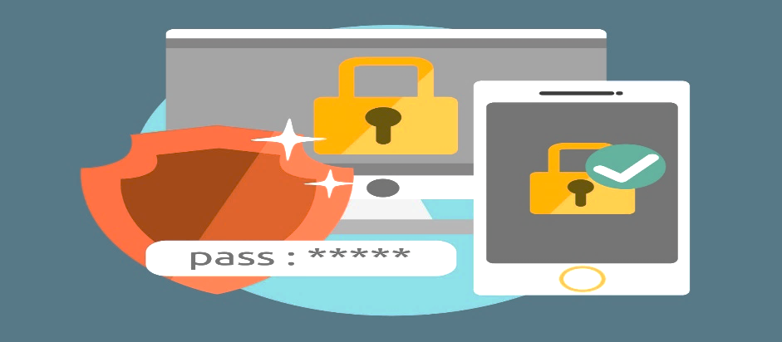
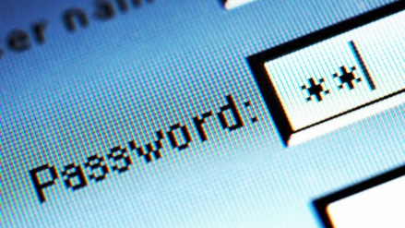
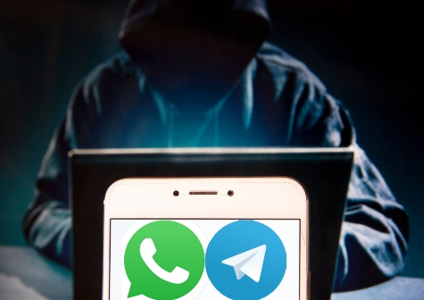
NETWORK PROTECTION
The first protection is PREVENTION (updates, backups, strong passwords).
Protecting our data and the tools we use to surf the Internet is the first step to using it safely and consciously.
Do not click on ads or links promising easy money or free products
Only browse and download online from trusted sources (HTTPS, official sites, etc.).

Slide 7
ONLINE INFORMATION
Safe :)
NOT safe :(
Websites using HTTPS protocol
Complex PASSWORDs with special symbols
Acting with awareness and respect towards others (social media, blogs...)
Websites that do NOT use the HTTPS protocol
DO NOT share your credentials with anyone!
IGNORE software and antivirus updates

Slide 8


HTTP HTTPS
PROTOCOL IN THE CLEAR
HTTP does not provide for any encryption or authentication, so data travel in the clear and are potentially intercepted by anyone;
It is NOT appropriate if the site contains sensitive information (login screens, payment windows with credit card data entry, etc.).
SECURE PROTOCOL
Encrypted protocol, i.e. it is difficult to intercept from the outside (avoiding cases of potential SNIFFING of the connection);
It includes various types of certificate, which attest to the veracity of the site in the user's browser (thus avoiding the risk of phishing);

Slide 9
PRIVACY
PRIVACY IS A FUNDAMENTAL RIGHT FOR EVERYONE!
LAW 196/2003 GDPR EUROPEAN PROTECTION
ALWAYS PAY CLOSE ATTENTION TO THE CONDITIONS YOU ACCEPT WHEN SUBSCRIBING TO A SERVICE
TIPS: COMPLEX PASSWORDS, DIFFERENT PASSWORDS FOR EACH APP OR SERVICE USED, TWO-FACTOR AUTHENTICATION (E.G. TOKEN OR BIOMETRIC UNLOCKING)

Slide 10
COPYRIGHT
THE USE OF IMAGES OR VIDEOS TAKEN FROM THE WEB WITHOUT THE CONSENT OF THE OWNER OR THE PERSONS DIRECTLY INVOLVED CAN LEAD TO SERIOUS CONSEQUENCES
INFORM YOURSELF BEFORE PUBLISHING ANYTHING THAT DOES NOT COMPLY WITH THE PREVIOUS POINT

Slide 11

TIPS ON CORRECT USE OF THE INTERNET
NOT PROVIDING TOO MUCH PERSONAL INFORMATION
USE DIFFERENT PASSWORDS FOR EACH SERVICE
UPDATE YOUR TOOLS
ONLY TRUST OFFICIAL WEBSITES AND APP STORES TO DOWNLOAD MATERIAL

Slide 12
THE FIRST DEFENCE IS YOU!!!

