Slide 1







MULTIMEDIA FOR PROMOTING CULTURAL HERITAGE
Smartphone filmmaking workshop part 1 - creating simple story-telling scenarios
M4W2

Slide 2
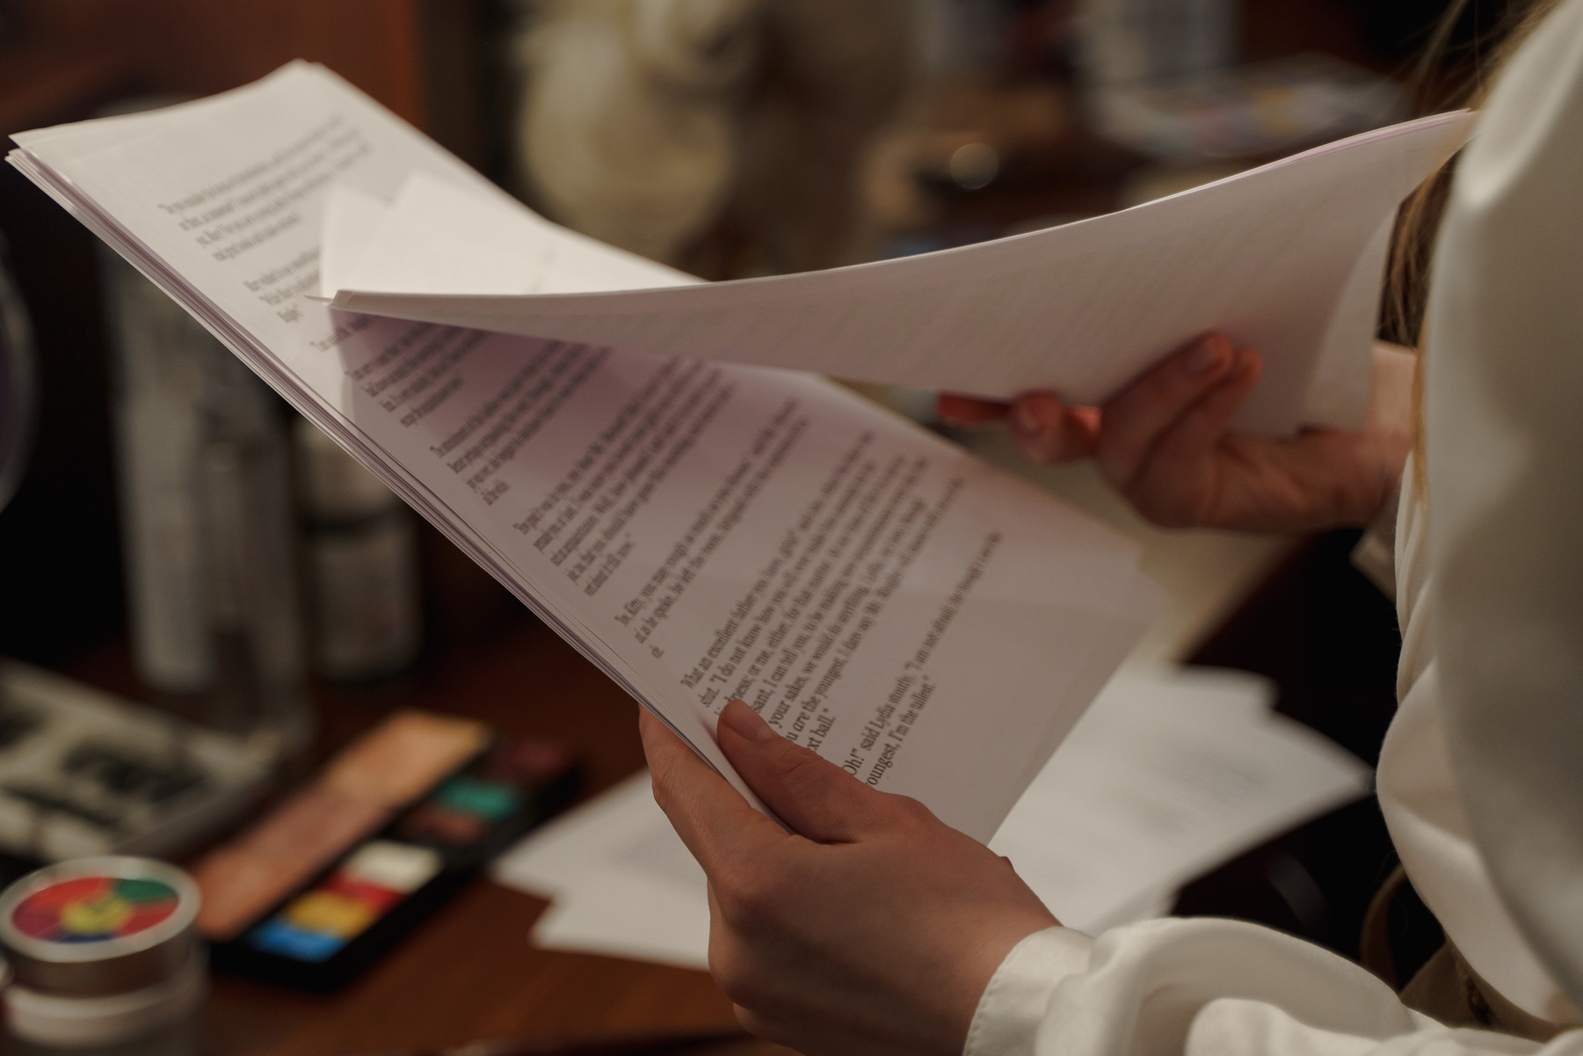
Stage 1: What is a film script?

Slide 3

Film script – the literary material on which the film is based, with narration in the present tense. Includes: dialogue, description of action, characters, places and time.

Slide 4

On the basis of the film script, a screenplay
- a technical plan for the production of the film -
is developed. including a detailed description of the subsequent scenes, set design and camera shots.

Slide 5




In addition to language issues, it is important to keep the various elements of the plan correct:
headline of the recorded scene
short description of the scene
actors
dialogue

Slide 6
headline of the recorded scene - it is usually marked with Arabic or Roman numerals. The digit is followed by the name of the scene in bold.

Slide 7
Short description of the scene
- characterisation of the set, description of the room, objects, behaviour of actors and context of the action.

Slide 8
Actors - character names are written in capital letters, separated by a dialogue module.

Slide 9
Dialogue – conversation between characters. They should be centred on the diagram of the document - as should the actors' names.

Slide 10
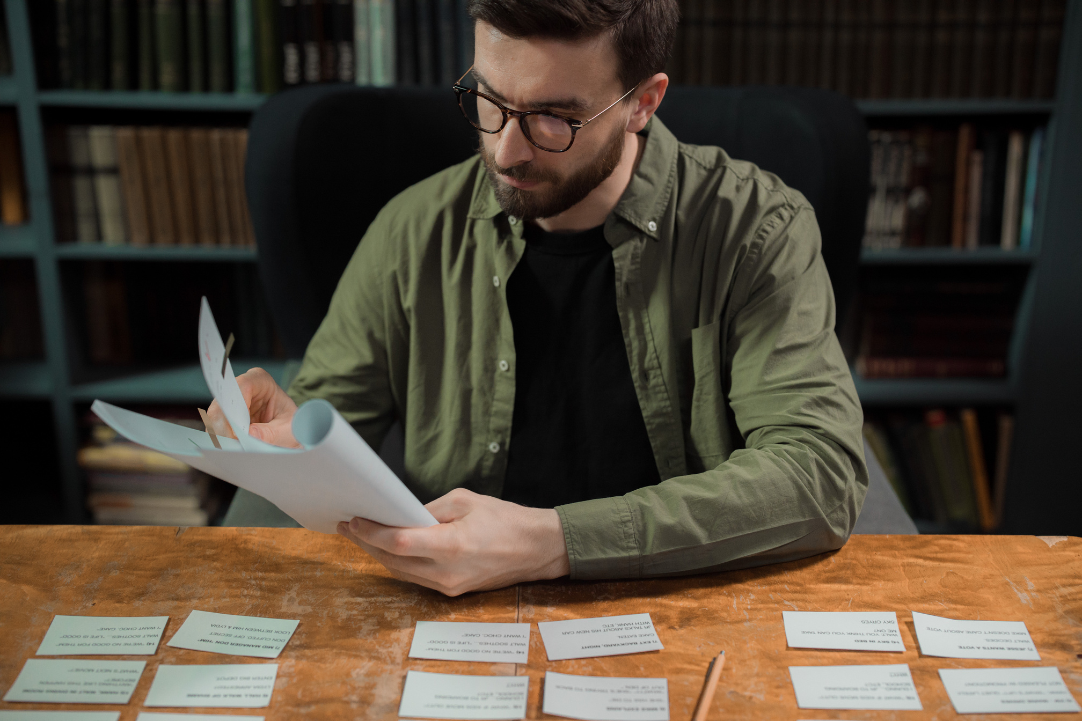
Stage 2: Conceptualising an interesting scenario

Slide 11

If our promotional video does not hold the viewer's attention within the first few seconds, we can be almost certain that the viewer will not watch it to the end.

Slide 12

If we want to convey too much the viewer will get tired and not make it to the end of the film.

Slide 13
Let's read our script and try to imagine the whole film shot by shot. Also consult it with several independent persons.

Slide 14

If, at the editing stage, any parts of the film seem boring or slow down the action - cut them out.

Slide 15

Use Storytelling, i.e. influencing the listener's imagination and emotions through "real life" stories.

Slide 16

What is most important? History. Originality. Interesting title.

Slide 17
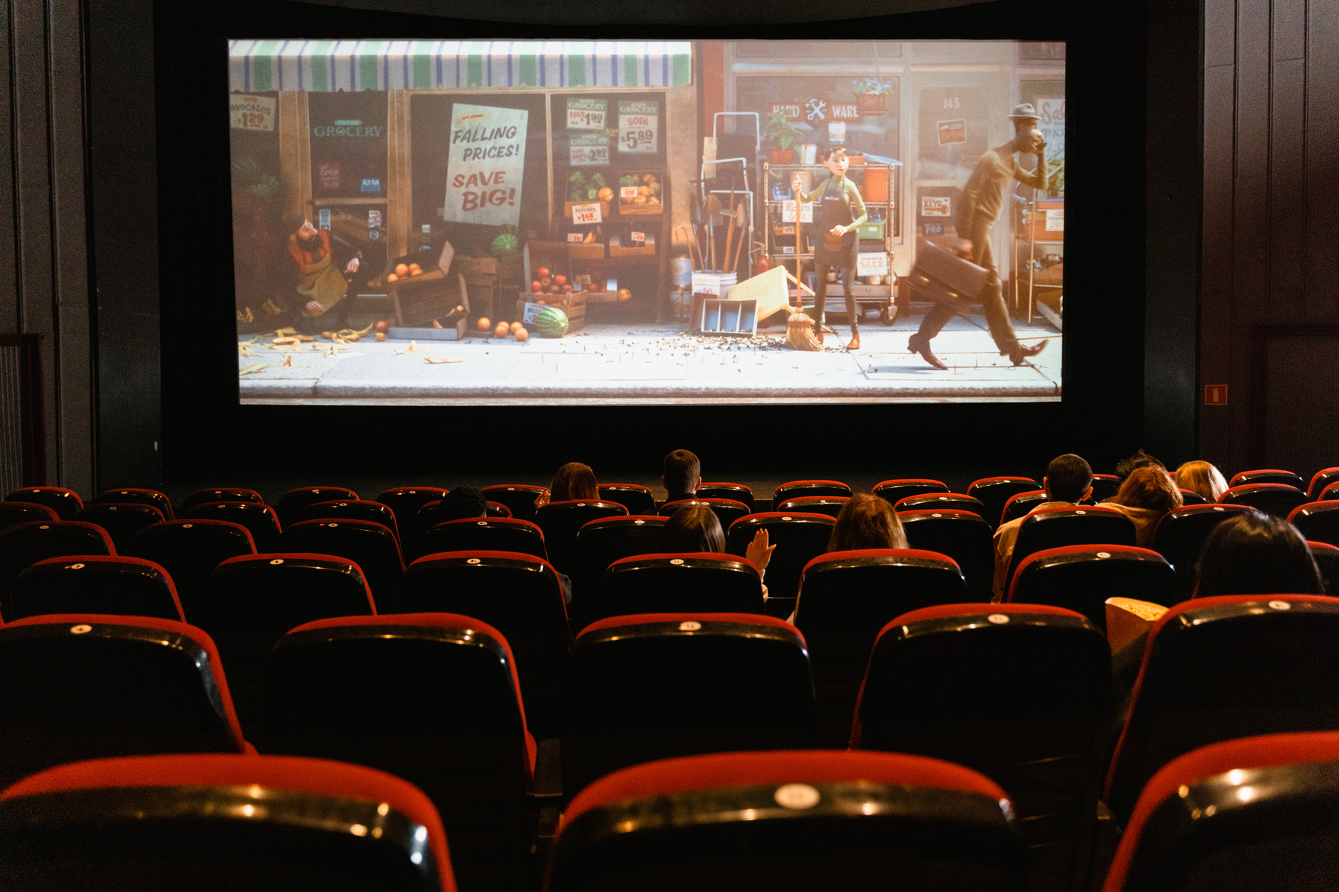
Stage 3: Scripting the films
- examples of good practice

Slide 18

In front of you are 4 videos made with different techniques and concepts.
Pay attention not to the content itself, but to how many possibilities there are for creating interesting video content.

Slide 19
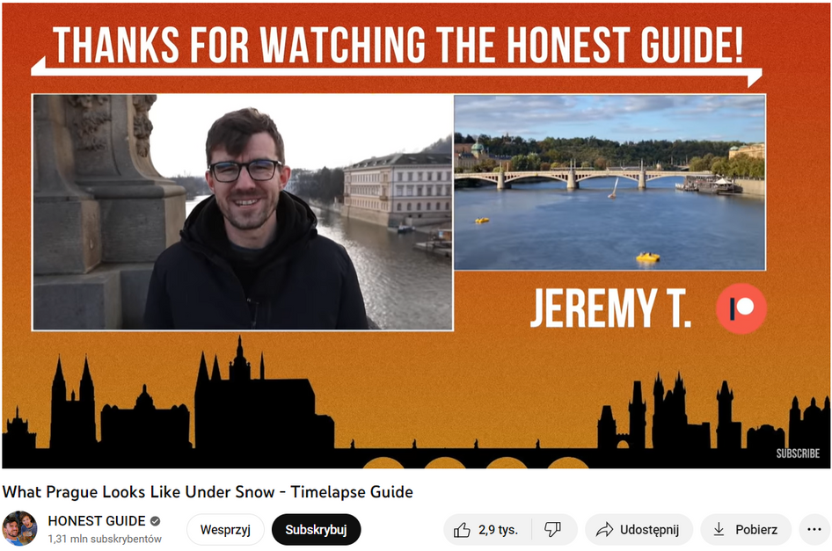

An honest guide
https://www.youtube.com/watch?v=UWIO2yG3DHk

Slide 20
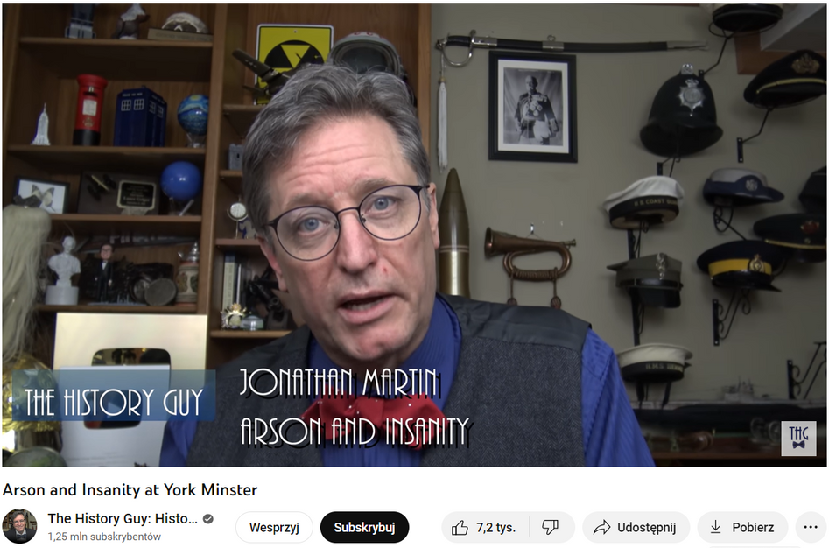
The history guy
https://www.youtube.com/watch?v=JDaauwvXysw

Slide 21
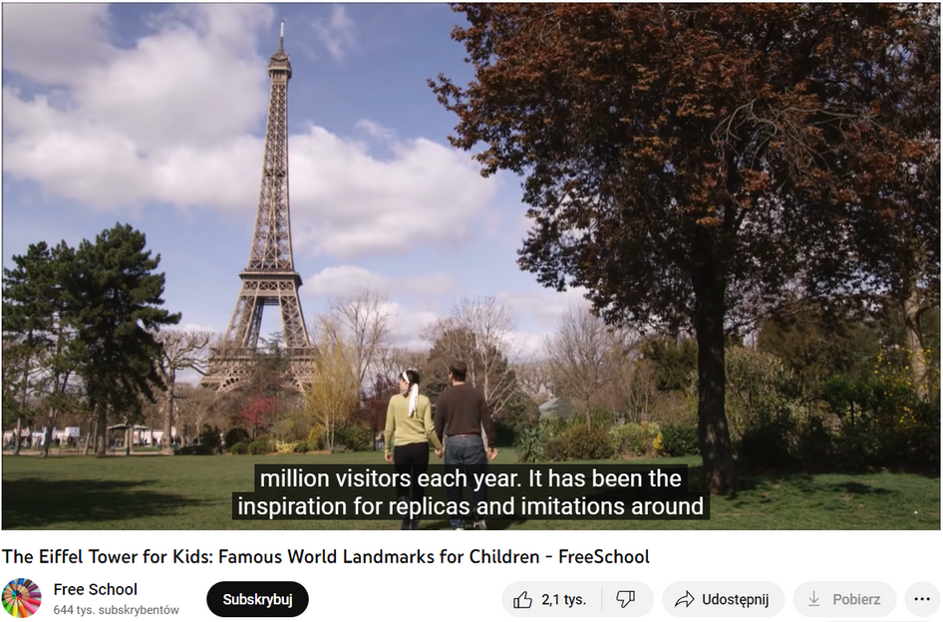
Eiffel Tower for children
https://www.youtube.com/watch?v=DUafW5QkASA

Slide 22
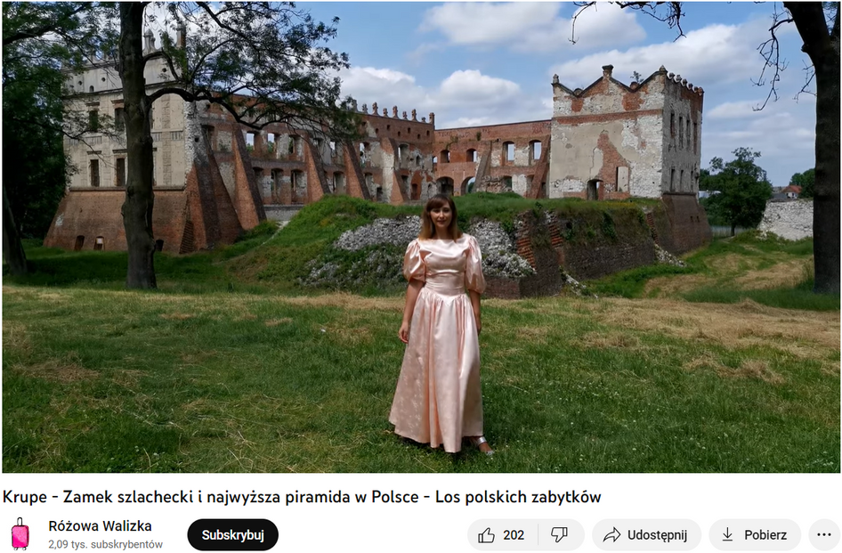
Pink Suitcase
https://www.youtube.com/watch?v=I5czYNgfPZs

Slide 23

Stage 4: Scriptwriting exercise

Slide 24

Scriptwriting exercise
Let's pair up, draw a theme scenario and write it!

Slide 25

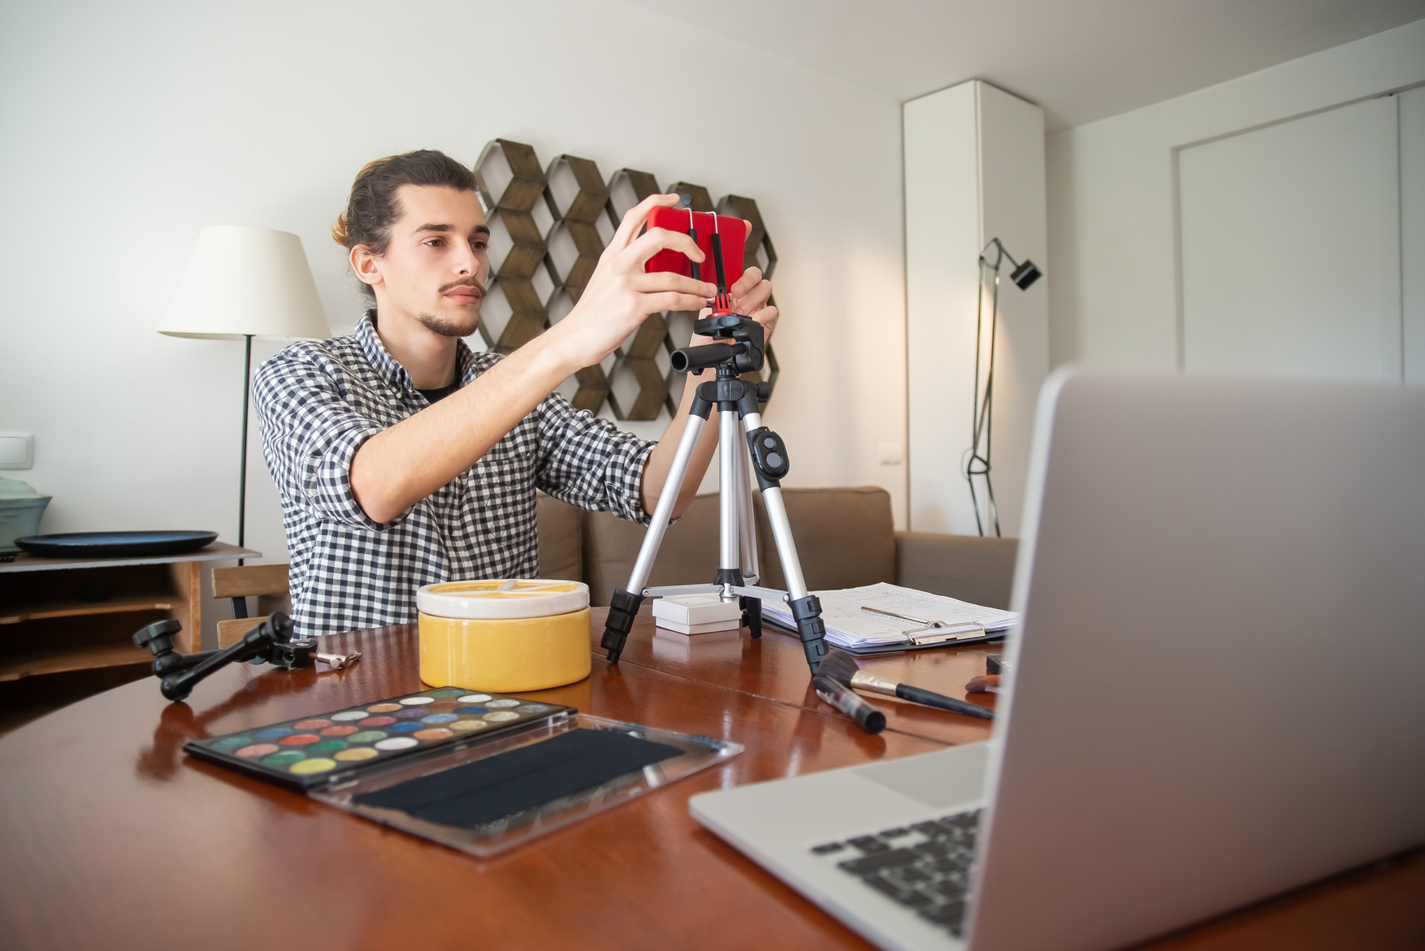
Stage 5: Conclusion

Slide 26

Think well of an interesting
film theme

Slide 27
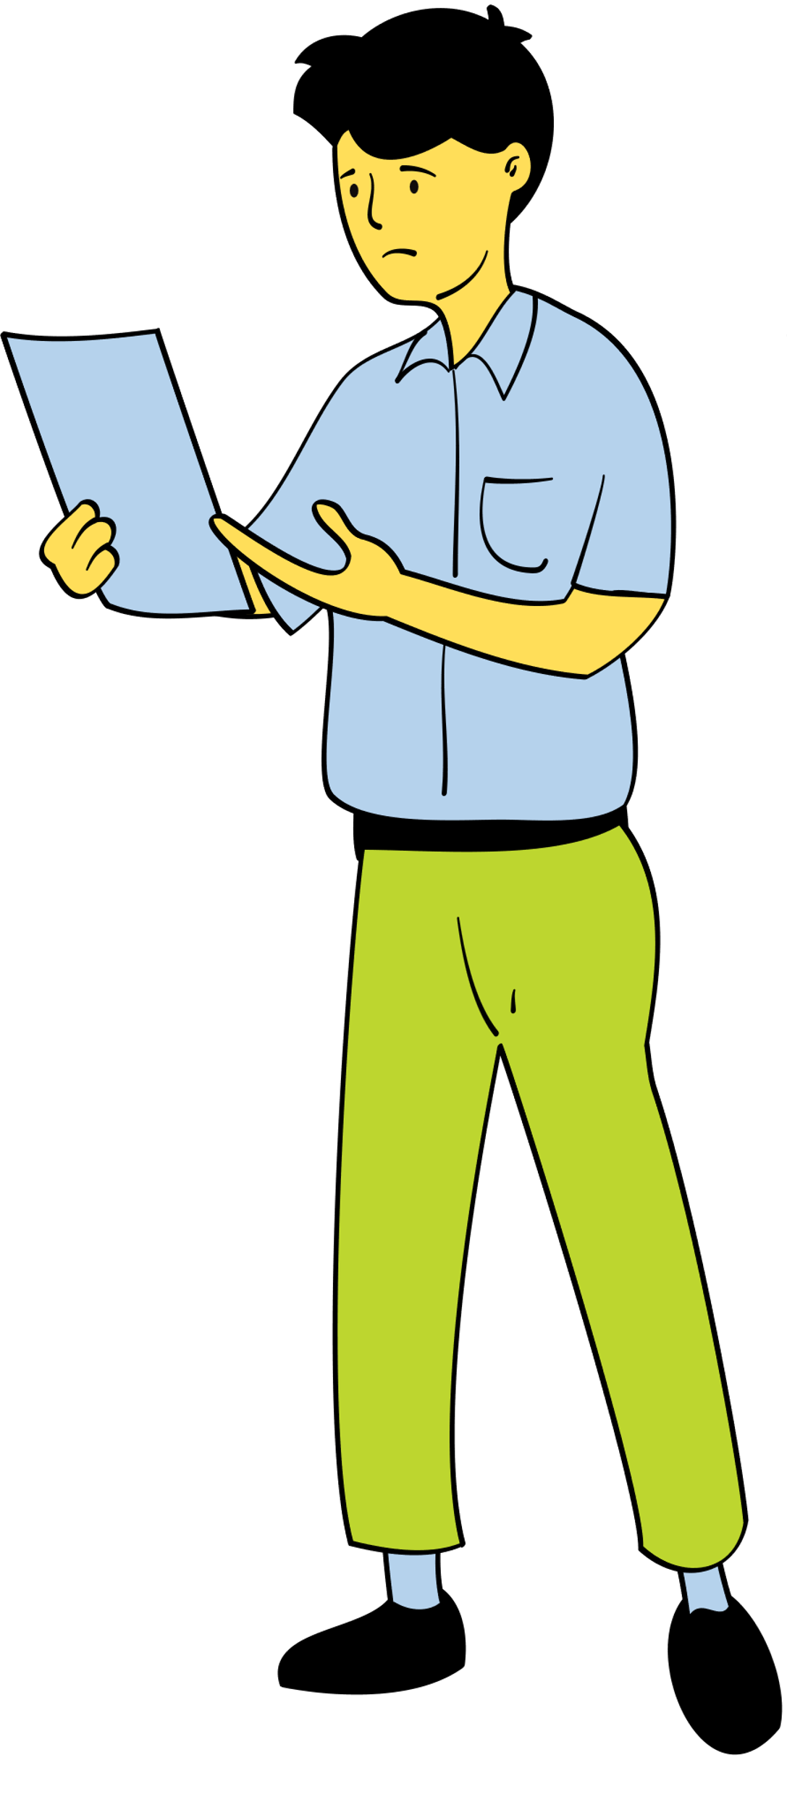
Prepare a concise original scenario

Slide 28

Try to include elements of Storyteling

Slide 29

Remember that the script
must engage the audience from the first second

Slide 30

Try to imagine the scenes of the film basing on the screenplay

Slide 31
Think of an intruguing title
tITLE!

Slide 32

Consult the script
with others

Slide 33

Thank you!

Slide 34



