Slide 1






SMART VIDEOMAKING
Your videos always with you
M4W3-M01

Slide 2
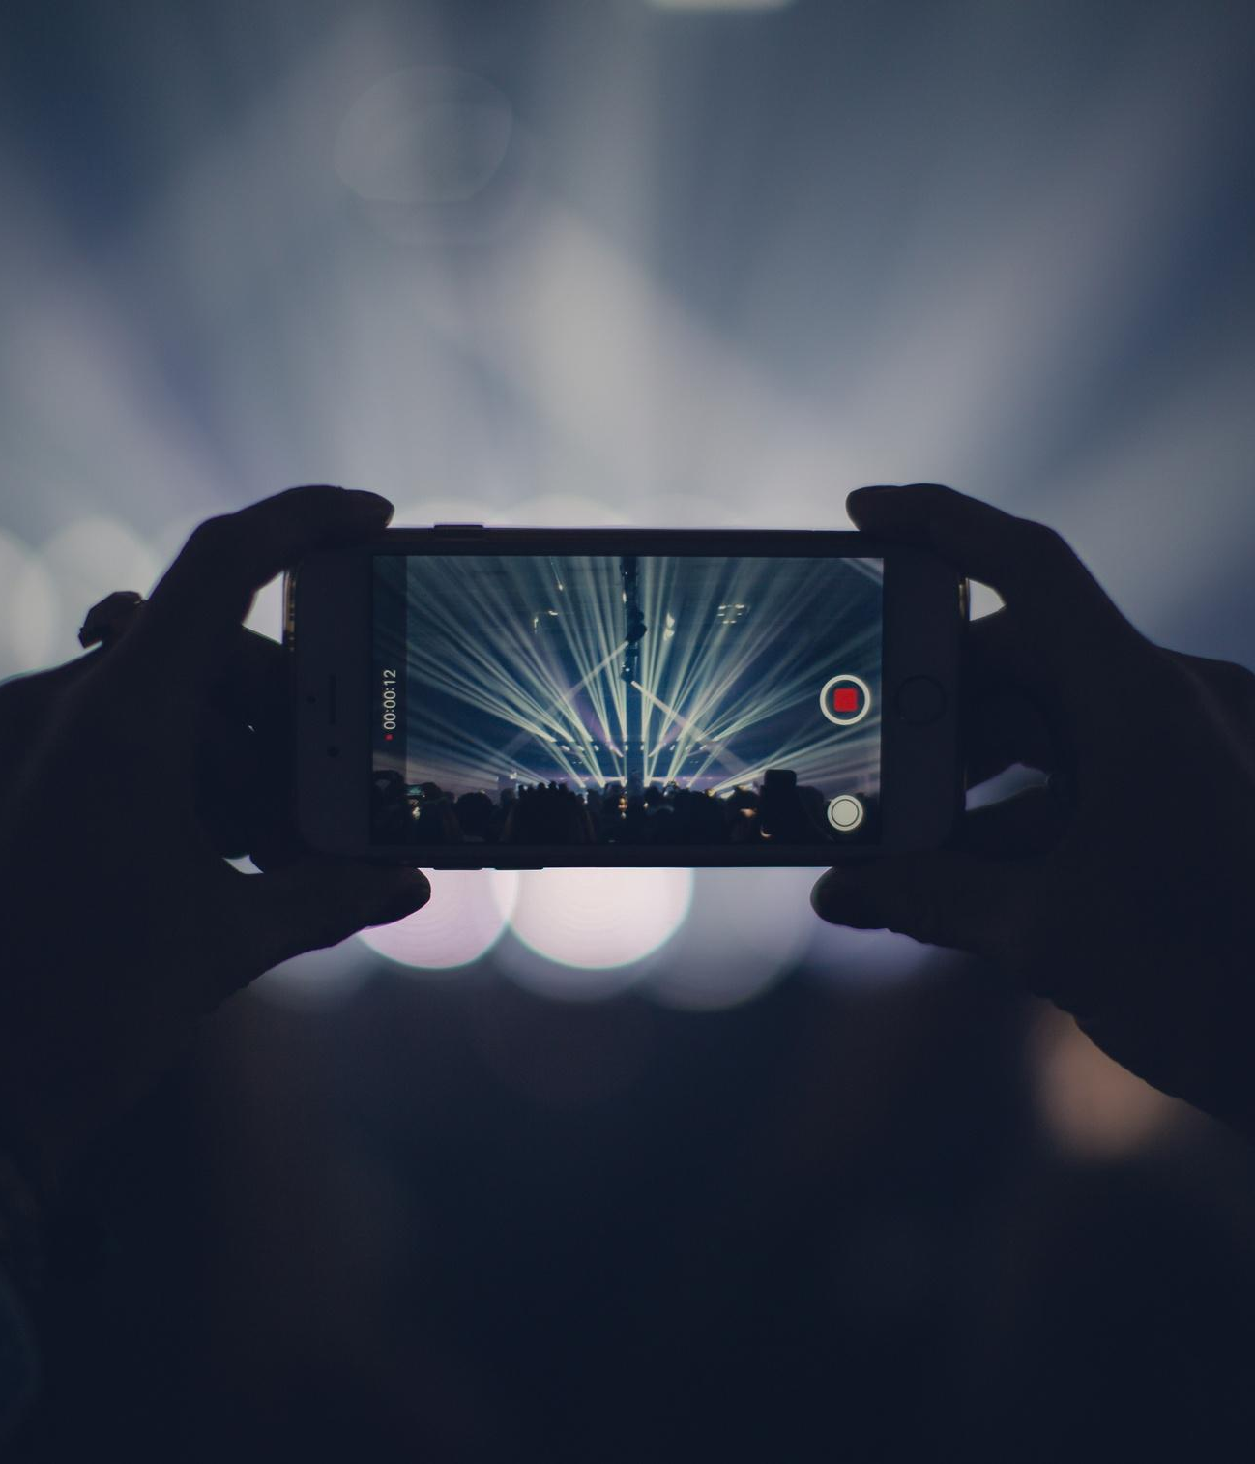
INTRODUCTION
Video is one of the most popular means of communication and dissemination in the world and through broadcasting channels such as computers, TVs and smartphones it reaches the attention of each of us.
Each video is different and unique depending on what you want to communicate.
We can in fact divide the videos into 3 main categories.

Slide 3
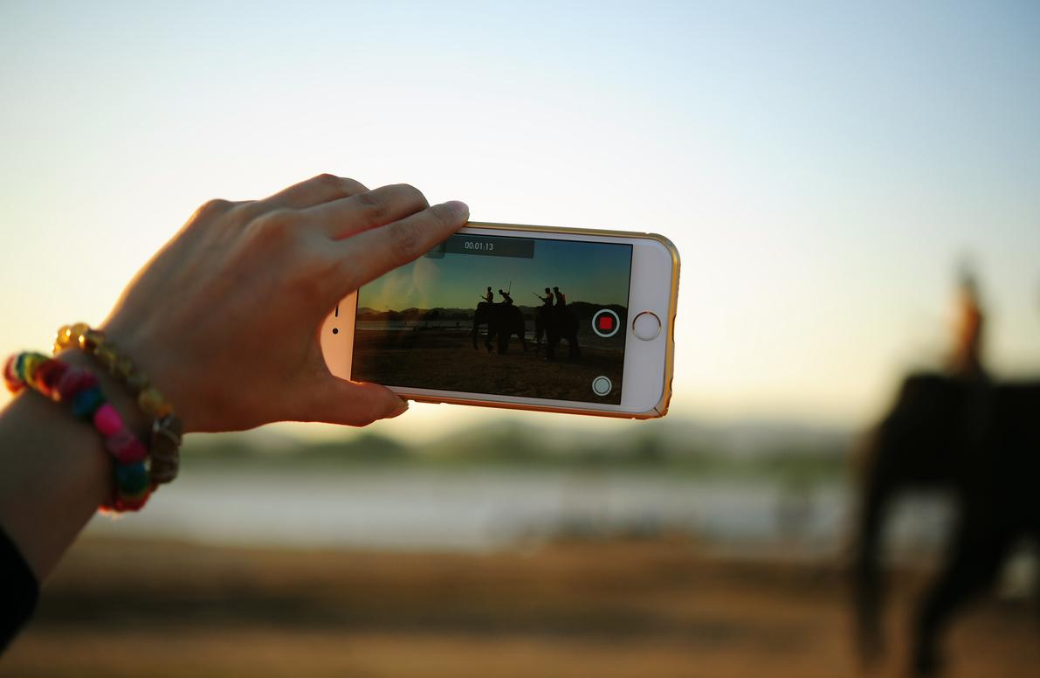
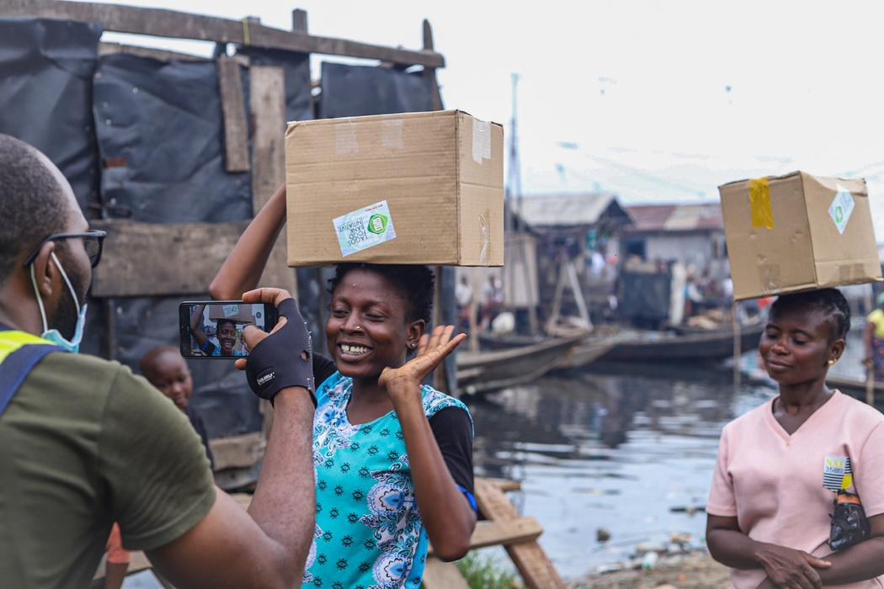
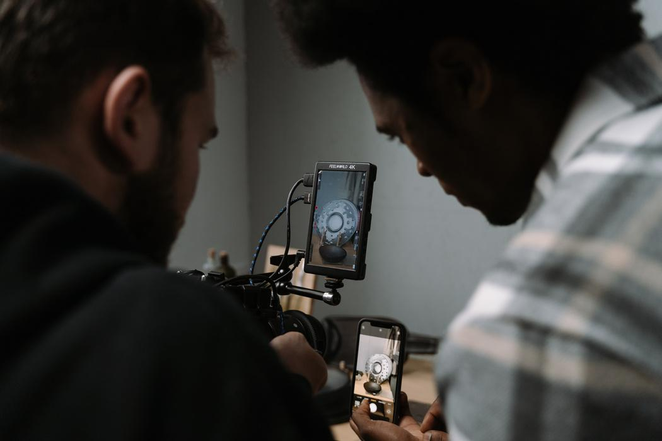
REGISTRATION
REPORTAGE
SHORT FILM
A common shot, very often vertically if made by a smartphone user, which does not involve any kind of post-production if not necessary.
Like a documentary, a reportage is nothing more than a collection of images that has the purpose of documenting an event or telling a story through testimonies.
The short is a type of video in which visual grammar and writing are fundamental for its realization.

Slide 4
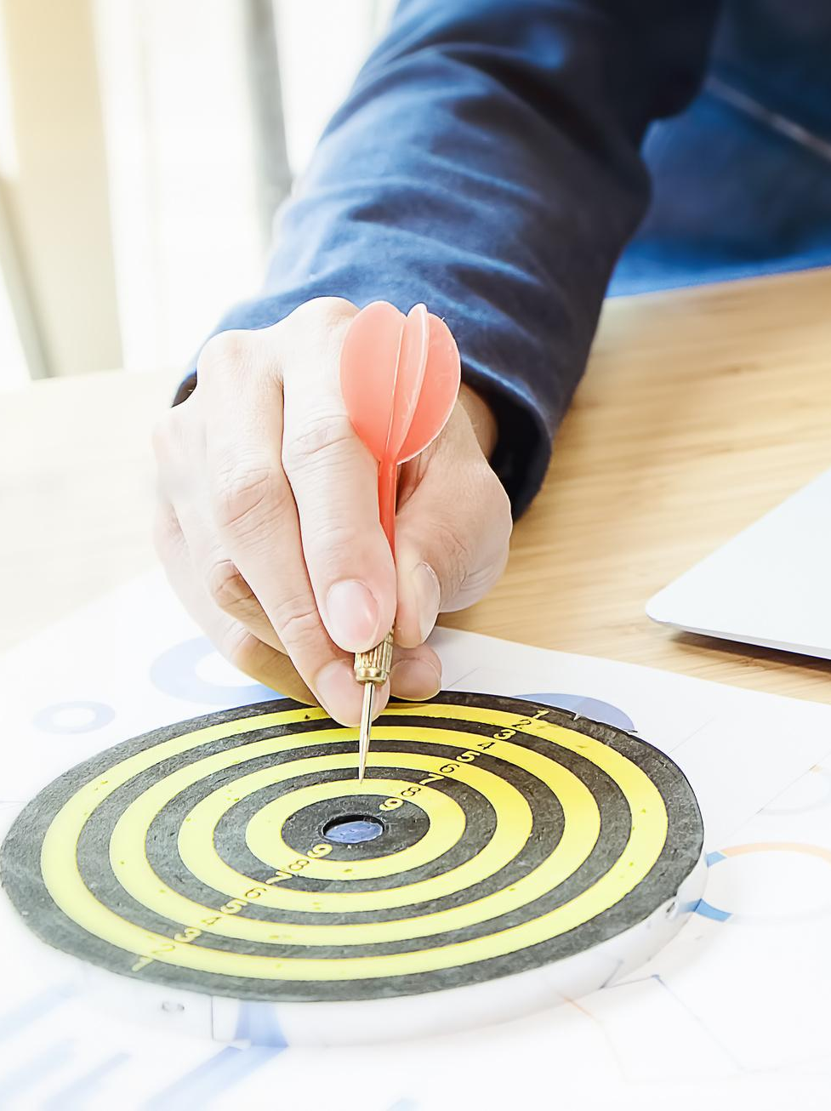
THE TARGET
A fundamental component in the processing of a film, as well as in the writing of a text, is the recipient, the audience we intend to reach with our communication.
The target defines the use of formal or informal language.

Slide 5


BIRTH OF THE IDEA

Slide 6
BIRTH OF AN IDEA
The development phases of a project
IDEA
SUBJECT
PROCESSING
It is the concept of the complete project at its maximum simplicity.
A short draft of the project, useful to present the idea in more detail.
It is the drafting of the entire project structured like a novel, that is, containing descriptions, characters and dialogues.

Slide 7
THE 5 W RULE!
To achieve effective communication, your project will have to answer these questions!
W
WHO?
WHAT?
WHERE?
WHEN?
WHY?

Slide 8

THE SHOTS
The shot is the window in which everything happens and it is the director's exclusive point of view through which the viewer faces the facts told.
Shooting techniques allow us to communicate emotions and sensations through an image that can also vary depending on the context.

Slide 9
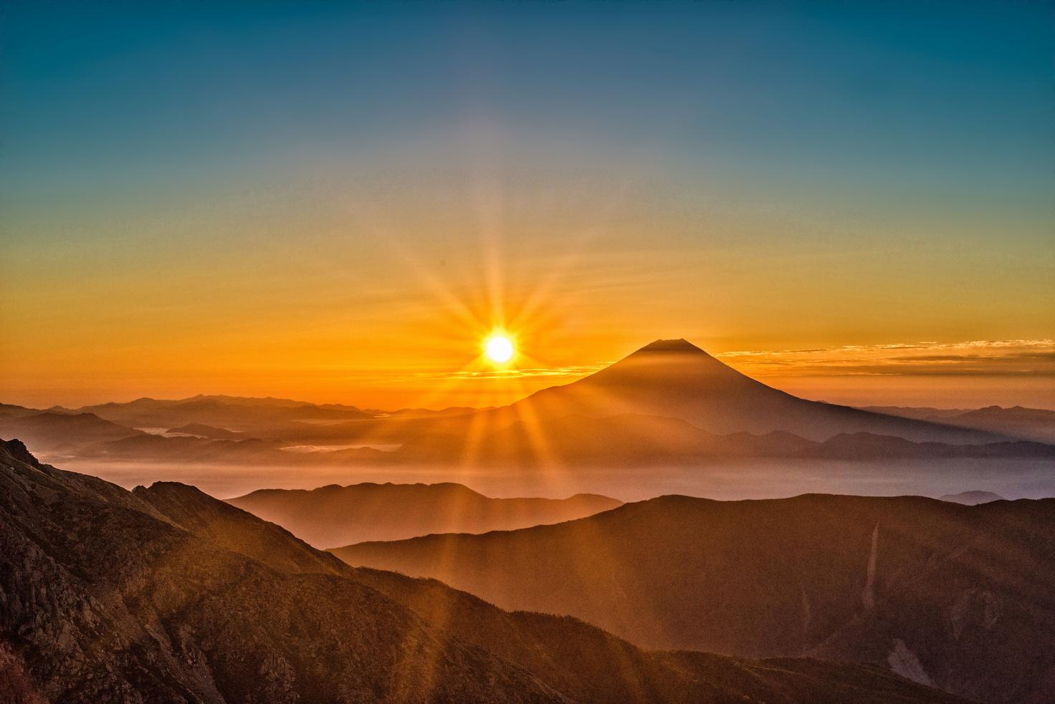
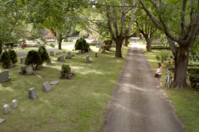
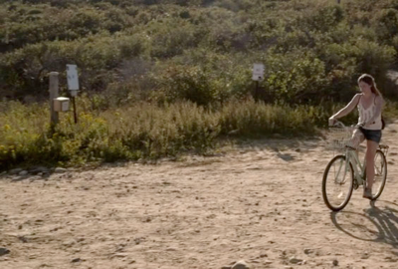
SHOTS
EXTREME WIDE SHOT
LONG SHOT
FULL SHOT
Shot used to enhance a landscape
Shot used to show figures in a landscape
Shot in which the environment is still predominant but the human figure becomes the protagonist and the action is more evident.

Slide 10
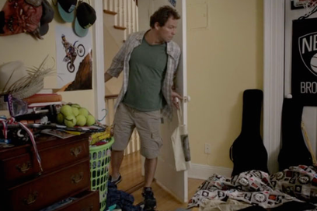
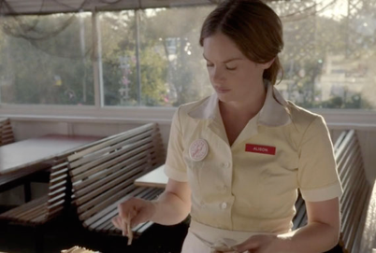
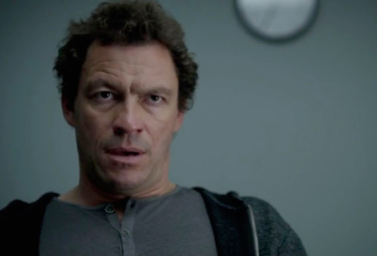
SHOTS
FULL PICTURE
MEDIUM SHOT
MEDIUM CLOSE-UP SHOT
The protagonist of the scene is framed from head to toe.
The protagonist is framed from the waist up.
The protagonist is framed from the shoulders up.

Slide 11
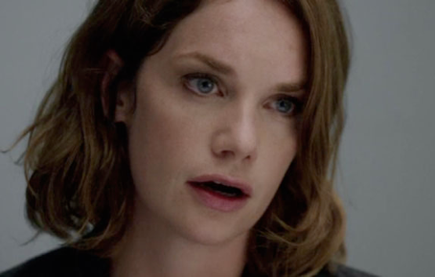
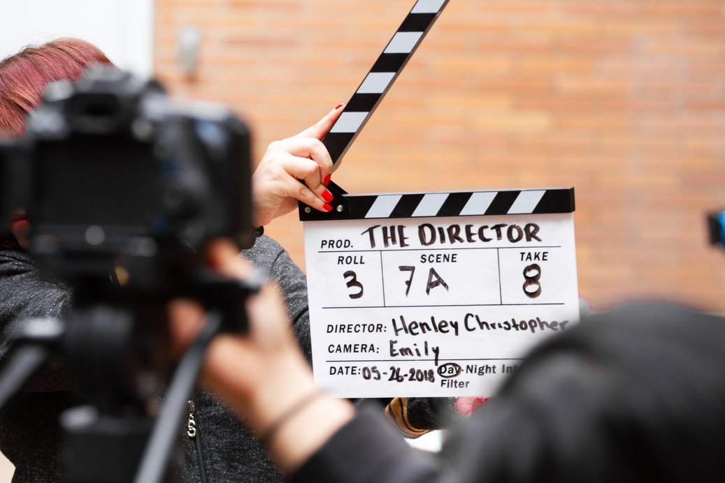
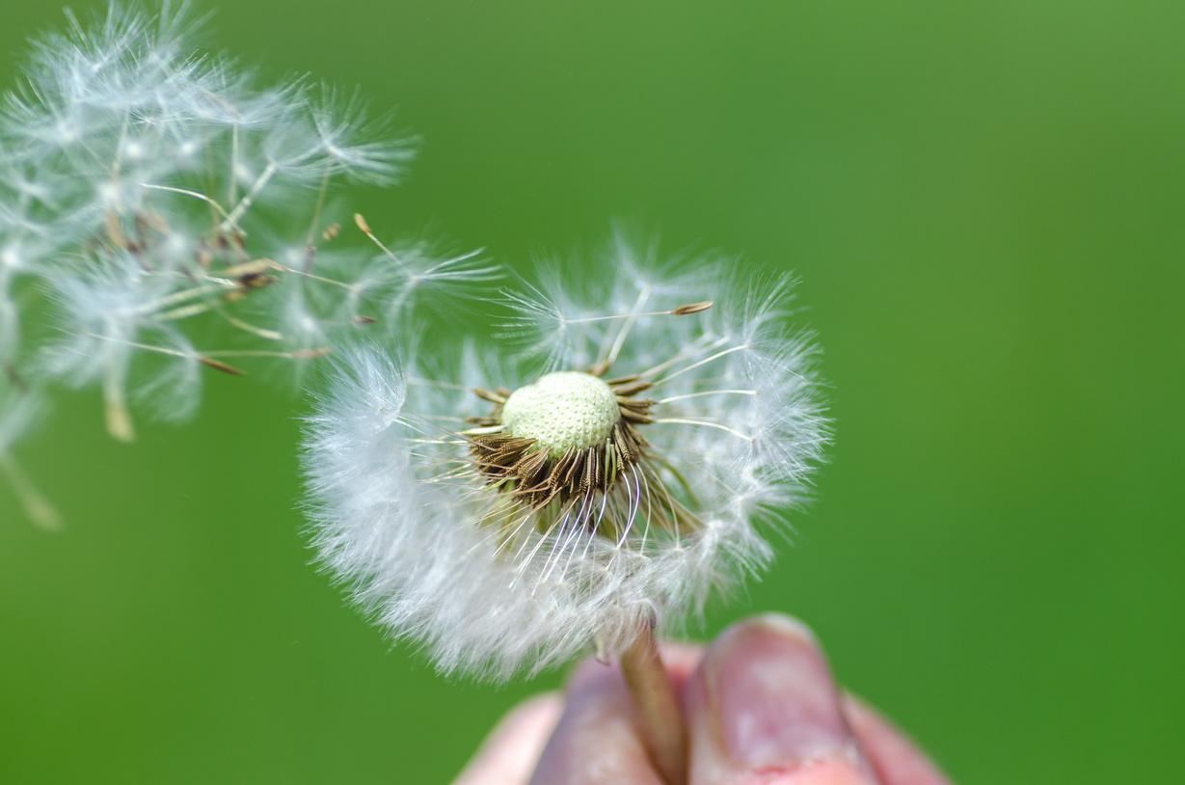

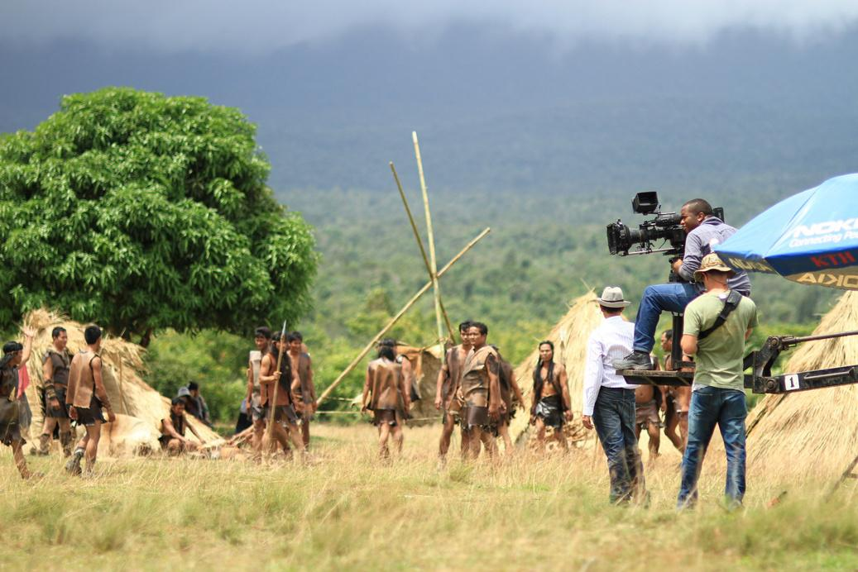
SHOTS
CLOSE-UP SHOT
EXTREME CLOSE-UP SHOT
DETAIL
The shot shows only the face of the protagonist to emphasize his expressions.
Very close-up shot on a detail of an object.
Very close shot on a particular human.

Slide 12
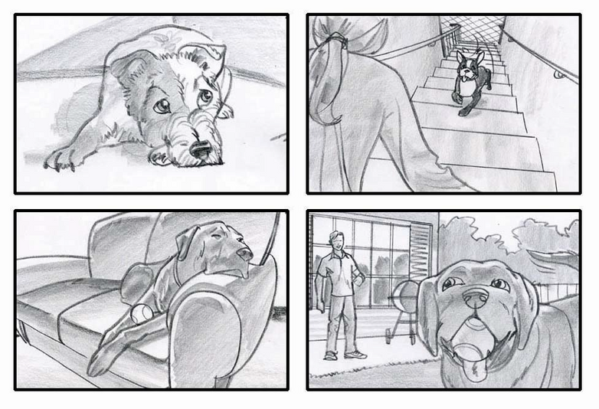
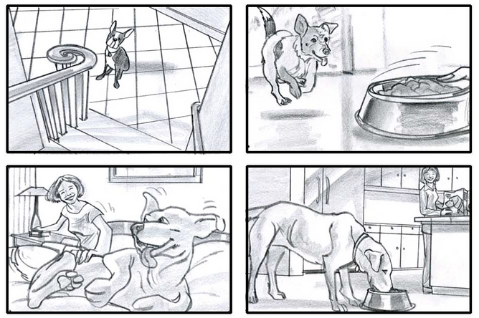
USEFUL TOOLS
Regardless of the purpose of the video you want to make, there are very useful tools that will facilitate your creative process.
The Storyboard, which can be briefly described as a cartoon version of your project. Composed of panels, it represents the sequence and the choice of the chosen shots and is very useful as a guide both during shooting and editing.

Slide 13
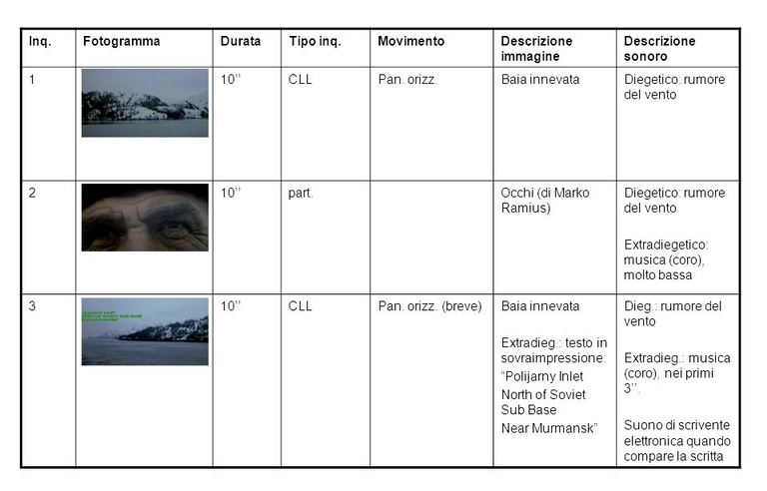
USEFUL TOOLS
Another fundamental tool for organizing a project is the technical decoupage, a text version of the project.
Structured as a list, you will go to sort the scenes, note the type of shot chosen, the locations of the scenes and specify whether they are shot indoors or outdoors.

Slide 14
This exercise aims to test your creative ability!
By choosing from one of these groups of words, you develop an idea and turn it into a subject!
ACTIVITY #1
GROUP 1:DOCTOR, LIBRARY, BAG, EVENING
GROUP 2: DOG, PARK, BALL, AFTERNOON
GROUP 3: KNIGHT, CASTLE, TREASURE, NIGHT

Slide 15
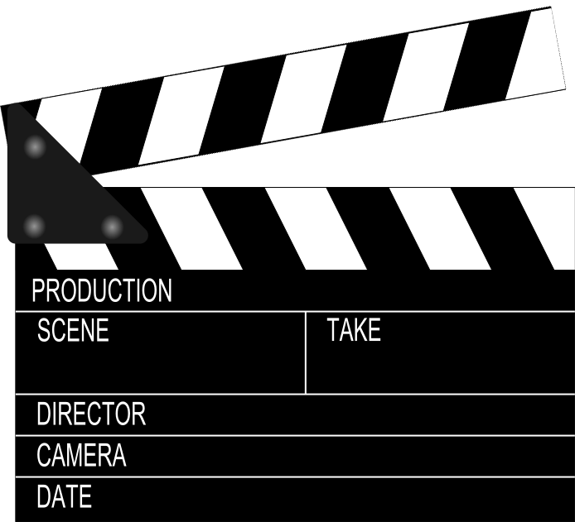
VIDEO EDITING

Slide 16
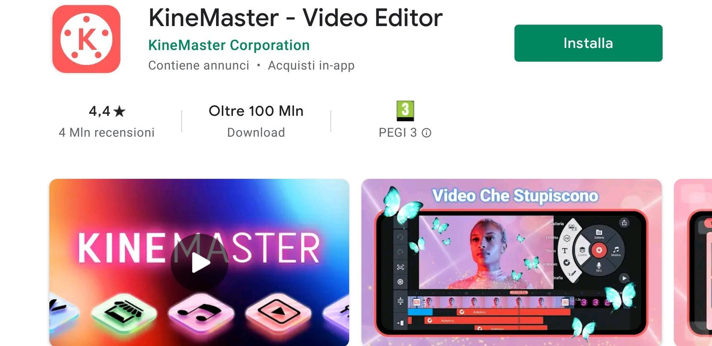
1 - DOWNLOAD THE APP KINEMASTER

Slide 17
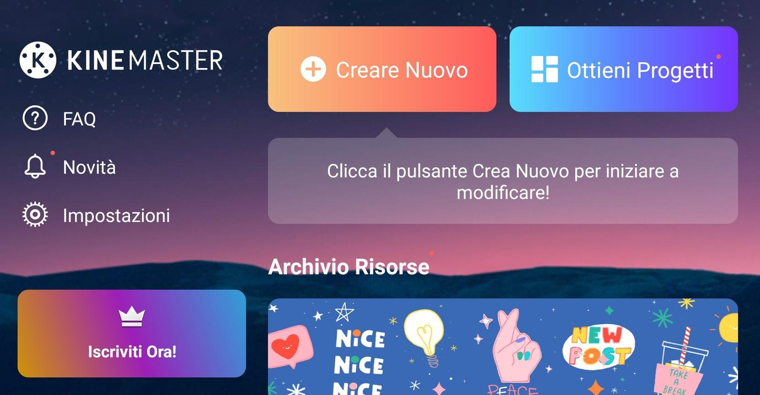
2 - WELCOME TO THE MAIN MENU

Slide 18
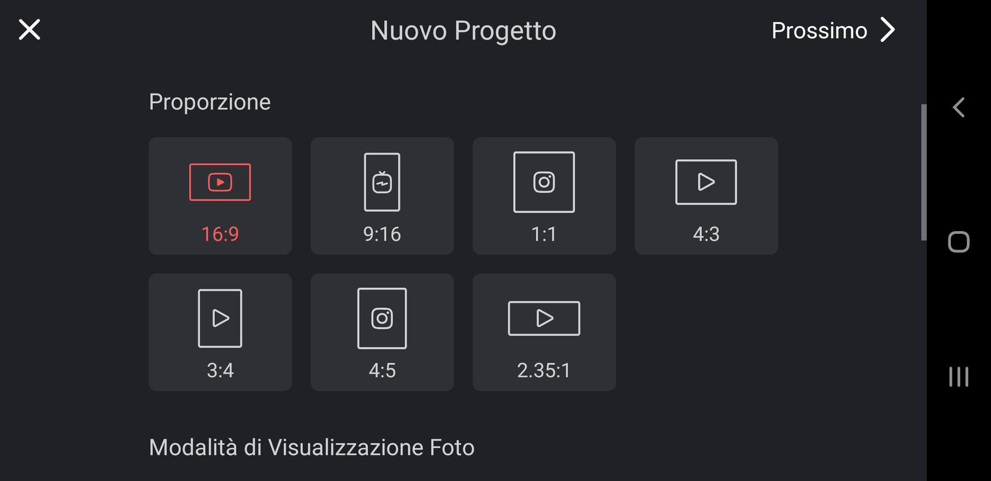
3 - THE PROPORTIONS

Slide 19
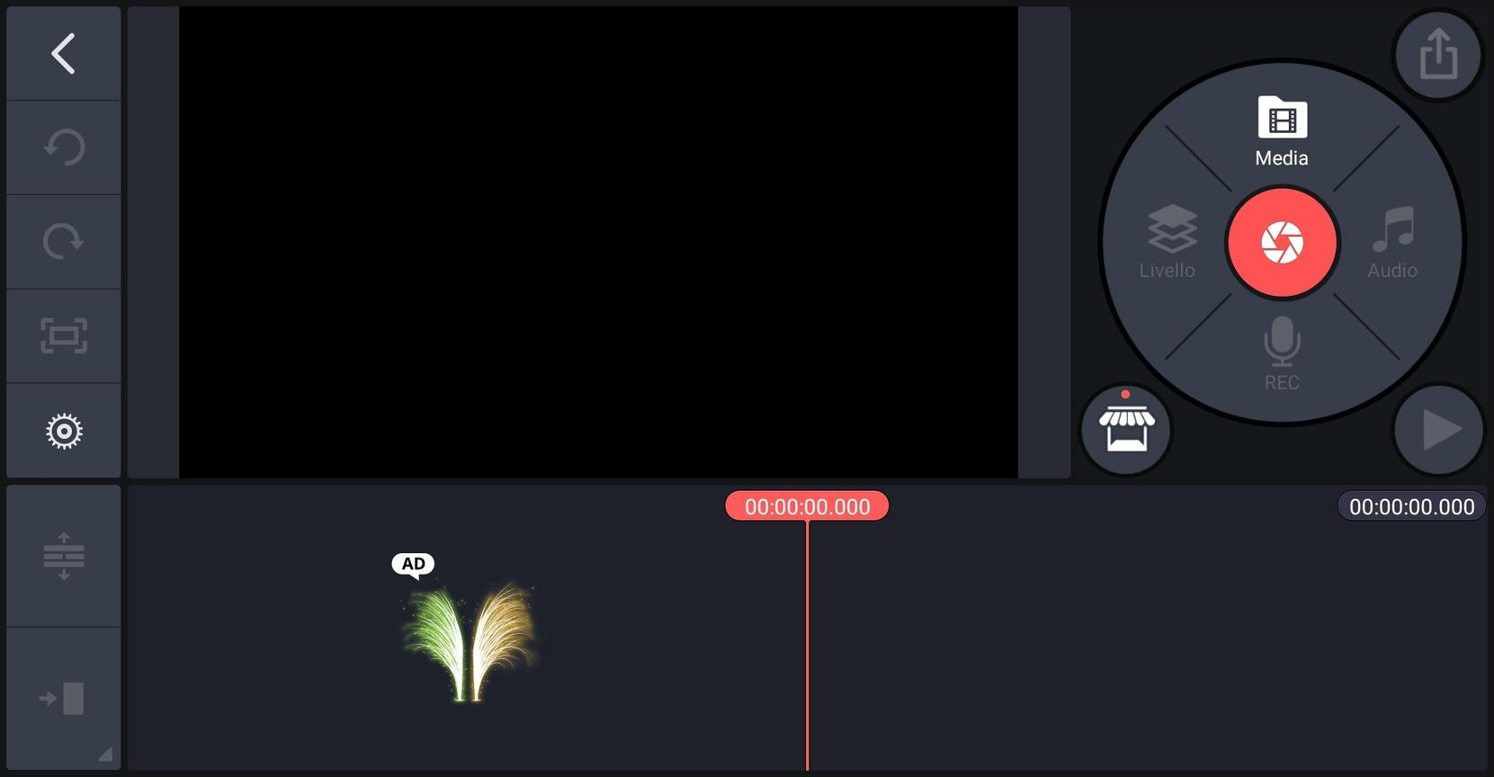
4 - DASHBOARD

Slide 20
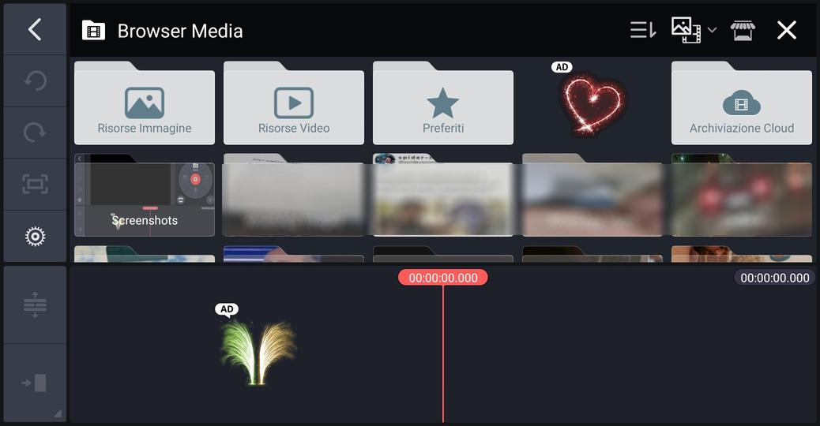
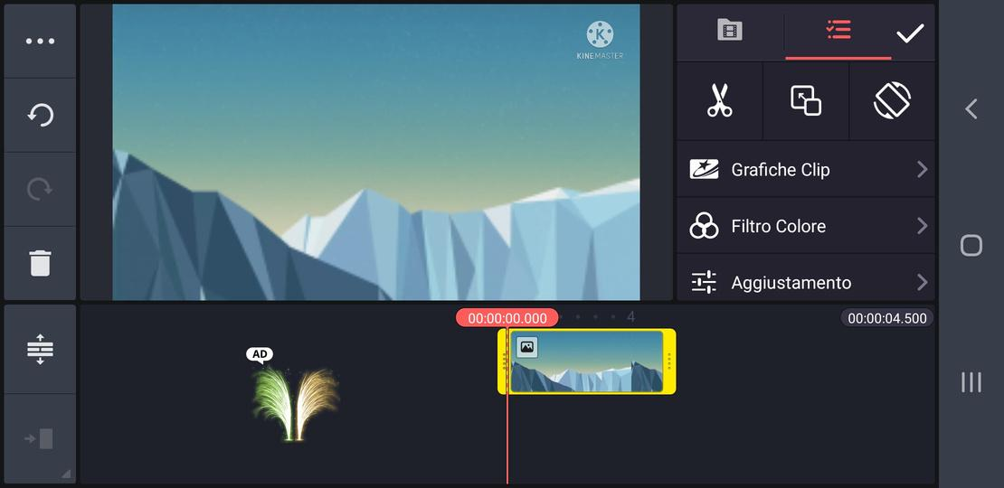
5 - TIMELINE

Slide 21
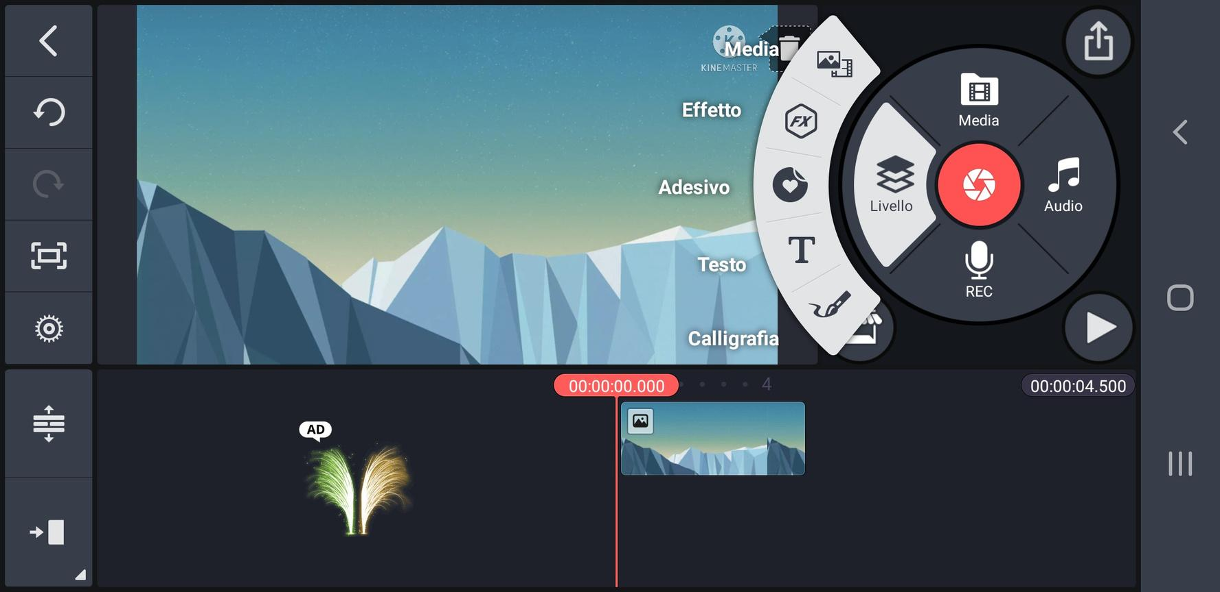
6 - TOOL WHEEL

Slide 22
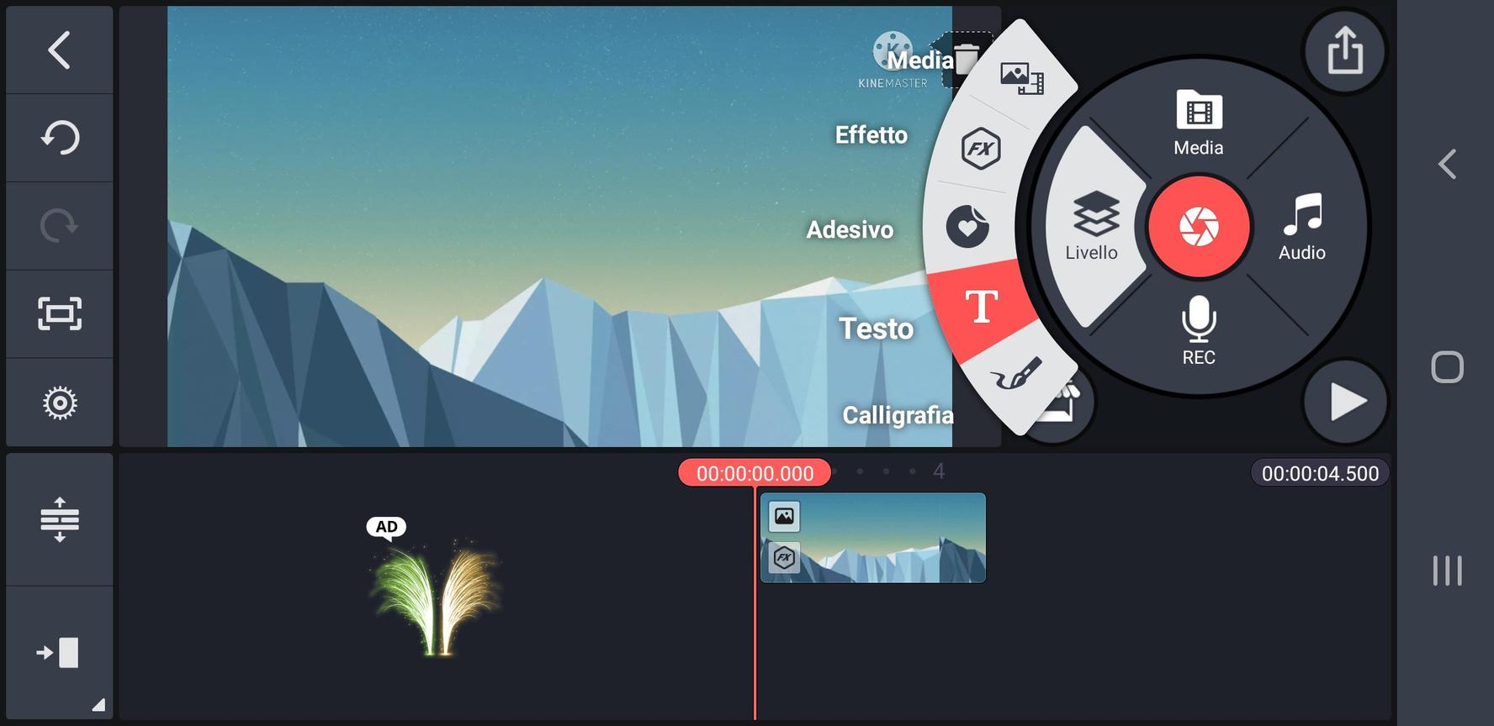
7 - TEXT

Slide 23
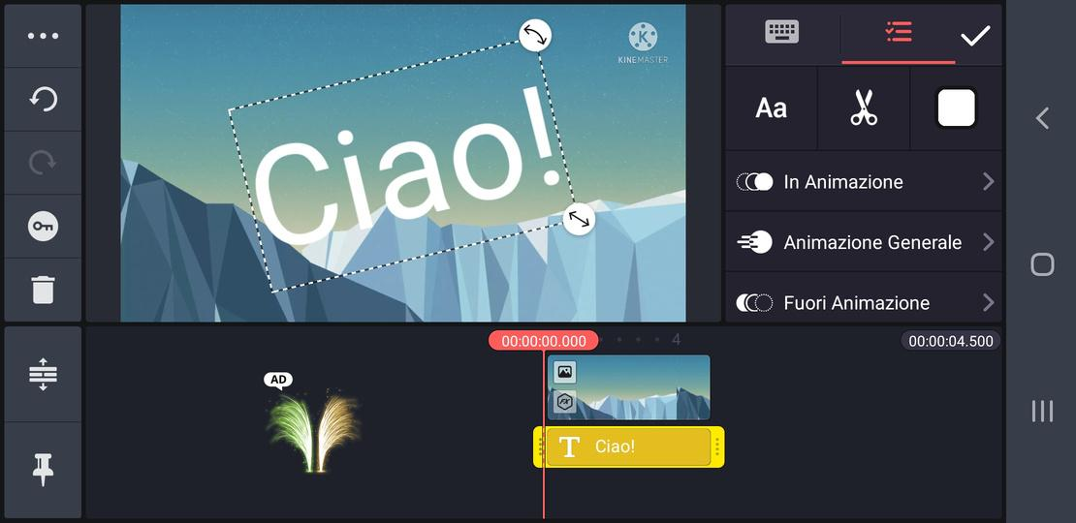
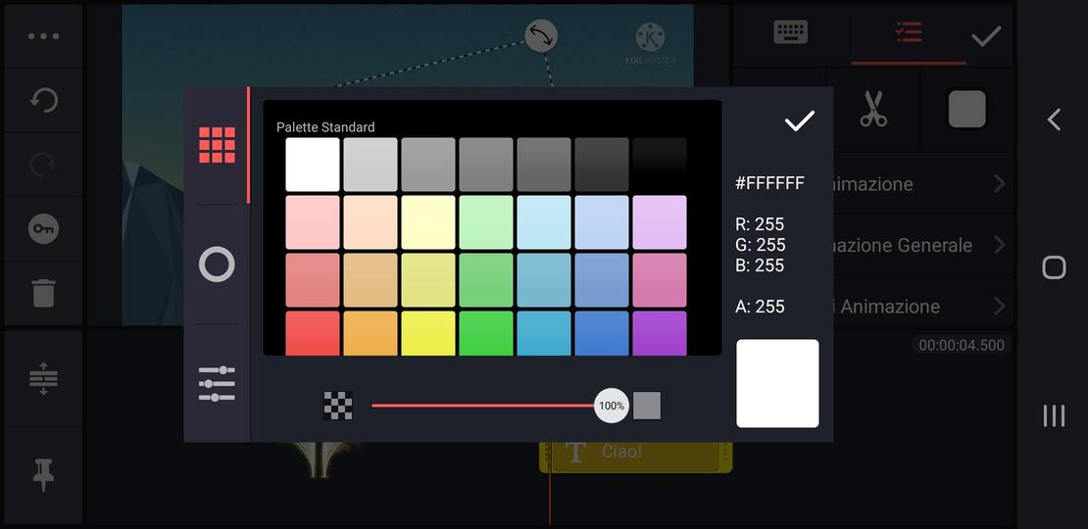
7.1 - TEXT

Slide 24
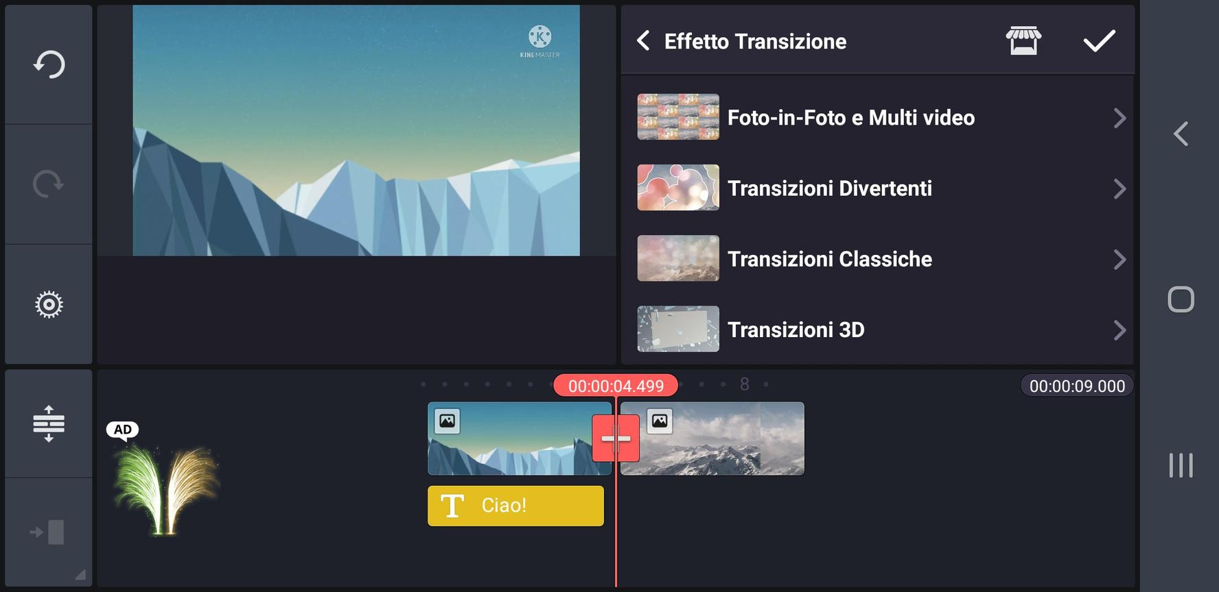
8 - FADE TRANSITION

Slide 25
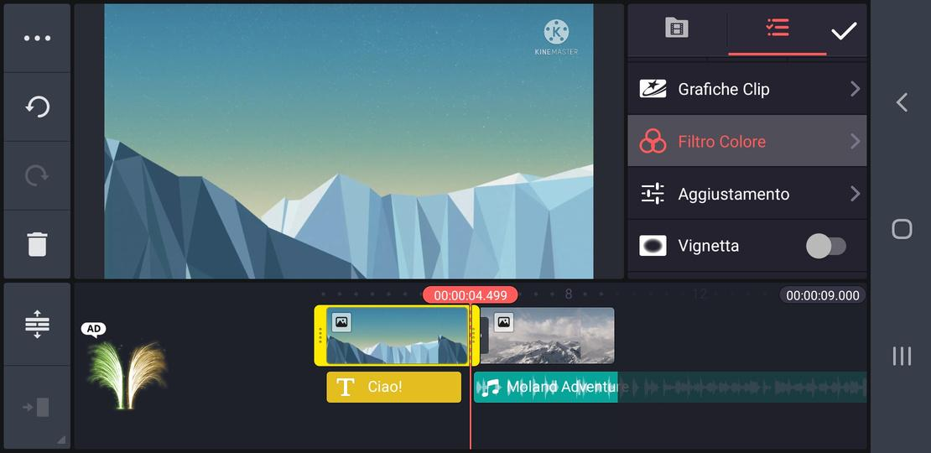
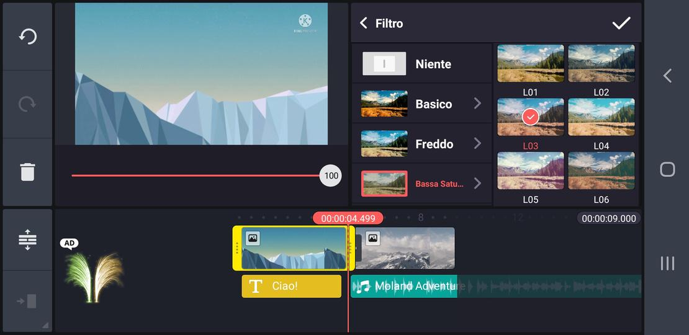
9 - COLOR CORRECTION

Slide 26
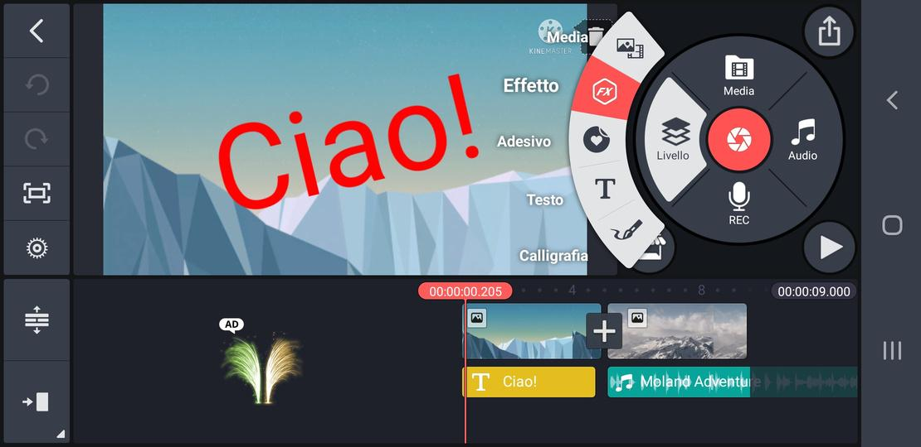
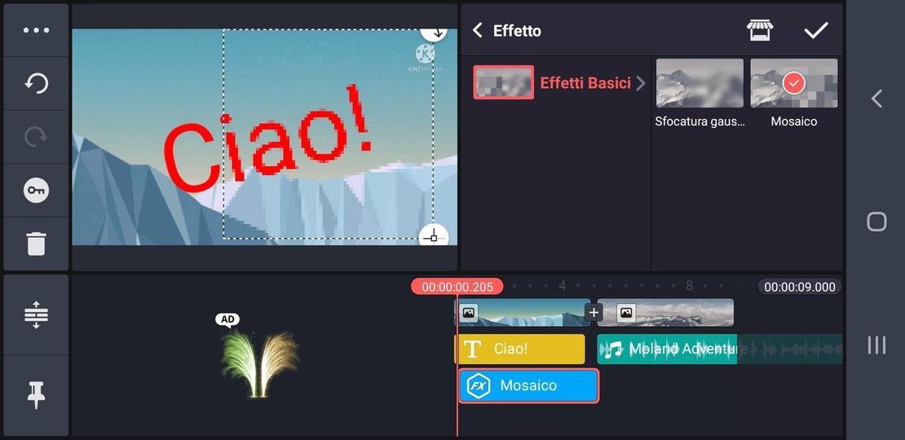
10 - EFFECTS

Slide 27
10.1 - EFFECTS

Slide 28
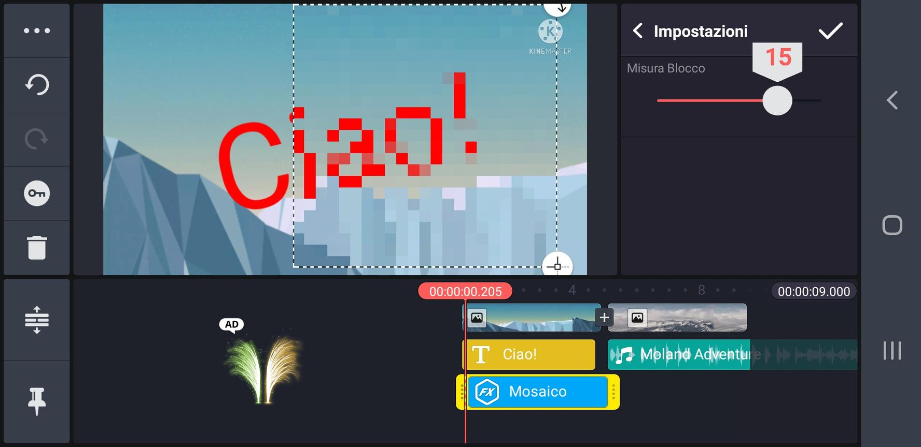
10.2 - EFFETTI

Slide 29
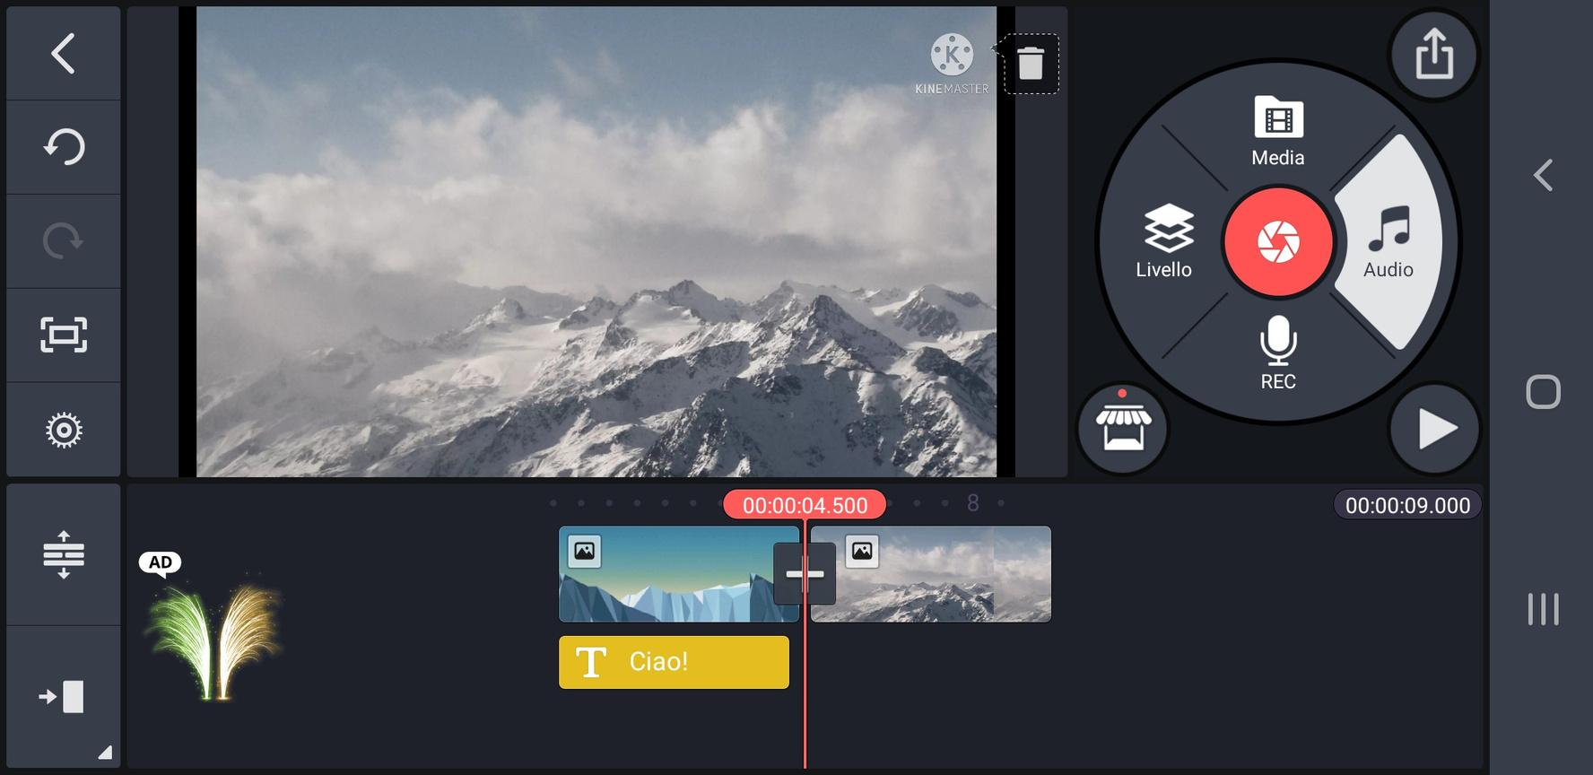
11 - AUDIO

Slide 30
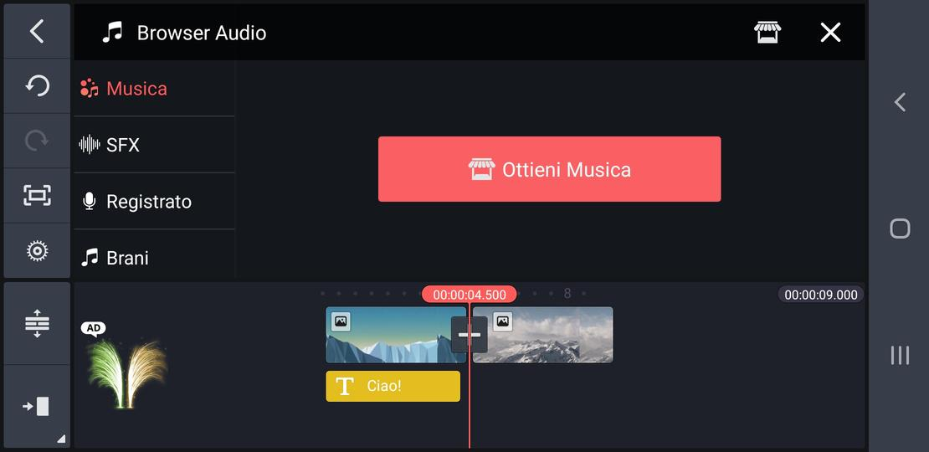
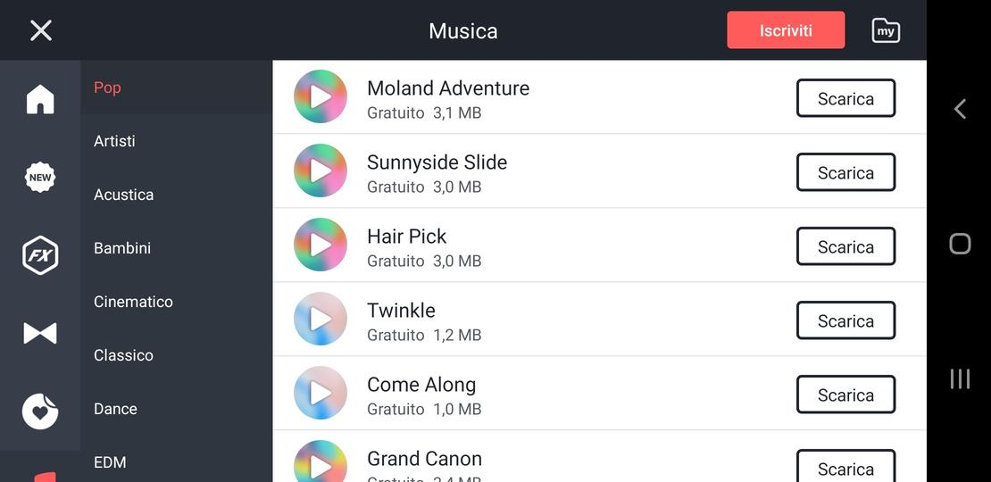
12 - FREE MUSIC

Slide 31
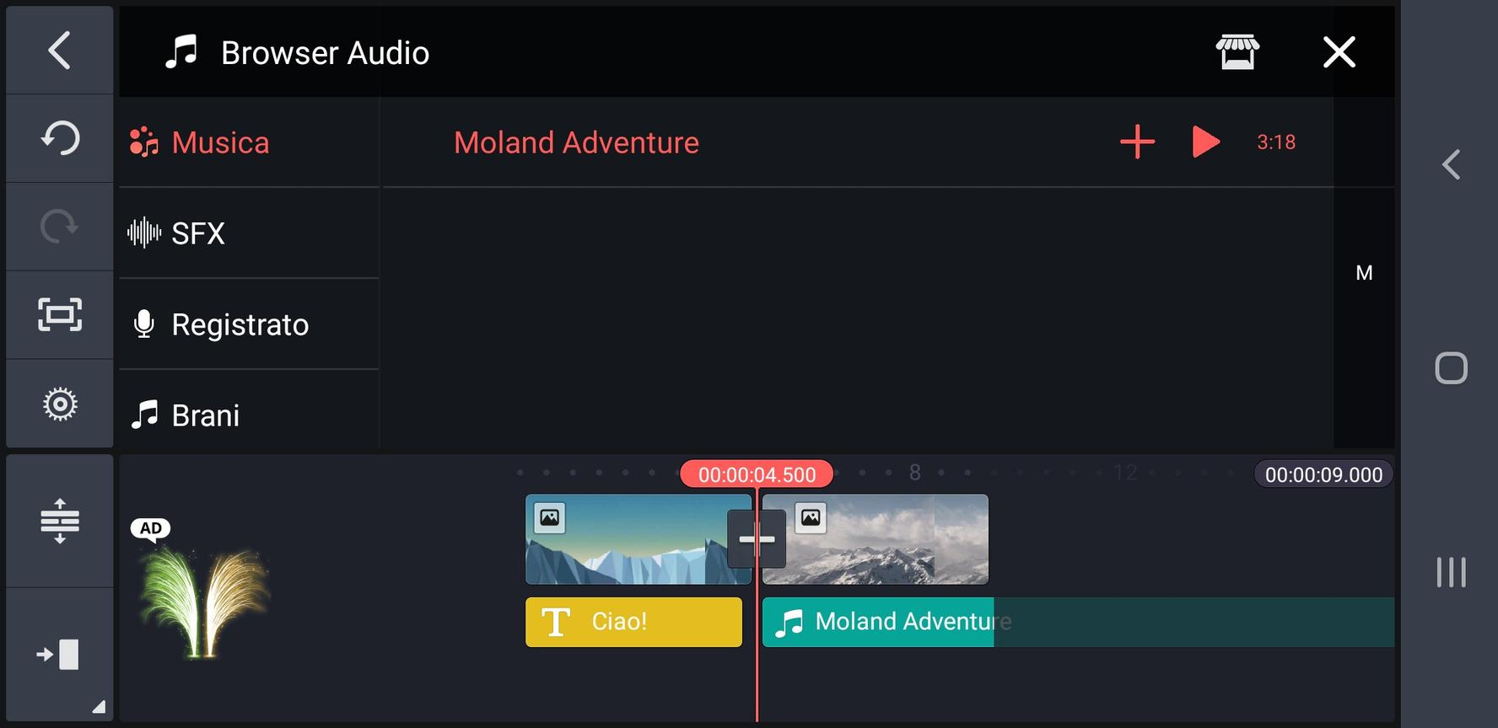
12.1 - FREE MUSIC

Slide 32
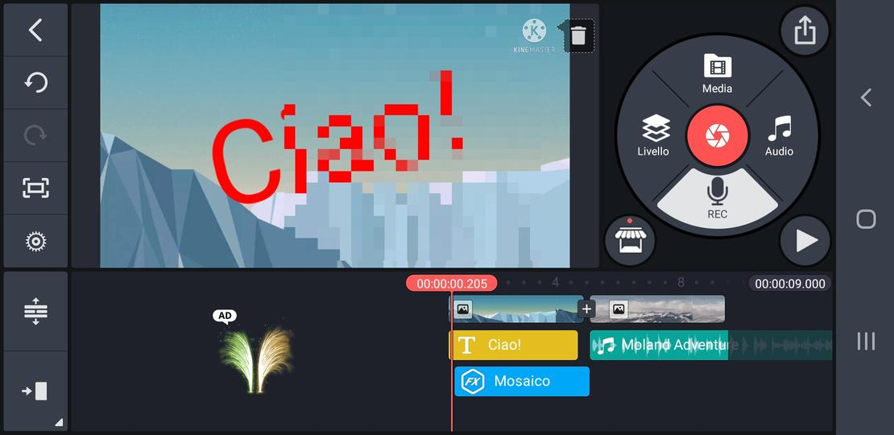
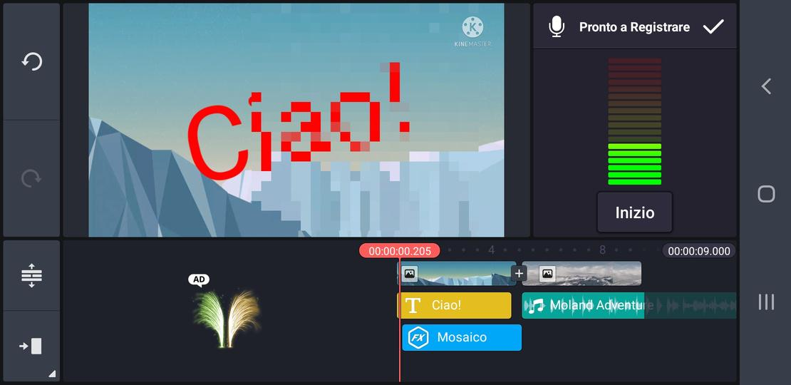
13 - VOICEOVER

Slide 33
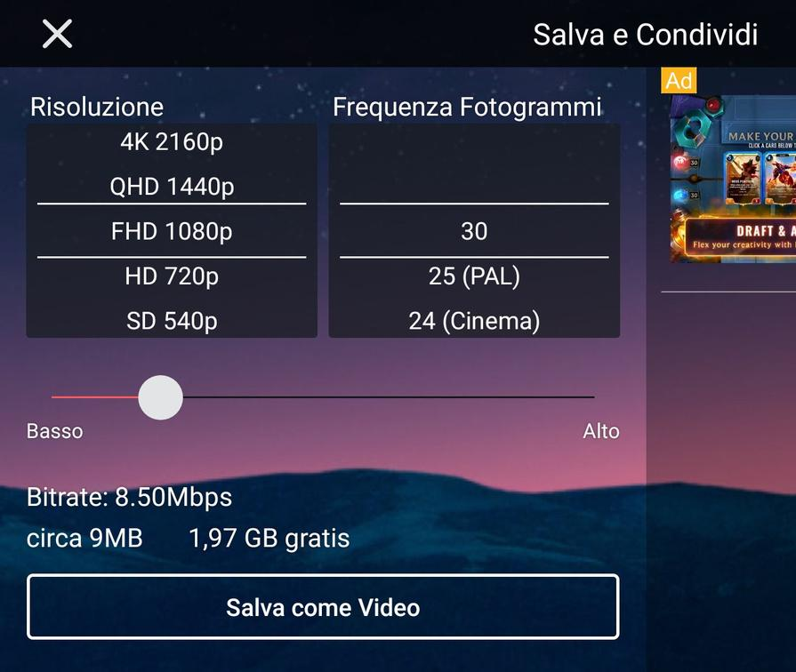
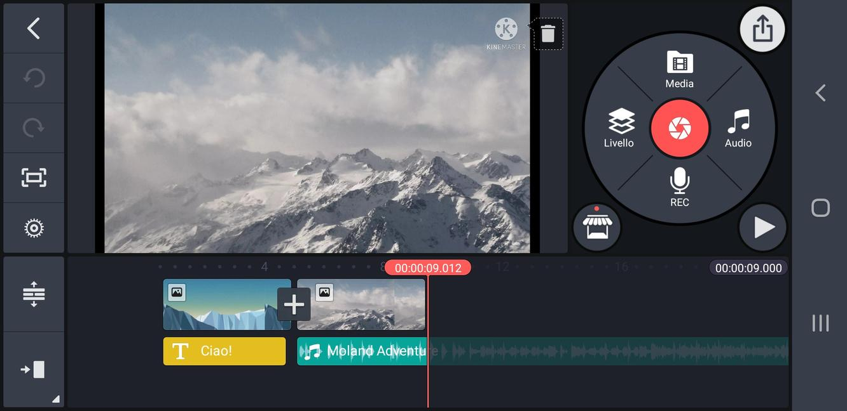
14 - EXPORT

Slide 34
This exercise aims to put the content of this module into practice!
Tell a story via montage using the images provided.
ACTIVITY #2

