Slide 1






SOCIAL FOR EVERYONE!
Introduction to the world of social media and their functions
M4W4-M01

Slide 2




SOCIAL for everyone!
INTRODUCTION TO THE WORLD OF SOCIAL MEDIA AND THEIR FUNCTIONS

Slide 3




The world of Internet, in particular the social media one, has seen an exponential growth in recent years and involves an increasing number of the population.

Slide 4


THE EVOLUTION OF SOCIAL MEDIA
1997
2003
2003
SIXDEEGRES
MYSPACE
FACEBOOK
FIRST SOCIAL PLATFORM IN HISTORY BASED ON MILGRAM'S 1967 "THEORY OF SIX DEGREES OF SEPARATION"
FIRST SOCIAL PLATFORM KNOWN WORLDWIDE WHOSE PURPOSE WAS TO CREATE BLOGS AND SHARE PHOTOS AND VIDEOS
CREATED BY MARK ZUCKERBERG, FACEBOOK STARTS THE ERA OF WEB 2.0, PAVING THE WAY FOR OTHER PLATFORMS

Slide 5


WHAT HAS CHANGED?
The way we work, shop, learn, relate and even think has changed.
The Web, now within everyone's reach, offers endless opportunities, allowing us to stay updated and interact with what surrounds us in real time.
Imagining the Web as the world, think of social media as a large square.

Slide 6

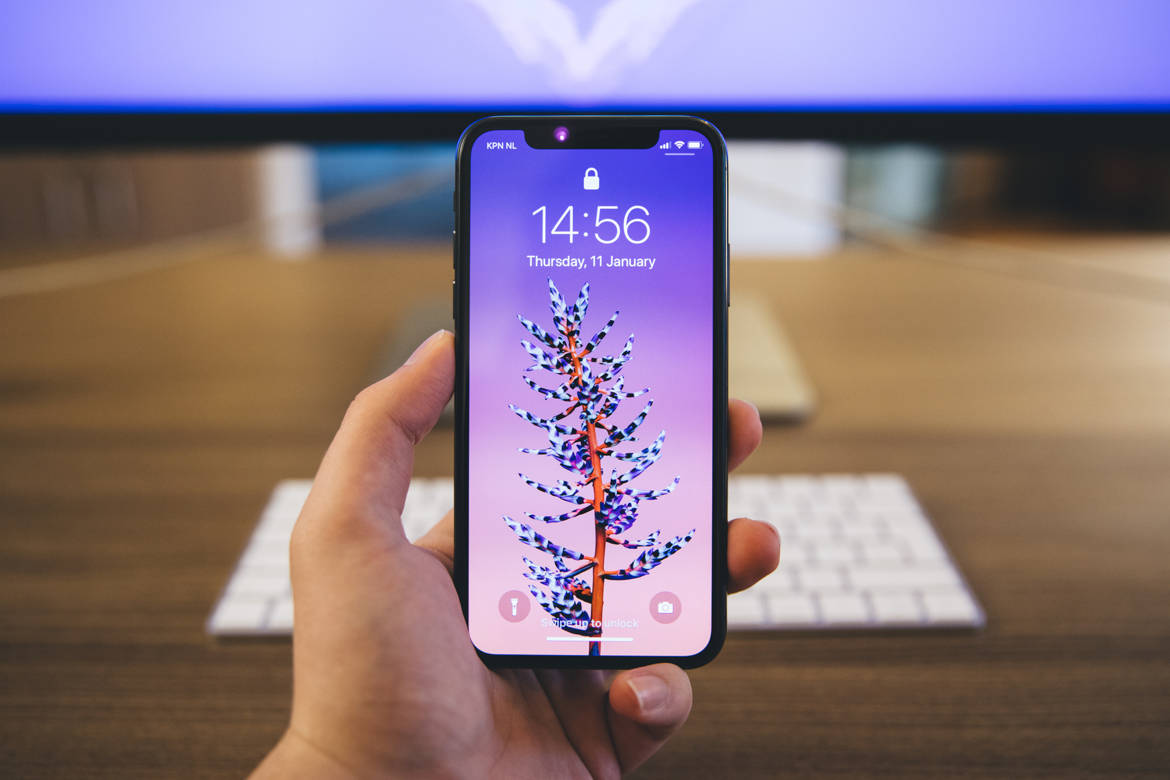
WHAT ARE "SOCIAL MEDIA"?
By definition, "social media" are the set of information and entertainment channels that allow users to interact with each other to exchange information and socialize.
A distinction must be made between social media and social network.

Slide 7



WITH THE DEVELOPMENT OF THE INTERNET
ITS DANGERS HAVE ALSO EVOLVED, INCLUDING THE "FAKE NEWS"
When reading news you need to pay attention to:
- the URL (site address)
-name of the newspaper
-date of publication of the news
- sources used to write the article

Slide 8


WHICH ARE THE MOST USED SOCIAL MEDIA?
Whether for work or leisure, the world of social media is very vast and choosing the right one can sometimes be difficult.
Actually, the most "populated" platforms are Facebook, Instagram and Whatsapp.

Slide 9


FACEBOOK

Slide 10

FACEBOOK
Facebook is a social platform that allows users to create networks of people, find old friends or maybe make new ones.
Once you have created your profile, you will have access to the "Facebook feed" where you can carry out many activities: publish posts, request "friendship" and chat privately with friends, share photos and videos, follow updates and main news, comment and leave a “Like".

Slide 11
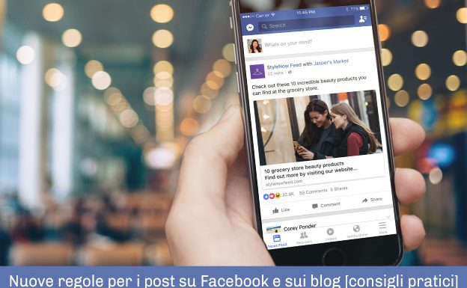
WHAT IS A POST?
The post is a status update, useful for sharing news or thoughts with your friends
The post can be textual or enriched with photos and videos and is often accompanied by "hashtags", keywords useful for finding our content.

Slide 12

NOT JUST POST!
Facebook is not just chat and post!
The platform also has other functions which, divided into sections, allow us to trade, find work or stay updated on events close to us!
Facebook is constantly evolving!

Slide 13

NOW SOME SLANG...
From the verb "to post" in English comes the Italianized word "postare", which indicates the very act of creating a post and publishing it.
From the verb "to chat" in English comes the Italianized word "chattare", which means "talking, chatting" with someone.
From the verb "to tag" in English comes the Italianized word "taggare", which means identify someone in a post, photo or status update you want to share.

Slide 14
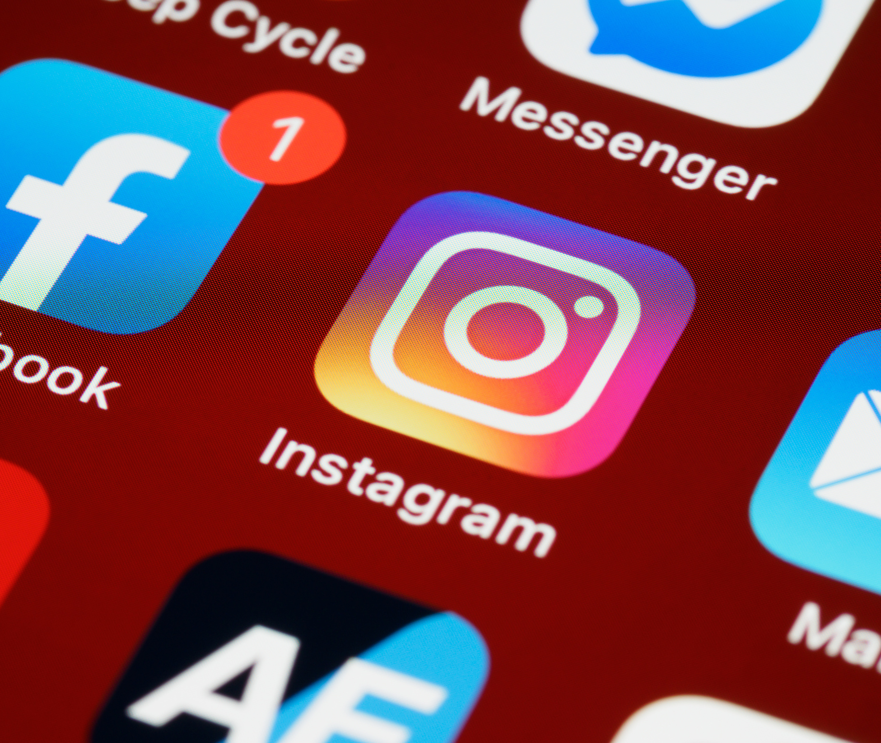
INSTAGRAM

Slide 15

INSTAGRAM
Instagram is a social media totally focused on sharing photos and videos of all kinds.
Each Instagram user has a personal profile with which to share the moments of their day with the people of their network, called "followers".
The platform, in addition to giving us the opportunity to get in touch with friends, allows us to closely follow the lives of our favorites celebrities!

Slide 16
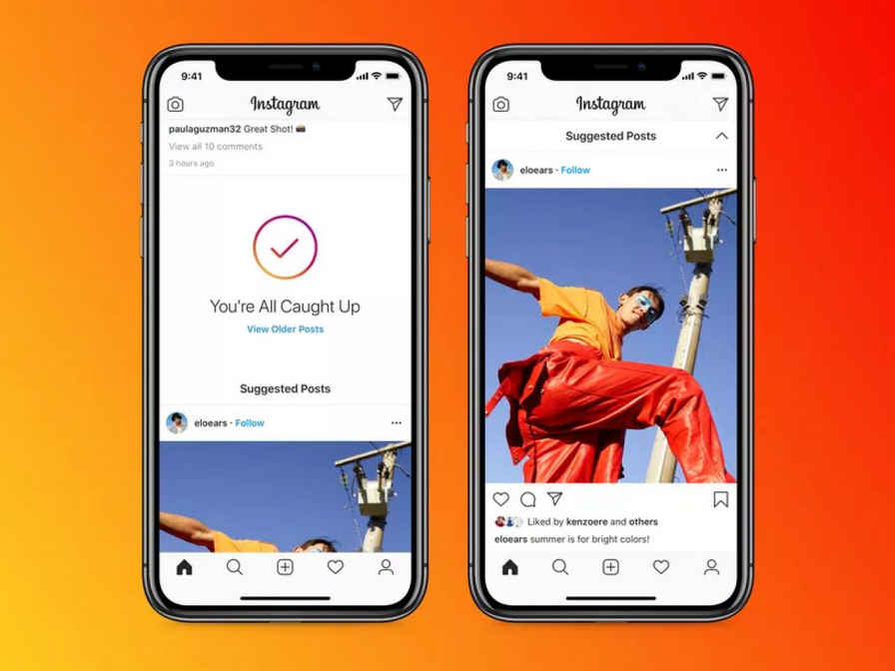
INSTAGRAM FEED
Like the Facebook feed, the Instagram one collects all the content that is published.
The contents are exclusively photos and videos, accompanied by a short caption and the "hashtags", essential for the use of the platform.
In addition to the classic post, other types of content can also be published on Instagram, such as Stories, IGTV or Reel.

Slide 17


WHAT IS A HASHTAG?
The hashtag is a "label", a keyword that is associated with posts to catalog their contents, in order to be found more easily by all those who are potentially interested in that topic.
Hashtags are always preceded by the hashtag symbol (#) and can be written in any language, sometimes even mixed together.
You cannot use punctuation or spaces between words and there is no distinction between upper and lower case.
#dog, #puppy, #mansbestfriend, #doglover, #nature, #park, #photography, #photooftheday, #postoftheday

Slide 18
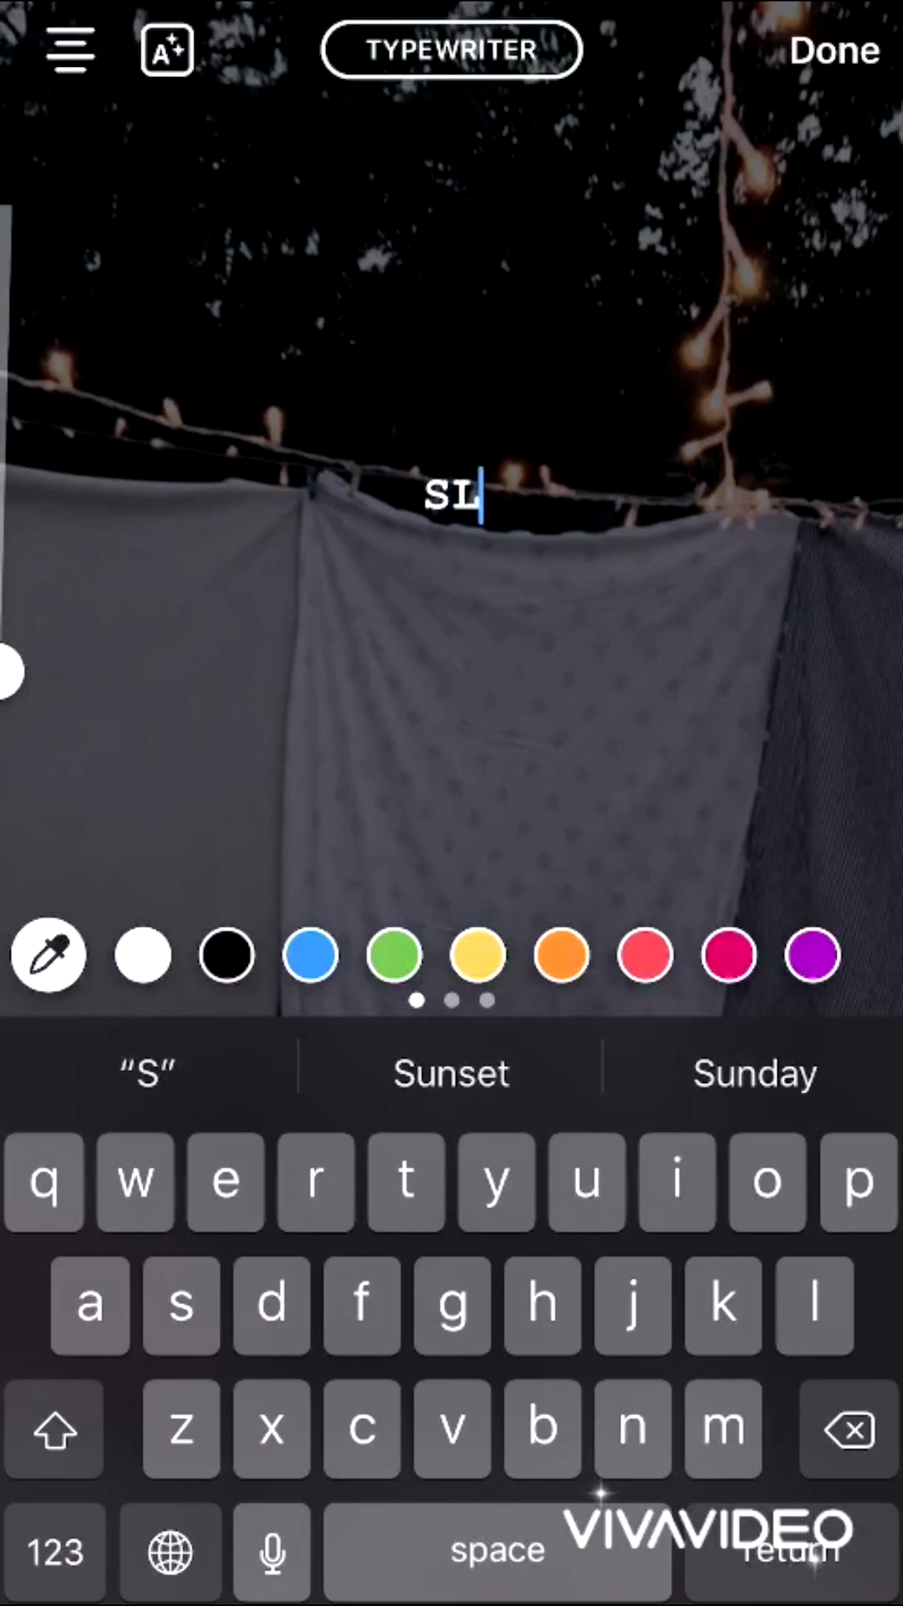
STORIES
An Instagram Story is content with a maximum duration of 15 seconds that remains visible only for 24 hours from its publication.
Through the stories you can publish photos or videos stored in the gallery of your smartphone or share what is happening in real time.

Slide 19
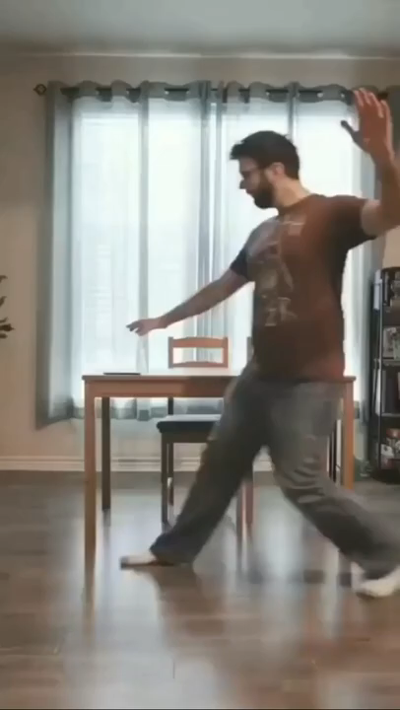
REEL
Reels are Instagram's newest feature, in response to the popular Tik Tok.
It is an editor for short videos ranging from 15 to 60 seconds that allows you to add graphic effects and background music.
Reels follow patterns called "trends": the more viral a trend is, the easier it will be to be viewed on the platform.

Slide 20

INSTAGRAM AND NEW FEATURES
The potential to reach a really large audience with Instagram is very high, which is why the platform has also developed in the business field, giving life to one of the hottest professions in recent years: the influencer.
It is for this reason that Instagram gives the possibility to open a Business account to promote your business or idea.
Among the new features we find the Shop and "Search on the map" to offer users the most complete experience possible!

Slide 21
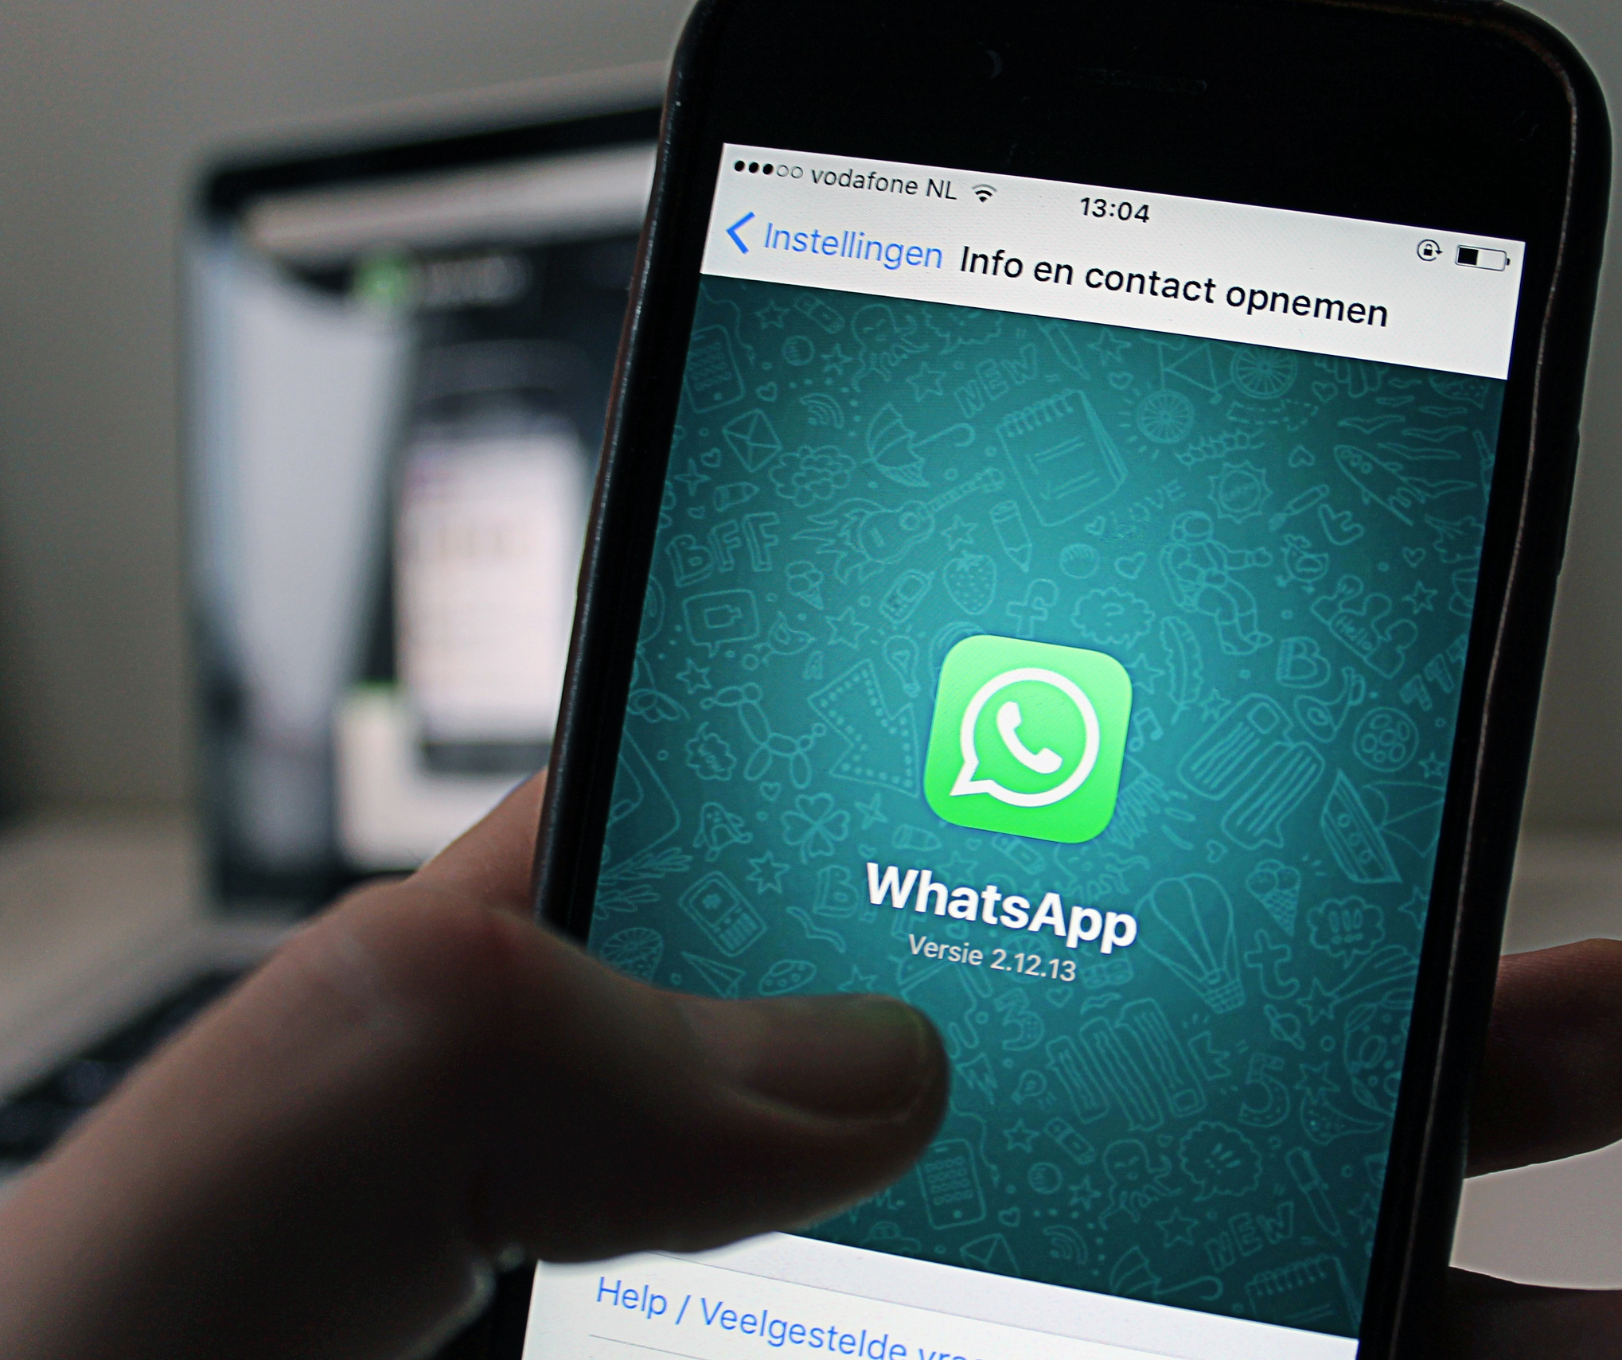
WHATSAPP

Slide 22

WHATSAPP
WhatsApp is the most famous and used instant messaging application in the world.
The main service offered by Whatsapp is to exchange messages with your contacts stored on your mobile phone (in turn registered on Whatsapp) using an internet connection.
We are not just talking about text messages, but also about photos, videos, documents, audio and GPS locations.
Thanks to Whatsapp it is also possible to make calls and video calls with one or more people and create groups.

Slide 23
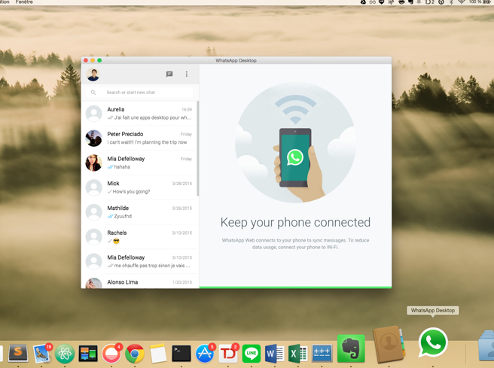
WHAT IS WHATSAPP WEB?
"Whatsapp Web" is the support function, also free, of Whatsapp that allows you to use the well-known instant messaging application directly on your computer, allowing you to carry out all those activities with the convenience of the large screen and keyboard to type at great speed .

Slide 24


Now that we have thoroughly analyzed some of the most used social platforms in the world, we just have to understand what content to share and what type of user we want to be!

